Slide 1
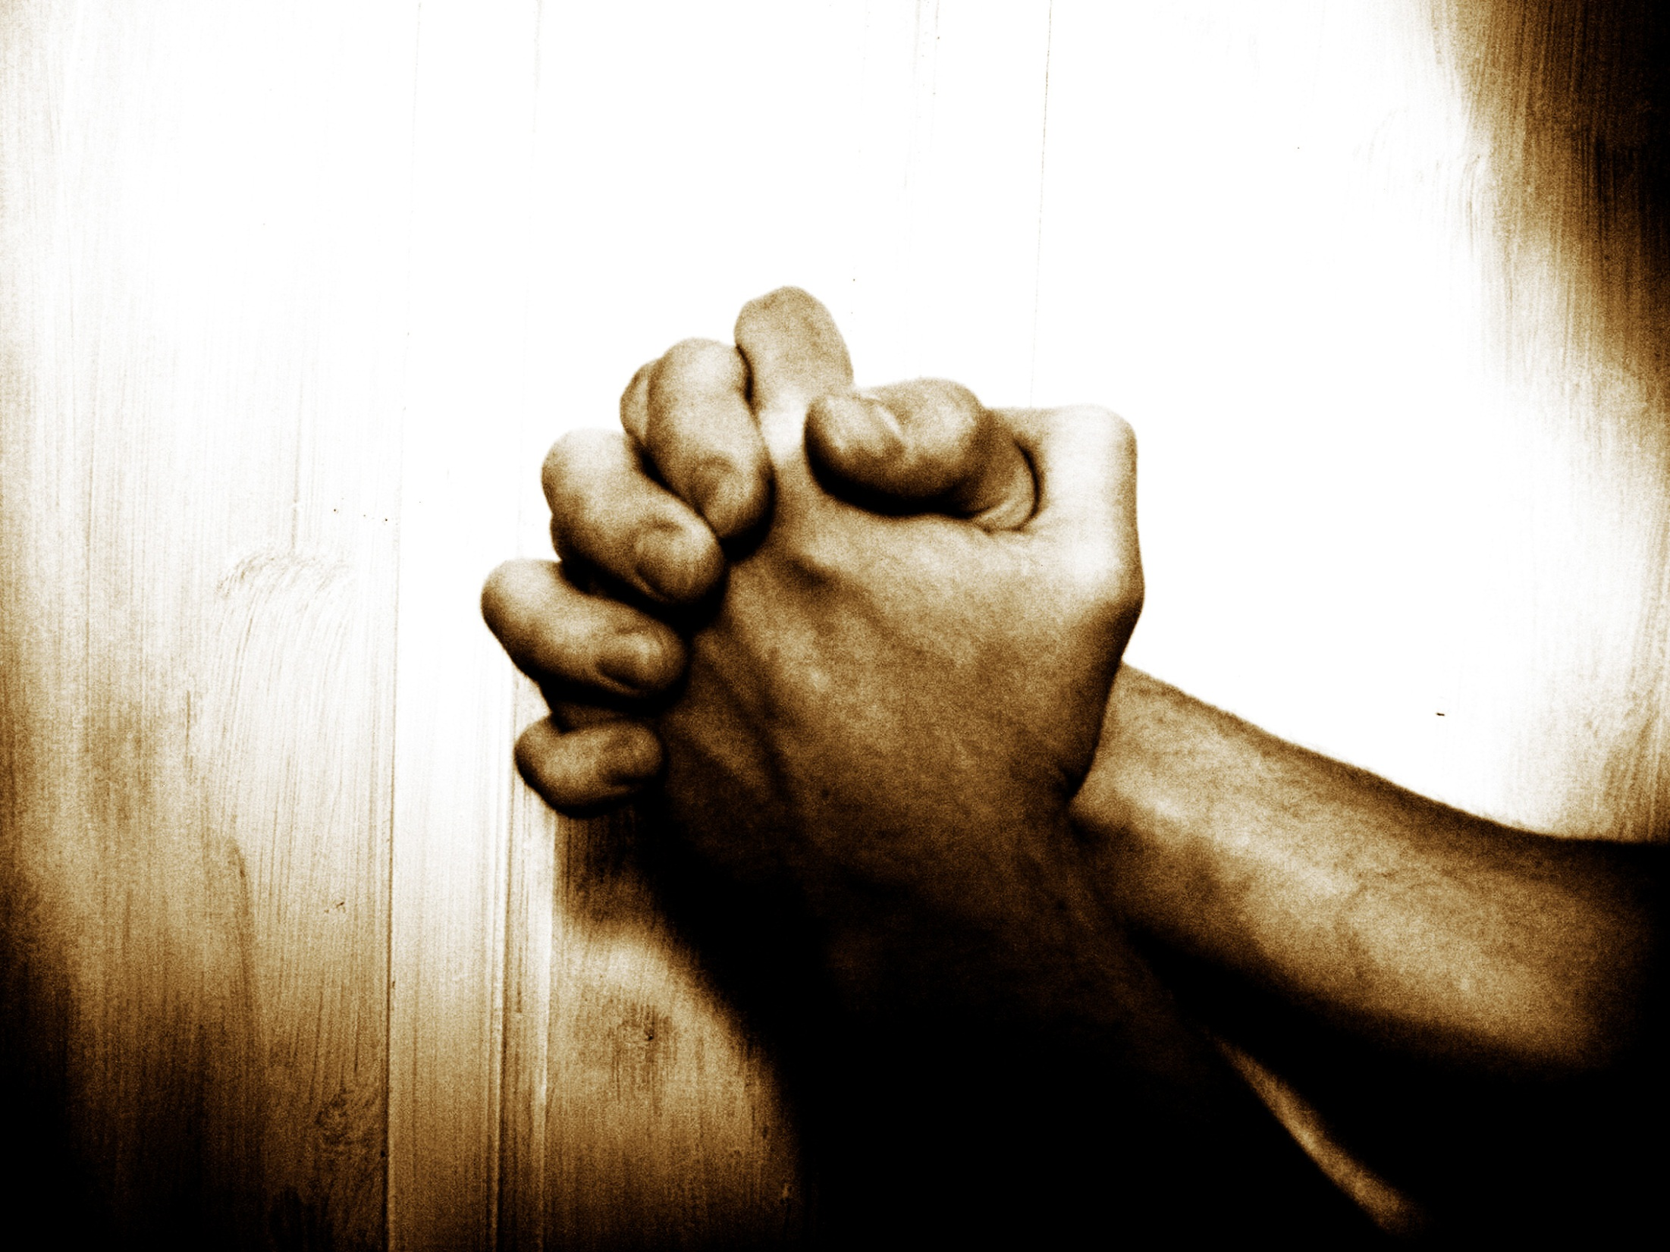

“Our Father”…
… A Prayer Journey
Jan – Mar2014
2 Chron. 7:14
If My people who are called by My name...

Slide 2

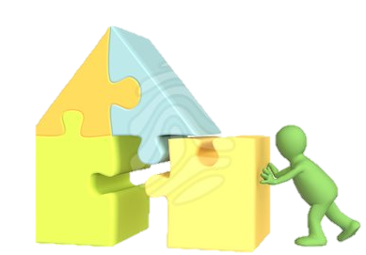

I. Why pray?
II. Foundations for effective prayer
III. Practicing prayer:
7 types: Principles & tools
recap
Part 1 – Intro
Part 2 – Intimacy
Part 3 –
Part 4 –
1 – Call to prayer
2 – Intimacy
3 – Partnership
4 – Role of Prayer
1 – Seeking His Presence by Faith
2 – Tabernacle prayer model
"The main lesson about prayer is just this: Do it! Do it!
Do it! You want to be taught to pray? My answer is
pray and never faint…" John Laidlaw

Slide 3
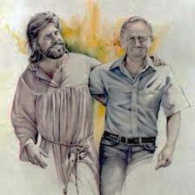
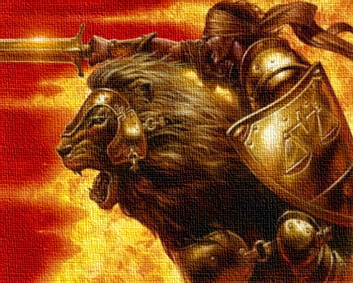
Recap: Weeks 1 - 4
Koinonia = Fellowship = Sharing life = Intimacy + Partnership
The Call: Called to unceasing prayer
Fellowship: Why? Share life with God = Intimacy + p’nrship
Intimacy: God delights in us & wants us to know Him
Partnership: God wants us to share His passions & pursuits. Called to partner in His mission, & develop a missional lifestyle
Prayer: Prayer is central to walking with God! Mystery 1: “The Lord will wait. At the sound of your cry, He will answer”. He wants us to come to Him in prayer
Communion: Mystery 2 : “Whatever we pray according to His will, He will do”. He wants us to unite our hearts with His
Presence first: Presence first, answers second
By faith: Seek His Presence, and grace, by faith
Word: Faith = trust & live by His Word (think, speak, do)
The Tabernacle Model: Tabernacle provides a “spiritual map” of faith steps deeper into His Presence

Slide 4
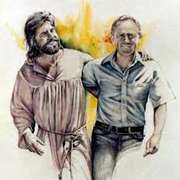

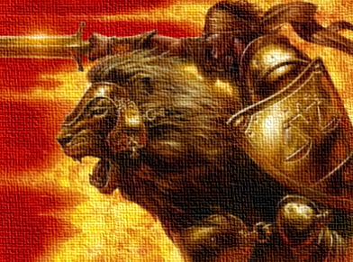
Faith response: 3 paradigms of prayer + time
The Intimacy Paradigm:
The Partnership paradigm:
The Power of
Prayer Paradigm
But be doers of the word, and not hearers only, deceiving yourselves… The one who looks into [the Word] and perseveres, being no hearer who forgets but a doer who acts, he will be blessed in his doing. (Jas 1:22–25)

Slide 5
I. Why pray?
II. Foundations for effective prayer
III. Practicing prayer:
7 types: Principles & tools
recap
1 & 2 - Adoration, & Confession
3 & 4 - Sanctification, & Edification
5 - Meditation
"The main lesson about prayer is just this: Do it! Do it!
Do it! You want to be taught to pray? My answer is
pray and never faint…" John Laidlaw

Slide 6
The Tabernacle Prayer Model
Old Covenant:
Physical steps
New Covenant:
Faith steps
"The main lesson about prayer is just this: Do it! Do it!
Do it! You want to be taught to pray? My answer is
pray and never faint…" John Laidlaw

Slide 7
Meditation is pursuing divine revelation of truth, in order to live by it
5
Station | 5 – Meditation
Biblical truth | He has given me all things, in knowing Him & His promises The Word reveals God’s nature, and my spirit nature (since I am His son) “He who looks into the Word being not a hearer only, but a doer who acts, he will be blessed in his doing”
Obstacles (untruth/ ignorance / unbelief) | Despising the Word - not actively pursuing revelation (time in Word) Ignorance of or not believing the Word
Faith step (spirit agreeing with God) | PRAYER: Meditate on the Word: Agree with God, Ask for & receive revelation, Keep the Word LIFE: Keep the Word. Be transformed by aligning thinking with what the Word says about God, the world, & me, & then live according to that.
Fruit | Walk in God’s provision & blessing

Slide 8
Go for maximum
HEAR: Him who has ears, let him hear what the Spirit has to say
SEEK: Ask Father to work miracles in your heart
TRUST: Trust that He will
ENGAGE: hungry heart, repentant (committed to Word-aligned action)
PRAY: 80% about prayer at home

Slide 9



Petition
“Our Father”… A Prayer Journey
Week 8 of 8
Session 12 of 13
Jan – Mar 2014
2 Chron. 7:14
If My people who are called by My name...

Slide 10
P1. We have arrived at the Altar of Incense, the final station before the Ark of God’s Presence.
Whatever you ask in my name, this I will do
(Jn 14:13-14)

Slide 11
Under the OC, a thick veil still separated the altar from God’s Presence

Slide 12
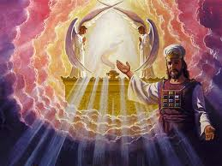
P2. Under the NC, there are 2 differences:
Having… boldness to enter into the holiest by the blood of Jesus, by the new and living way that he opened for us through the curtain… Let us draw near (Heb 10:19-22)
… the twenty-four elders fell down before the Lamb, each holding a harp, and golden bowls full of incense, which are the prayers of the saints. (Rev 5:8)
    The veil is torn, so we come right into God’s throne room;
    We offer prayers, not incense

Slide 13
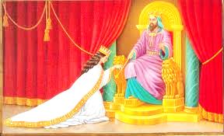

P3. The King's chambers are where we petition Him for grace for ours & others’ needs
Let us then with confidence draw near to the throne of grace, that we may receive mercy and find grace to help in time of need. (Heb 4:16)

Slide 14
P4. The heart of our King is abounding in kindness, deeply desiring to release grace
Do not be anxious [about provison]. But seek first the kingdom of God & his righteousness, & all these things will be added to you. (Mt 6:31–33)
Ask, and it will be given to you; seek, and you will find; knock, and it will be opened to you. (Mt 7:7-11)
Whatever you ask in my name, this
I will do (Jn 14:13-14)
    He tells us to come. He tells us to ask. He says He will give. Father’s desire is to give us grace and mercy

Slide 15

SOME QUESTIONS:
15
Notes:
Who here has at least 1 story like that?
Is that what happens 100% of the time
Or even the majority of the time?
I have lots of prayers that didn’t seem to be answered. Anyone else have that?
WHY? Who do we have prayers that go unanswered?
What is the usual explanation for prayers that go unanswered?

Slide 16
Problems with the popular explanation
1
That’s not what scripture says
Scripture
Explanation
Whatever you ask in my name, this I will do (Jn 14:13-14)
Ask, and it will be given to you; seek, and you will find; knock, and it will be opened to you. (Mt 7:7-11)
Some things you ask in my name, I might do
Ask and it might be given; seek and we might find; knock and it might be opened
2
Whatever you ask in prayer, believe that you have received it, and it will be yours. (Mk 11:24–25)
    How do we reconcile this disconnect?
Notes:
Can anyone tell me what the problem is what that explanation?
Well I can share two problems that I see
The first is that that’s not what the scripture says…
The second is that this prevents us from praying with faith, as the scripture tells us to…
So if this is not the right answer, how do we reconcile this disconnect?

Slide 17
Exercise 1: Summarise Mt Ch 6:5 – 7:11
1. THE HEART OF PRAYER
(6:5-8)
  Motive - seek God, not the praise of men
  Manner - don't chant as the pagans do, speak as a son to Father God
3. LIFESTYLE FOR EFFECTIVE
PRAYER (6:14-7:6)
  Forgive others
  Fast sincerely
  Values - Don't accumulate earthly possessions, accumulate heavenly ones
  Trust - Don't pursue security; trust God to provide & pursue the Great Commission
  Don’t judge
  Discern- Don’t share Kingdom matters with Kingdom haters
2. PRAYER PRIORITIES (6:9-13)
(The Lord's Prayer)
  God's glory
  God's purposes & plans
  Daily bread
  Forgiveness for sin
  Deliverance from sin
  Deliverance from evil / harm
  Praise
4. CONCLUSION: THE PROMISE OF PRAYER (7:7-11)
  Ask, seek, knock – God will answer
Notes:
To begin to answer this question, I’d like us to spend a bit more time in the longest passage on prayer in the new testament, Mt Ch 6 – 7
And we’re going to do an exercise here, which is to read and summarise this whole section, from Ch 6:5 – 7:11
<EXERCISE>
Ok, how’d you go?
Now I’m not going to call anyone to the front to share, I’m just going to share how I did it
Heart of prayer
Prayer priorities – what He guides us to pray for, 6 things + praise
Various ad hoc advice
Conclusion: the promise of prayer
Question regarding section 3. All seems to be about prayer except that random ad hoc advice in the middle
Now, the bible is never random. So when it seems random, look a little deeper.
What many of you will recognise is a common Hebrew literary device, which is a set of parentheses. Often in Hebrew literature, a section will begin and end with a statement on the core topic, indicating that everything in between relates to that topic and should be interpreted in that way
And here we have just that, a set of parentheses, at least in Hebrew literary form
So that tells us this middle section is actually also about prayer
And in fact we can see there is a clear link, because the section talks about provision, section 4 talks about provision, and in between section 3 talks about how we get provision. In fact the section ends on how we get our basic needs met by God. So this is definitely one big connected idea, all on the topic of prayer
So then, I infer that section 3, which seems to be advice on Christian lifestyle, related to prayer. So I have named it “lifestyle for effective prayer”
So the Lord’s advice on prayer is quite a lot richer than at first glance and it includes quite a bit of advice on how to live in order to walk in the Lord’s provision
So then, if we step back, I want you to notice 2 things
First, that Father’s desire is to give us what we ask. That’s the conclusion. That’s the punchline.
Second, that mixed in with Jesus advice on how to pray is advice on how to live in order to walk in God’s provision.

Slide 18
Note the lifestyle guidance maps to prayer stations
Forgive others
Confession
Fast sincerely
Edification
Values - Don't accumulate earthly possessions, accumulate heavenly ones
Sanctification
Trust - Don't pursue security; trust God to provide & pursue the Great Commission
Edification, sanctification, meditation
Don’t judge
Confession
Discern - don’t share precious Kingdom matters with those not in Christ
?
Notes:
Okay so trust me, I’m going somewhere with this. What I now want you to do with me is to see if you can identify in Jesus’ lifestyle advice any relationship to the stations of prayer we have been covering. Ok?
Alright lets start with the first one: forgiveness, where does that fit? – right, Confession, its about dealing with sin. Forgive and you shall be forgiven
Ok, fast, where does that fit? We didn’t cover this but its at edification, denying the flesh to train ourselves to respond to the Spirit
Setting our hearts on heavenly treasures, not earthly ones? – right, sanctification…
So what I want you to notice is that most of Jesus’ lifestyle advice in this section relates to the Tabernacle, and to the faith steps of the Tabernacle prayer model
So what does this mean?
Well let me stop beating around the bush and just cut to the chase over here…

Slide 19
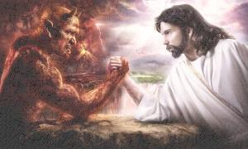
    P5. Obstacle # 1:
    The flesh nature
Put off your old self, which belongs to your former manner of life and is corrupt through deceitful desires, … put on the new self, created after the likeness of God (Eph 4:22–24)
    We can live in, and pray in, either the flesh / old man, or the spirit / new man
Notes:
I believe that there are 2 reasons we don’t get prayer answered, even though Father God promises us answered prayer:
The first, is praying in the flesh
You remember this passage from Eph? What Paul is telling us is that we can either live in the flesh, or the spirit, the choice is ours and we are called as God’s people to believe, and so walk in the Spirit

Slide 20
    P6. God doesn’t hear prayers prayed in the flesh
 | Old man | New Man
Nature | Flesh | Spirit
Walks in | Unbelief | Faith
Relationship with sin | Alive to sin (sinner) | Dead to sin
Relationship with God | Enemy of God | Son of God
Relationship with World & righteousness | Loves the world, righteous when not inconvenient | Not of the world, righteous by nature
Top priority | Self-pleasing in this life (achievem’t, fun, pleasure, comfort…) | God’s will - always good, no matter how much suffering
He hears prayers of faith, not unbelief. Hence He hears prayers when we live & pray in the Spirit, not when we live & pray in the flesh
Notes:
And here’s the thing: God only answers prayers prayed in the spirit. He doesn’t answer prayers prayed in the flesh.
You see, the old man, the flesh nature, walks in unbelief and is by nature at war with God. No prayers prayed in the flesh get answered because the flesh is dead to God, it was crucified with Jesus on the cross so to God the flesh is dead
All God’s promises were made to us as born again children of God, as new creatures, as spirit beings who walk by faith. All His promises apply to our spirit man. But the flesh nature cannot appropriate any of the promises of God because
The promises are spiritual and the flesh is carnal
The promises are in Christ, and the flesh is not in Christ
SO any prayers prayed in the flesh nature, the nature which is self-seeking and is loves this world, those prayers don’t get answered.
The prayers which are prayed in the spirit will always be in line with God’s will, and they will always be answered.

Slide 21
P7. As we walk ‘in the new man’, by faith, God’s promise of answering our prayers applies to us
Stn | Biblical truths | Flesh / Old Man / unbelief response | Spirit / New Man / Faith response
1 | I am called to come (draw & stay near to God, in worship) | Don’t “come” / draw & stay near to God, in worship | “Come” – Devoted time, Intimacy Paradigm, Worship
2 | I can draw near as a son, cleansed by Jesus’ blood, given a holy nature | Cling to sin → ashamed to come Don’t forgive → not forgiven | Come as a son: Forgive, be cleansed, live out new nature, come boldly
3 | I am a priest of God, in Christ | Impure heart / double-minded / self-centered life | Come as a priestly son: Accept & live out priestly identity in Christ
4 | I am an overcomer of this world – by Christ in me | Flesh nature (self centered) | Come in spirit: Live by the Light & power of Christ’s Spirit within
5 | I am “born of the Word”- it describes my new nature. | Ignorance of, despising, not believing the Word | Think, speak, do the Word: because it reveals my DNA
Notes:
So here’s the thing about the Tabernacle Prayer Model.
We don’t come to the altar to make requests of God until we are in the spirit nature, in alignment with the Word, seeing things through the eyes of faith.
So when we do come to make requests of God, in faith, walking in the truth, we pray according to His will, because the Holy Spirit leads us, and so we are promised answers to our prayers.
When we are walking as sons of God by faith, that’s when the Word is truth that “whatever you ask in my name, that I will do”
So the key thing to recognise is that by walking in the flesh we choose to disqualify ourselves of walking in the power of the Kingdom, we live futile lives filled with frustration
But when we walk in the spirit, we walk in power and authority and we see answers to our prayers and bear fruit for the King! Hallelujah!
That’s why I love the Tabernacle prayer model. It is a systematic way of noticing and correcting where I have strayed into the flesh. It is a powerful tool to quickly break agreement with darkness and come back into the light
So that’s reason 1. God’s promises don’t apply to the flesh, so it is only when we live and pray in the spirit that His promises apply to us

Slide 22
P8. Obstacle #2: Ignorance. When we respond in faith to the gospel & set ourselves apart to live for God, we enter the Gospel economy of His provision
Eden
Fall
Law
Gospel
1
        4
2
3
1
3
“you may eat of every tree”
If you faithfully obey the voice of the LORD… being careful to do all his commandments … Blessed shall be… the fruit of your ground & the fruit of your cattle, the increase of your herds & [their young]. Blessed shall be your basket & your kneading bowl. (Dt 28:1–5)
2
“by the sweat of your brow you will eat”
4
Therefore do not be anxious, saying, ‘What shall we eat?’ or ‘What shall we drink?’ or ‘What shall we wear?’ … But seek first the kingdom of God & his righteousness, & all these things will be added to you. (Mt 6:31–33)
    The key is not in what we do, but why we do it. When we make His business our business, he makes our provision His business
Notes:
But I believe there is a second reason, and that is ignorance.
Now we’re going to cover this one very briefly, even though we could take a good hour on this topic alone. But just in brief terms, the issue is not understanding the nature of our covenant with God and as God said my people are destroyed for lack of knowledge.
Now I want to define a term for you, which is “economy”. Most of you will have heard the term economy, or even studied economics. You will know it as a system of the limited supply and demand for goods and services. Well, in terms of our relationship with God, there has always been a system for the supply of our needs, and that is most definitely a type of an economy. So I’m going to use the term the economy of God’s provision.
Some of you will be surprised to learn that there have been 4 different economies of God’s provision
Can anyone tell me what those economies have been? .
…
…
..
So that leads to the second obstacle, which is simply ignorance. If you don’t live by faith in the gospel economy, you won’t enjoy the gospel economy because everything in the Kingdom is by grace, through faith.
And how do you access this Kingdom economy of God’s blessed provision?
Well it tells us right there in Mt 6:31 – Don’t stress about your future provision; rather, seek the Kingdom of God and His righteousness, and all else will be added. That’s it.
In other words, When you by faith walk in your priestly identity in Christ, you will by faith access the King’s supernatural provision. You will no longer be limited by the sweat of your brow. Instead you can access the King’s storehouses because you are seeking first the Kingdom of God.
Now if we are not walking in the Kingdom economy by faith, then we won’t be accessing the King’s storehouses and that’s why we will be seeing prayers go unanswered.

Slide 23
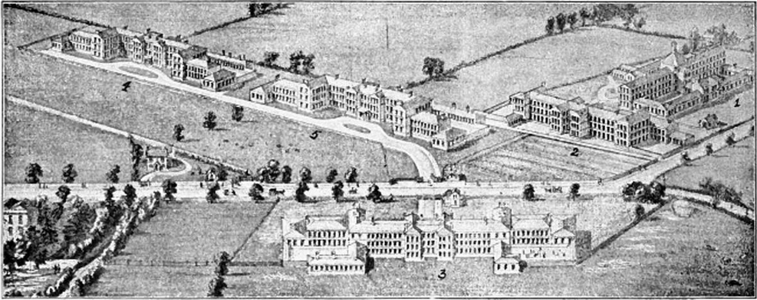
An illustration of the gospel economy
Notes:
I want to tell you a brief story to illustrate this Kingdom economy.
George Mueller; father of orphanges in England, early 1800’s. Cared for 10,000 orphans, educated 120,000, never asking for donations and never in debt.
Once, time for breakfast nothing to eat. Simply said with glee, watch and see what the Lord will do. Sat down to say grace. As finished, knock at door. Baker. Could not sleep. Felt compelled to give all his freshly baked bread. Milkman, had broken down in front of orphange, needed to dispose of his milk.
That is the gospel economy. Seek first the Kingdom and all these other things SHALL be given.
But it is by grace, through faith. If we do not believe in the plain teaching of Mt Ch6, don’t know the gospel economy, we are effectively believing in a Law-based economy and under such we will live
Now I want to make clear, this does not mean we all quit our day jobs. It means we seek first the Kingdom, whether the Lord directs us to work in our day jobs, or do something else. The point is our provision is not tied to our day jobs, when we walk in the Gospel economy by faith. We make God’s business our business, and He makes our provision His business

Slide 24
P9. As we walk in the Gospel economy by faith, we
1
Ask, and it will be given to you (Mt 7:7–11)
You do not have, because you do not ask (Jas 4:2)
He will be very gracious to you at the sound of your cry; when He hears it, He will answer you. (Isa. 30:18-19)
“if we ask anything according to his will he hears us, &… we have [what] we have asked (1Jn 5:14–15)
Ask in faith, with no doubting… the one who doubts… must not suppose he will receive anything from the Lord (Jm 1:5-8)
I tell you, whatever you ask in prayer, believe that you have received it, and it will be yours (Mk 11:24–25)
2
3
    …ask…;
    …according to His will…;
    …in faith…
    i.e., ask according to the promises of God
Notes:
But not us. Because we are sons of God and we believe His Word. We believe where it says

Slide 25
P10. …And 4) hold on to our confession in God’s faithfulness
All provision is in God’s promises
  His divine power has granted us all things that pertain to life and godliness, through … his … promises (2 Pe 1:3–5)
Confessing God’s Promises releases the grace
  With the heart one believes and is justified, and with the mouth one confesses and is [sozo’d] (Rom 10:9)
The devil uses deception to war against our faith & confession
  The weapons of our warfare… have divine power to destroy strongholds. We destroy arguments & every lofty opinion… against the knowledge of God, & take every thought captive to… Christ (2 Co 10:4–6)
We conquer by holding onto our *confession*
  for the accuser of our brothers has been thrown down, who accuses them day & night before our God. They have conquered him by the blood of the Lamb & by the word of their testimony (Rom 12:10–12)

Slide 26
Petition is coming as a son of God living by faith, & asking our Father, filled with faith
6
Station | 6 – Petition
Biblical truth | I am set apart as a priestly son of God, called to the family business of building (‘seeking first’) the Kingdom God is my provider. Jesus promises whatever we pray in His name, He will do.
Obstacles (untruth/ ignorance / unbelief) | Living and praying in the flesh: not living from faith in the full gospel, hence not living as a son of God through faith, but in the flesh; hence not coming in Jesus’ name in faith
Faith step (spirit agreeing with God) | Life: Live as a son of God, by faith. Walk in the spirit, live as a priest of God, prioritise the Great Commission, trust God to provide. Prayer: Pray as a son of God, by faith. 1. Abide in Christ; 2. Knit heart with God’s, praying according to His heart, prioritising the Kingdom; 3. Ask in faith, according to His will; 4. Hold onto confession
Fruit | “ask whatever you wish, and I will do it”

Slide 27
How (1/2): 3 practical applications
1
Begin quiet times by passing through first 5 stations, before making requests of God. Seek sincerely to align your heart with His
When seeking God for a “major” miracle, journey through first 5 stations to come into the spirit and into agreement with Him
Walk in the spirit at all times, so every brief prayer is effective
2
Whatever you ask in my name, this I will do
(Jn 14:13-14)
3

Slide 28
How (2/2): Tools
T1. The Lord’s Prayer as a guide to Petition
Our Father in heaven, | Intimacy
hallowed be your name. | Intercession for Kingdom For God's glory
Your kingdom come, | For God's purposes
your will be done, on earth as it is in heaven. | For God's plans
1. Give us this day our daily bread, | Petition for self & others
2. and forgive us our debts, as we also have forgiven our debtors.
3. And lead us not into temptation,
4. but deliver us from evil.
for thine is the kingdom, the power, and the glory, forever and ever, amen | Praise

Slide 29
How (2/2): Tools
T2. God’s promises to answer our prayers
Let us then with confidence draw near to the throne of grace, that we may receive mercy and find grace to help in time of need. (Heb 4:16)
Whatever you ask in my name, this I will do, that the Father may be glorified in the Son. If you ask me anything in my name, I will do it. (Jn 14:13-14)
Ask, and it will be given to you; seek, and you will find;
knock, and it will be opened to you. For everyone who asks receives, and the one who seeks finds, and to the one who knocks it will be opened (Mt 7:7-11)
If you abide in me, and my words abide in you, ask whatever you wish, and it will be done for you. By this my Father is glorified, that you bear much fruit and so prove to be my disciples. (Jn 15:7–9)
And this is the confidence that we have toward him, that if we ask anything according to his will he hears us. And if we know that he hears us in whatever we ask, we know that we have the requests that we have asked of him. (1 Jn 5:14–15)

Slide 30
Soaking
“Our Father”… A Prayer Journey
Week 8 of 8
Session 13 of 13
Jan – Mar 2014
2 Chron. 7:14
If My people who are called by My name...
Notes:
We have now laid the foundation by revealing Father’s deep desire for intimacy and for partnership with His children. The next few sessions will unpack some of the principles of experiencing spiritual intimacy with the Living God in a practical and experiential way.

Slide 31
P1. We have arrived at the pinnacle of prayer: the place where we gaze upon His beauty
He is the radiance of the glory of God and the exact imprint of his nature, and he upholds the universe by the word of his power. (Heb 1:3)

Slide 32
Now Moses used to take the tent and pitch it outside the camp, far off from the camp, and he called it the tent of meeting. And everyone who sought the Lord would go out to the tent of meeting… Whenever Moses went out to the tent, all the people would … watch Moses until he had gone into the tent. When Moses entered the tent, the pillar of cloud would descend and stand at the entrance of the tent, and the Lord would speak with Moses. …
When Moses turned again into the camp, his assistant Joshua the son of Nun, a young man, would not depart from the tent. (Ex 33:7–11)
    P2. Soaking is about simply being in the Presence of the Lord with no agenda but to enjoy Him

Slide 33
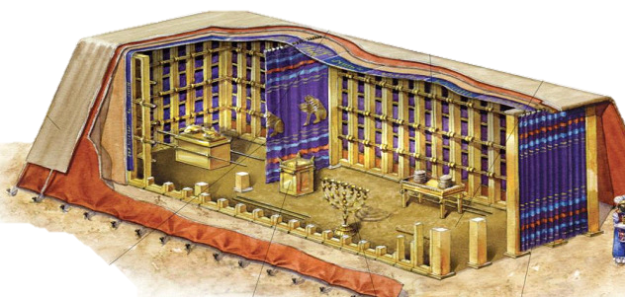
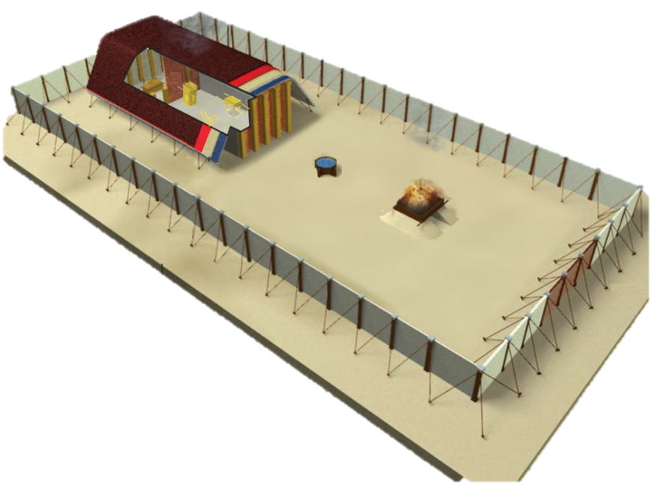
  “O Lord Almighty, God of
  Israel, enthroned between
  the cherubim” (Isa 37:16)
  And there I will meet with thee, and I will commune with thee from above the mercy seat… upon the ark of the covenant
  (Exo 25:8-9, 22)
    P3. The ark of the covenant represents Father’s throne, the place of meeting and communion with Him
Notes:
→ So Moses’ tabernacle gives us some very important insights about finding God’s Presence, His throne, under the Old Covenant arrangement

Slide 34
P4. In the Throne Room, there is a
1) what 2) how 3) why 4) and fruit
Seek HIM – His Person;
by
Gazing on & worshipping Him;
because
His love is better than life and our soul needs Him
resulting in
our soul being satisfied and overflowing with joy
O God, you are my God;
earnestly I seek you;
my soul thirsts for you; my flesh faints for you, as in a dry and weary land where there is no water.
So I have looked upon you in the sanctuary, beholding your power and glory.
Because your steadfast love is better than life,
my lips will praise you. So I will bless you as long as I live; in your name I will lift up my hands.
My soul will be satisfied as with fat and rich food, and my mouth will praise you with joyful lips,
when I remember you upon my bed, and meditate on you in the watches of the night;
for you have been my help, and in the shadow of your wings I will sing for joy.
My soul clings to you;
your right hand upholds me. (Ps 63)

Slide 35
P5. The point of soaking is…
The Lord is my light and my salvation; whom shall I fear?
The Lord is the stronghold of my life; of whom shall I be afraid?
When evildoers assail me to eat up my flesh, my adversaries and foes, it is they who stumble and fall.
Though an army encamp against me, my heart shall not fear;
though war arise against me, yet I will be confident.
One thing have I asked of the Lord, that will I seek after:
that I may dwell in the house of the Lord all the days of my life,
to gaze upon the beauty of the Lord and to inquire in his temple
(Psalm 27:1-4)
    …to simply be with the Lord, gazing on and enjoying the fullness of His glory and majesty

Slide 36
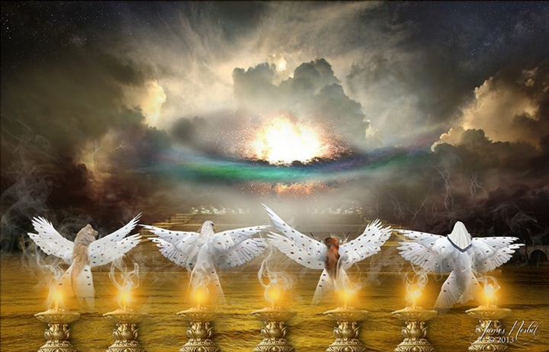
P6. We know when we are in His presence when…
In your presence there is fullness of joy; at your right hand are pleasures forevermore. (Ps 16:11)
    … we experience supernatural joy and pleasure

Slide 37
Soaking – Summary of principles
    P1. We have arrived at the pinnacle of prayer: the place where we simply gaze upon His beauty
    P2.
    P3. The ark of the covenant represents Father’s throne, the place of greatest nearness to / intimacy with Him
    P4. In the Throne Room we
  Seek HIM – His Person;
  By Gazing on, enjoying, & worshipping Him;
  Because His love is better than life and our soul needs Him
  Resulting in our soul being satisfied and overflowing with joy
    P5. The point of soaking is to enjoy the Lord in the fullness of His glory and majesty
    P6. We know when we are in His presence when we experience supernatural joy and pleasure

Slide 38
Bringing it all together: 4 applications of the TPM
Old Covenant: Physical steps
New Covenant: Faith steps
Quite times
Prayer retreats
Life
“Spiritual diagnostics”
"The main lesson about prayer is just this: Do it! Do it!
Do it! You want to be taught to pray? My answer is
pray and never faint…" John Laidlaw

Slide 39
End
“Our Father”… A Prayer Journey
Jan – Mar 2014
2 Chron. 7:14
If My people who are called by My name...

