Slide 1
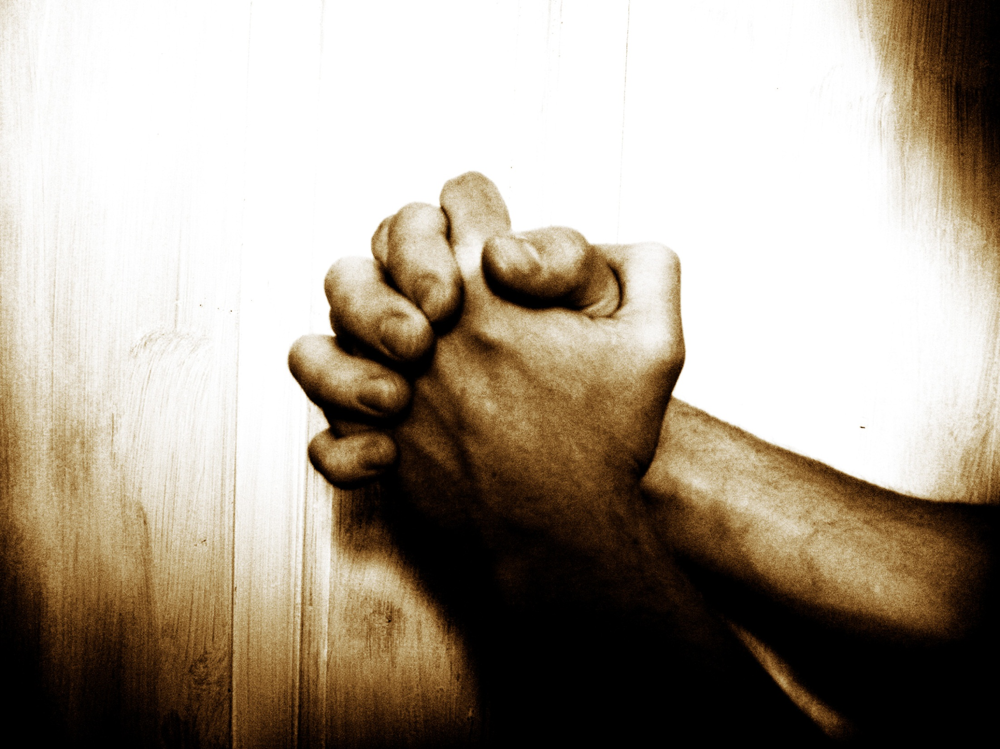

“Our Father”…
… A Prayer Journey
Jan – Mar2014
2 Chron. 7:14
If My people who are called by My name...

Slide 2



“Our Father”… A Prayer Journey
Week 7 of 8
Session 11 of 13
Jan – Mar 2014
2 Chron. 7:14
If My people who are called by My name...

Slide 3


QUESTION: What 1 habit above all others tends towards prospering in every area of God’s will for your life?
3

Slide 4
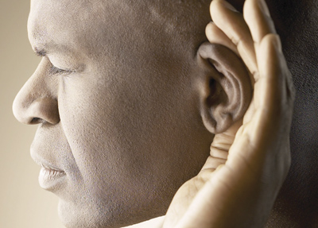
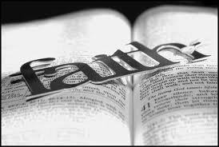
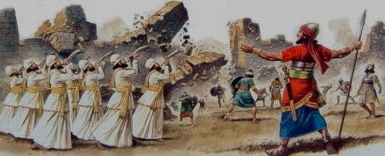
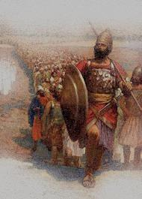
Keys to a prosperous* life (1/3)
Joshua 1:1-10:
After the death of Moses… the Lord said to Joshua … “Moses my servant is dead. Now therefore arise, go over this Jordan, you and all this people, into the land that I am giving to them, to the people of Israel. Every place that the sole of your foot will tread upon I have given to you, just as I promised to Moses…. No man shall be able to stand before you all the days of your life. Just as I was with Moses, so I will be with you. I will not leave you or forsake you. Be strong and courageous, for you shall cause this people to inherit the land that I swore to their fathers to give them…
* God’s definition of prosperous – e.g. Col Ch 3&4

Slide 5
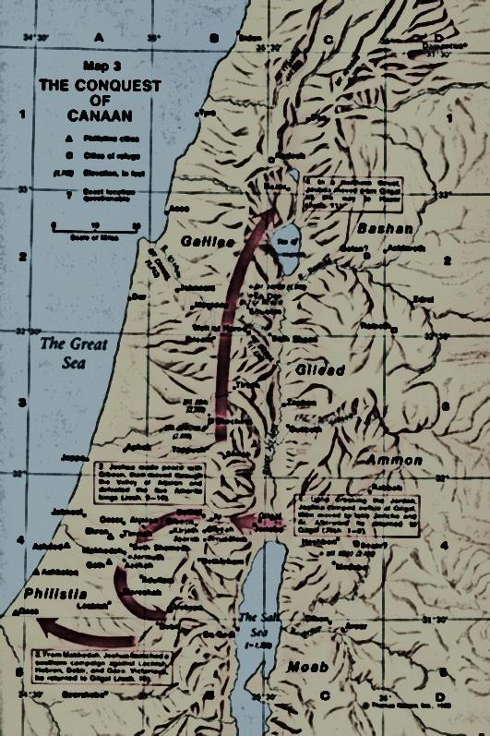

Keys to a prosperous* life (2/3)
Joshua 1:1-10 – cont…
…Only be strong and very courageous, being careful to do according to all the law that Moses my servant commanded you. Do not turn from it to the right hand or to the left, that you may have good success wherever you go. This Book of the Law shall not depart from your mouth, but you shall meditate on it day and night, so that you may be careful to do according to all that is written in it. For then you will make your way prosperous, and then you will have good success. (Joshua 1:1–10)
    The key to prosperity & success* in God’s Kingdom is to think, speak, and do His Word

Slide 6
Keys to a prosperous* life (3/3)
Psalm 1:
“Blessed is the man That walketh not in the counsel of the ungodly, Nor standeth in the way of sinners, Nor sitteth in the seat of the scornful. But his delight is in the law of the Lord; And in his law doth he meditate day and night. And he shall be like a tree planted by the rivers of water, That bringeth forth his fruit in his season; His leaf also shall not wither; And whatsoever he doeth shall prosper. ” (Psalm 1:1–3)
* God’s definition of prosperous – e.g. Col Ch 3&4

Slide 7
Meditation & proclamation
“Our Father”… A Prayer Journey
Week 7 of 8
Session 11 of 13
Jan – Mar 2014
2 Chron. 7:14
If My people who are called by My name...

Slide 8
Our 5th Station en route to God's Presence is the Table of Shewbread, representing the Word of God
“In the beginning was the Word, and the Word was with God, and the Word was God…. And the Word became flesh and dwelt among us”
(Jn 1:1-14)
“I am the bread of life”
(Jn 6:48-50)
    Only priests actively on duty in the Tabernacle enjoy the blessings of the Shewbread; & requires light from the lamp

Slide 9
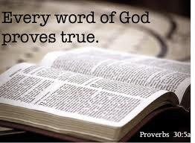
His divine power has granted to us all things that pertain to life and godliness …through the knowledge of Him who called us to his own glory and excellence, by which he has granted to us his precious and very great promises…… so that through them you may become partakers of the divine nature, having escaped from the corruption that is in the world because of sinful desire
(2 Pe 1:3–4)

Slide 10
  His divine power has granted to us all things [for] life & godliness through…
    …so that through them you may become partakers of the divine nature, having escaped from the corruption that is in the world because of sinful desire (2 Pe 1:3–4)
    P1. 2 promises: 1) Father has already provided for all our needs; 2) we are partakers of the divine nature\

Slide 11
  His divine power has granted to us all things [for] life & godliness…through
  the knowledge of Him who called us to his own glory and excellence,
  by which he has granted to us his precious & very great promises…
  … so that through them you may become partakers of the divine nature, having escaped from the corruption that is in the world because of sinful desire (2 Pe1:3–4)
    P2. Provision & partaking of His nature come through
    1) the knowledge of God, and
    2) walking in His Promises

Slide 12
Knowledge of God
But when the Comforter is come, … the Spirit of truth,… He shall testify of me (Jn 15:26)
“… He will guide you into all the truth… He will glorify [reveal the truth about] me” (John 16:13–14)
Faith in His promises
Faith comes from hearing, & hearing from the word <‘rhema’ – spoken word> of God (Rom 10:9–17)
    P3. The knowledge of God & faith in His promises come from revelation (‘supernatural hearing’ of ‘rhema’ Word, spoken by His Spirit)

Slide 13
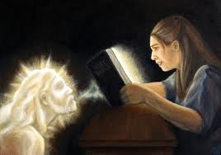
P4. Revelation is receiving spiritual knowledge, when the Spirit of God imparts spiritual truths into our hearts, giving us faith in that Word
Now we have received not the spirit of the world, but the Spirit who is from God, that we might understand the things freely given us by God…And we impart this in words not taught by human wisdom but taught by the Spirit, interpreting spiritual truths to those who are spiritual. The natural person does not accept the things of the Spirit of God, for they are folly to him, and he is not able to understand them because they are spiritually discerned… we have the mind of Christ. ” (1 Cor 2:9–16)
Faith comes from hearing, & hearing from the [spoken] word of God (Rom 10:9–17)

Slide 14
What you do
What you pursue
What you get
My son, if you receive my words and treasure
up my commandments with you, making your
ear attentive to wisdom and inclining your
heart to understanding; yes, if you call out for insight and raise your voice for understanding, if you seek it like silver and search for it as for hidden treasures, then you will understand the fear of the Lord and find the knowledge of God. For the Lord gives wisdom; from his mouth come knowledge and understanding; he stores up sound wisdom for the upright; he is a shield to those who walk in integrity, (Pr 2:1–7)
My son, be attentive to my words; incline your ear to my sayings. Let them not escape from your sight; keep them within your heart. For they are life to those who find them, and healing to all their flesh. (Pr 4:20–23)
    P5. Revelation comes by meditation, which is actively seeking the gift of spiritual knowledge from the Holy Spirit

Slide 15


P6. Therefore, meditating on God’s Word is the key to prospering under God’s blessing…
P1. Father has already granted us full provision (all things we need for life, and a godly life)
P2. All His provision comes through the knowledge of Him and His promises
P4. Knowledge of Him & His promises come through revelation
P5. Revelation comes by
meditation
P6. Meditation is the key to Father’s provision in all things
(i.e. to prospering under Father’s blessing)

Slide 16
Remember…
Joshua 1:1-10 – cont…
…Only be strong and very courageous, being careful to do according to all the law that Moses my servant commanded you. Do not turn from it to the right hand or to the left, that you may have good success wherever you go. This Book of the Law shall not depart from your mouth, but you shall meditate on it day and night, so that you may be careful to do according to all that is written in it. For then you will make your way prosperous, and then you will have good success. (Joshua 1:1–10)
    P7. The grace is released as we live by faith in the Word: Think, speak & do

Slide 17
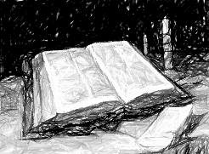
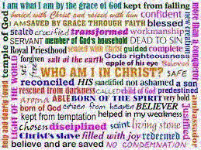

P8. Meditating on God’s Word remains the key to prospering in the new testament
…you abide in me…
…my words abide in you…
…ask whatever you wish, and it will be done for you.
&
If
John15:1-17

Slide 18
P9. And under the NC, grace is still released when we 1) believe, 2) confess (proclaim) and 3) do God’s Word
For with the heart one believes and is justified, and with the mouth one confesses and is saved. (Rom10:9–17)
But be doers of the word, and not hearers only, deceiving yourselves… The one who looks into the perfect law, the law of liberty, and perseveres, being no hearer who forgets but a doer who acts, he will be blessed in his doing.
(Jas 1:22–25)
1
2
G4982. σώζω sōzō, sode´-zo; to save, i.e. deliver or protect, heal, preserve, … make whole. Strong, J. (2009)
3

Slide 19
P10. Here we encounter a fifth set of obstacles to intimacy and power in prayer:
…you abide in me…
…my words abide in you…
…ask whatever you wish, and it will be done for you.
&
My people are destroyed for lack of knowledge
(Ho 4:6)
Without faith it is impossible to please God (Heb 11:6)
If
John15:1-17
    … Ignorance of, despising, or not believing God’s Word

Slide 20
P11. Faith 1) invests time to meditate on God’s Word, in order to 2) be a doer of His Word
What you do
What you pursue
What you get
My son, be attentive to my words; incline your
ear to my sayings. Let them not escape from
your sight; keep them within your heart. For
they are life to those who find them, and healing to all their flesh. (Pr 4:20–23)
Put away all filthiness and rampant wickedness and receive with meekness the implanted word, which is able to save your souls. But be doers of the word, and not hearers only, deceiving yourselves. For if anyone is a hearer of the word and not a doer, he is like a man who looks intently at his natural face in a mirror. For he looks at himself and goes away and at once forgets what he was like. But the one who looks into the perfect law, the law of liberty, and perseveres, being no hearer who forgets but a doer who acts, he will be blessed in his doing. (Jas 1:21–25)

Slide 21

Example: The Promise of
Healing
Surely He has borne our griefs (sicknesses, weaknesses, and distresses) and carried our sorrows and pains [of punishment]… But He was wounded for our transgressions, He was bruised for our guilt & iniquities; the chastisement [needful to obtain] peace and well-being for us was upon Him, and by His stripes we are healed. (Isa 53:4-5; Ampl.)
This was to fulfill what was spoken by the prophet Isaiah: “He took our illnesses and bore our diseases.”
(Mt 8:17)

Slide 22
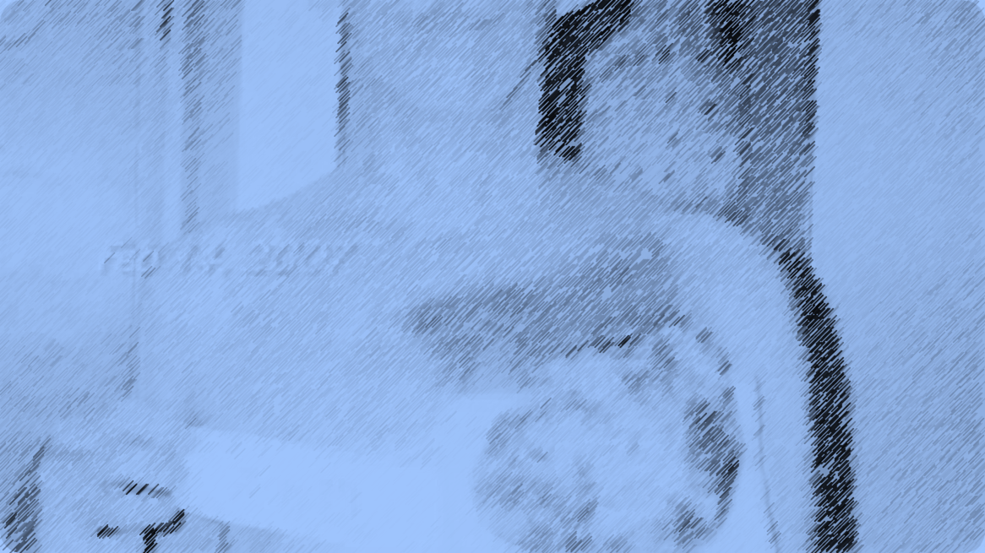
Mike Hoesch’s testimony on faith & healing

Slide 23
Meditation is pursuing divine revelation of truth, in order to live by it
5
Station | 5 – Meditation
Biblical truth | Blessing, favour, & provision come from walking in God’s ways. I must know them and walk in them My true nature is to walk in God’s ways because I am His son, a partaker of His nature. His NC commands reveal my DNA Knowing Him & walking in His ways is key to provision
Obstacles (untruth/ ignorance / unbelief) | Ignorance of, despising, not believing the Word Not actively pursuing revelation (time in Word)
Faith step (spirit agreeing with God) | PRAYER: Meditate on the Word: Agree with God, Ask for & receive revelation, Keep the Word LIFE: Keep the Word. Be transformed by aligning thinking with what the Word says about God, the world, & me, & then live according to that.
Fruit | Walk in God’s provision & blessing

Slide 24


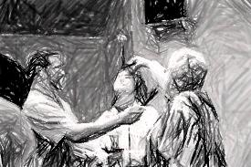
HOW Part 1:
3 practical applications
1
During morning prayers, after praying for your spirit man to be strengthened, meditate on the many layers and facets of the gospel and what God says it means for you, practically, today. Proclaim it.
2
Whenever you face trials or come under spiritual attack, remember the promises of God and proclaim them in faith
3
When making requests of God, remind Him of His promises and know that you are praying His will. Ask for what He has promised; thank Him in faith

Slide 25
HOW Part 2:
Process
T4 – T6
1. Devote the time
2. Prioritise your practical needs
7. Proclaim & act on the Word in faith
3. Find His promises
4. Pray for revelation
6. Meditate on the Word
5. Purify your heart
T3
T1
T2

Slide 26
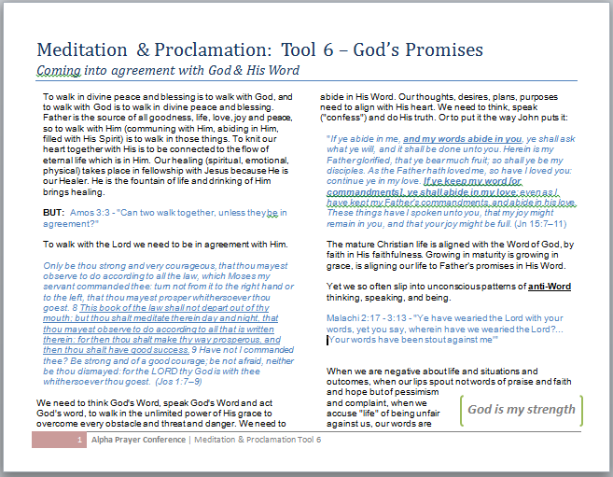
HOW Part 3: Tools
T1: Proclaiming the Promises of God
In whatever needs you may have…
Find the promises of God that speak of His heart for you in the situation (start with this booklet, build your own “library”)
Meditate on His promises until the Spirit releases revelation & faith in His promise
Proclaim out loud God’s promises to you, as though your need / concern is a wicked enemy overcome by God’s promise

Slide 27
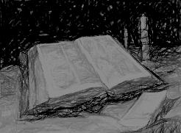
T2. TRUST: Prayer before entering a time of meditation
Thank You for Your commitment to transform me and cause me to partake of Your divine nature by the renewing of my mind (Rom 12:1-3; 2 Pet 1:3-5)
Release a spirit of Wisdom and Revelation (Eph 1:17-21)
So that you can
Use me to accomplish Your purposes (Eph 2:8-10)
Strengthen me to comprehend your love (Eph 3:16-19)
Teach me & lead me into truth, by Your Spirit (Jn 14:15-26)

Slide 28
T3. ARK - Attitude while in meditation
Agree (unreserved commitment to accept God’s Word as truth, regardless of circumstances)
Request Revelation (Eph 1:14-21)
Keep (do – comimtment to go away and practice the Word)

Slide 29
T4. “Chewing guide”
Steps in the meditation process - R-W-S-S-P
Read it
Write it
Say it
Sing It
Pray it

Slide 30
T5. Five key questions for meditation
Father, what are you teaching me about Who You are?
Father, what are you teaching me about Who You are TO ME?
Father, what are you teaching me about what You have done, are doing, and will do in and through and for me?
Father, what are you teaching me about living as a disciple of Christ?
Father, what do you want me to do with this today?

Slide 31
T6. Practical template to focus meditation
Verse: [write the verse out here]
Tasks:
[Capture distractions here, then let them go]
Revelation:
What is Father speaking into your heart in this passage by His Spirit, about the God-head, and how to walk in fellowship with Himself?
  Who is God?
  Who is God TO ME?
  What has God done, is He doing, and will He do in and through and for me?
Pursuits:
how will I act on this
iv. How will I live more as a disciple of Christ?
v. How will I act on this today

