Slide 1
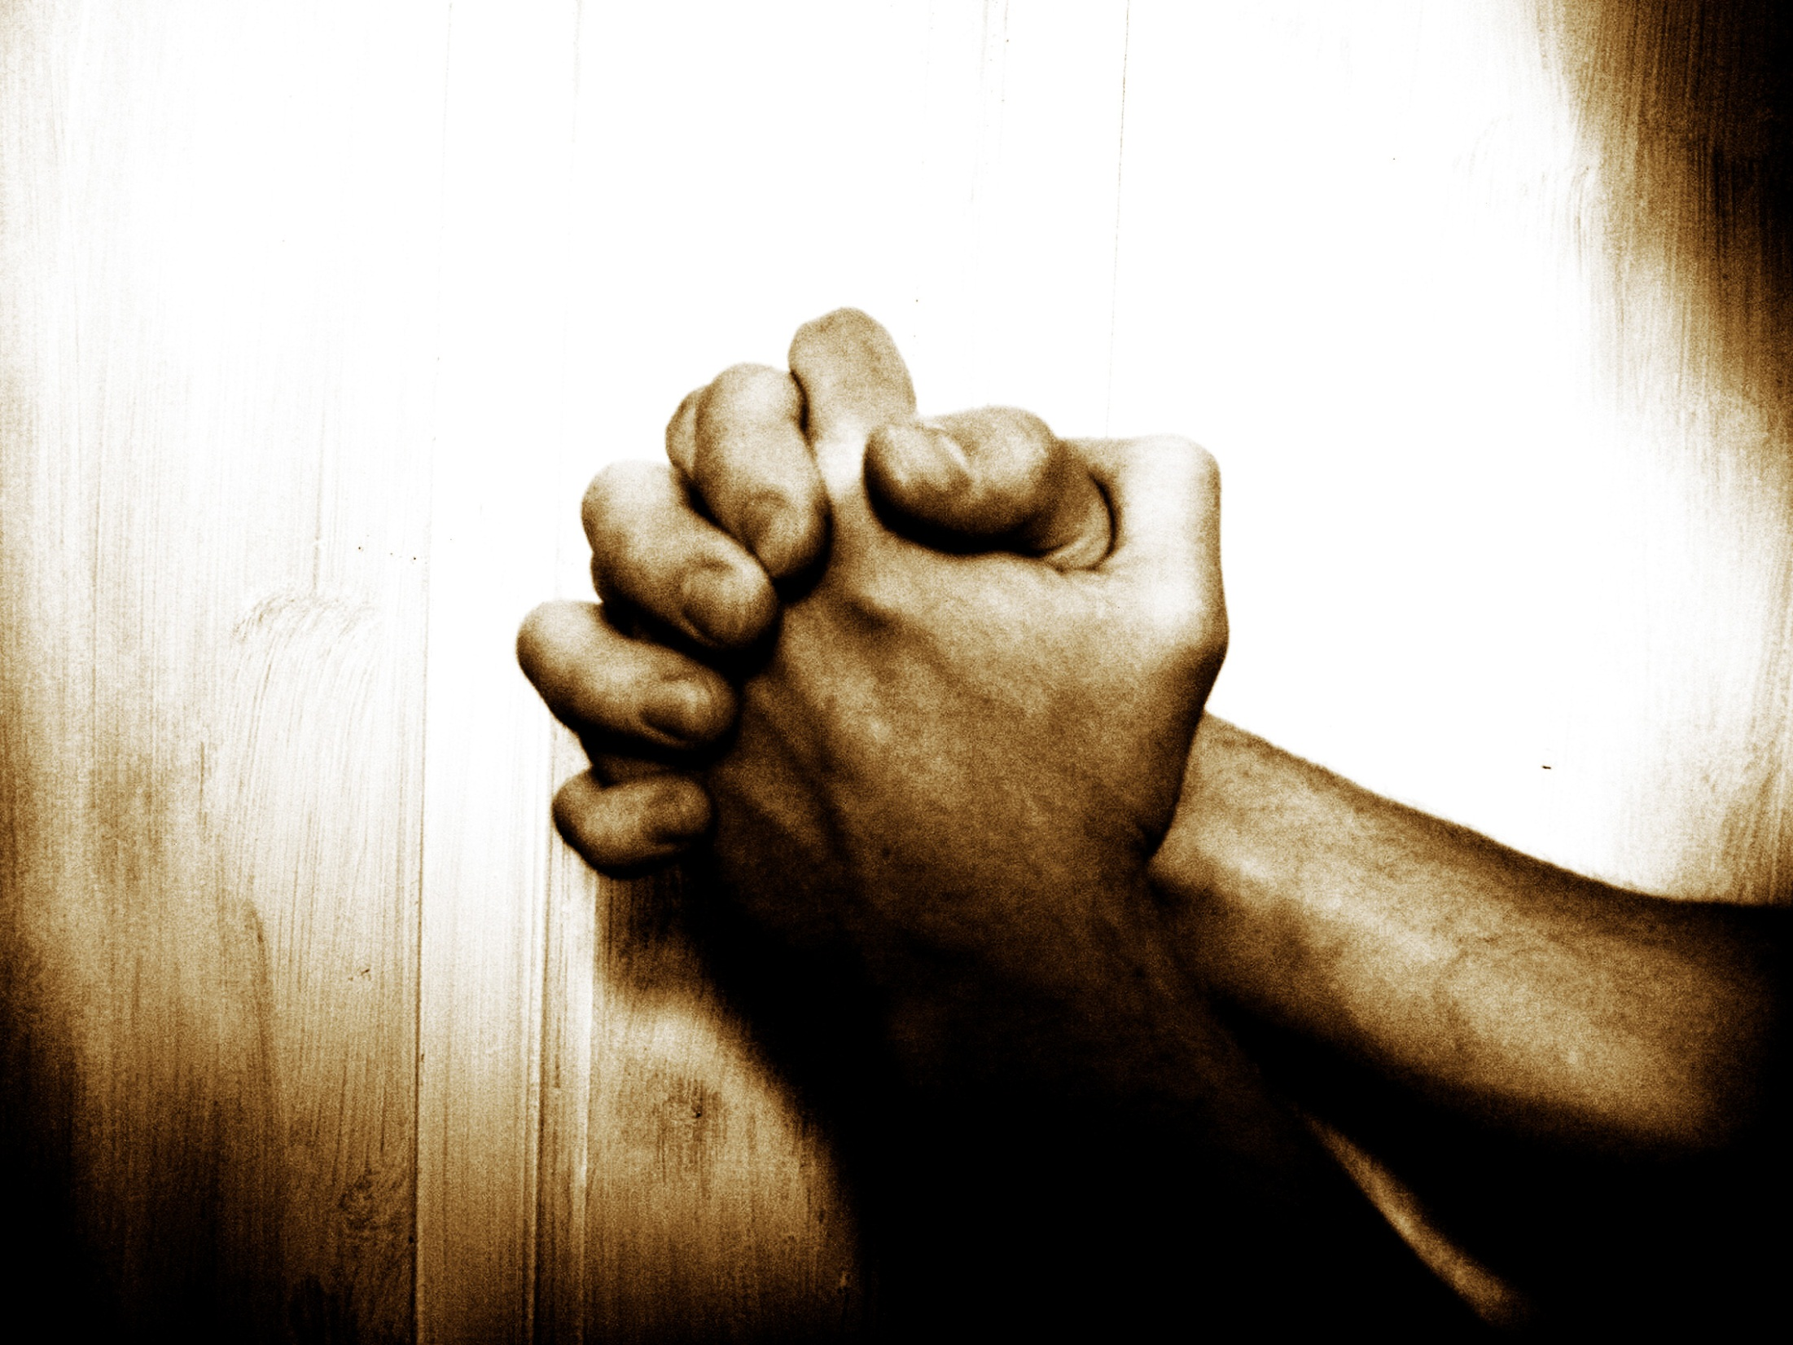

“Our Father”…
… A Prayer Journey
Jan – Mar2014
2 Chron. 7:14
If My people who are called by My name...

Slide 2

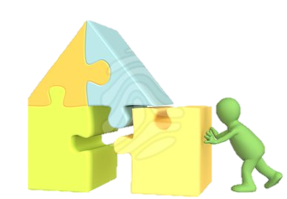

I. Why pray?
II. Foundations for effective prayer
III. Practicing prayer:
7 types: Principles & tools
recap
Part 1 – Intro
Part 2 – Intimacy
Part 3 –
Part 4 –
1 – Call to prayer
2 – Intimacy
3 – Partnership
4 – Role of Prayer
1 – Seeking His Presence by Faith
2 – Tabernacle prayer model
"The main lesson about prayer is just this: Do it! Do it!
Do it! You want to be taught to pray? My answer is
pray and never faint…" John Laidlaw

Slide 3
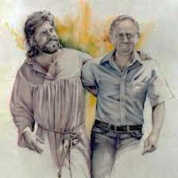
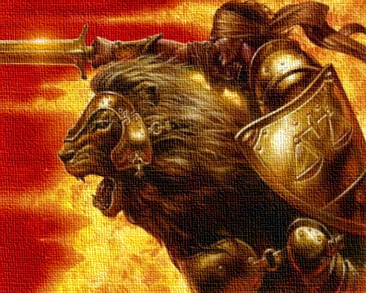
Recap: Weeks 1 - 4
Koinonia = Fellowship = Sharing life = Intimacy + Partnership
The Call: Called to unceasing prayer
Fellowship: Why? Share life with God = Intimacy + p’nrship
Intimacy: God delights in us & wants us to know Him
Partnership: God wants us to share His passions & pursuits. Called to partner in His mission, & develop a missional lifestyle
Prayer: Prayer is central to walking with God! Mystery 1: “The Lord will wait. At the sound of your cry, He will answer”. He wants us to come to Him in prayer
Communion: Mystery 2 : “Whatever we pray according to His will, He will do”. He wants us to unite our hearts with His
Presence first: Presence first, answers second
By faith: Seek His Presence, and grace, by faith
Word: Faith = trust & live by His Word (think, speak, do)
The Tabernacle Model: Tabernacle provides a “spiritual map” of faith steps deeper into His Presence

Slide 4
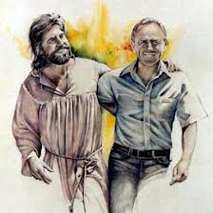

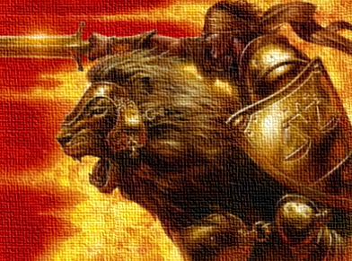
Faith response: 3 paradigms of prayer + time
The Intimacy Paradigm:
The Partnership paradigm:
The Power of
Prayer Paradigm
But be doers of the word, and not hearers only, deceiving yourselves… The one who looks into [the Word] and perseveres, being no hearer who forgets but a doer who acts, he will be blessed in his doing. (Jas 1:22–25)

Slide 5
I. Why pray?
II. Foundations for effective prayer
III. Practicing prayer:
7 types: Principles & tools
recap
"The main lesson about prayer is just this: Do it! Do it!
Do it! You want to be taught to pray? My answer is
pray and never faint…" John Laidlaw

Slide 6
The Tabernacle Prayer Model
Old Covenant:
Physical steps
New Covenant:
Faith steps
"The main lesson about prayer is just this: Do it! Do it!
Do it! You want to be taught to pray? My answer is
pray and never faint…" John Laidlaw

Slide 7
Adoration is faith in the truths that He is, Who He is, & that He calls us to live in worship of Him
1
Station | 1 - Adoration
Biblical truth | I am called to draw & stay near to God, in worship God is. That changes everything! He alone is worthy of my worship. He calls me to draw near & worship Him (Jm 4:8; Jn Ch 4,14, 15)
Obstacles (untruth/ ignorance / unbelief) | Don’t “come” (draw near and worship God) Don’t focus on Him as the “departure point”/ first truth, in all things
Faith step (spirit agreeing with God) | “Come” : 1. Draw near; 2. With Intimacy Paradigm (faith in the call); 3. Through Praise & thanks (natural response of faith to the truths: i. that He is; ii. Who He is; iii. Who He is to me!)
Fruit | Draw near to God, scatter the enemy

Slide 8
Confession is a faith response to what Christ did on the cross about my relationship to sin
2
Station | 2 – Confession
Biblical truth | I can draw near as a son 1. I have been forgiven; 2. …& made “the righteousness of God”; 3. … & a ‘remade’ with the nature of a son of God, truly holy & righteous ; 4. hence I don’t respond to sin, I respond to God (Rom Ch 5-8; 2 Cor 5:17-21; Eph 4:24)
Obstacles (untruth/ ignorance / unbelief) | Believe I am a sinner → act like a sinner/ cling to sin → heart condemns → ashamed to come Don’t forgive → not forgiven (1Jn 3:19-24; Mt 6: 14-15)
Faith step (spirit agreeing with God) | Forgive, be cleansed & come boldly 1. Confess; 2. Repent - sin is death God’s ways are life; I am dead to sin; 3. Forgive; 4. Accept forgiveness; 5. Draw near
Fruit | Love righteous living, power to resist sin, clean conscience, freedom to draw near to God

Slide 9



Consecration
“Our Father”… A Prayer Journey
Week 6 of 8
Session 9 of 13
Jan – Mar 2014
2 Chron. 7:14
If My people who are called by My name...
Notes:
We’re kicking off Week 6, session 9 of your prayer journey, and I trust you’re all doing the real growing at home in quiet time with the Lord. From this session on, in particular, the real growth comes from the time you spend with the Lord in prayer.
How are you all doing on that devoted time in prayer?

Slide 10
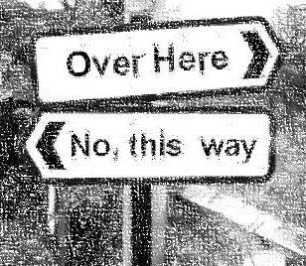
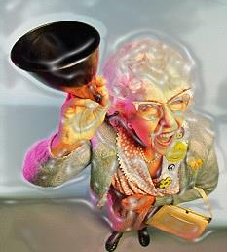
I appeal to you therefore, brothers … to present your bodies as a living sacrifice, holy and acceptable to God, which is your spiritual worship.
Do not be conformed to this world, but be transformed by renewing your mind, that by testing you may discern what is the will of God, what is good and acceptable and perfect. (Ro 12:1–2)
I know the plans I have for you, declares the Lord
(Je 29:11)
1
2
3
    P1. 1) Serving God & 2) walking in our true identity (by faith in the gospel) leads to 3) us being “tuned in” to hear God. I.e. Serving God leads to hearing God
Notes:
So let’s remember from last week that Jesus has given you a new nature. If anyone is in Christ, He is a new creation. The old is gone, behold the new has come. You have been made a new creation. Being born again is a totally supernatural event. When you get born again, it is literal – you really get born a new person. The old person dies. A new one takes residence in the same mind & body. Same memories, same personality, same muscles, skills, job, bank account. Different spirit. You are no longer the same person. You no longer love sin and hate the idea of walking with God because it means you can’t do anything you want to. You are no longer attracted to what God hates so you no longer fear walking with God. Your new nature loves God, and what God loves because you are born of the same DNA as God has. Now there is more to it than that, as we will discuss tonight. But it remains true that the real you loves what God loves, and hates what God hates. That’s who you are. That’s the beauty of being born again. Before you were born again, you were cursed to despising what God loves, and therefore cursed to separation from God, and therefore separated from the fountain of all goodness and life. You were cursed to darkness and misery. Being born again makes you someone who loves what God loves, and pursues goodness and righteousness. As Romans says it makes you a slave to righteousness, it makes delight in obedience to God’s counsel. That’s the real you when you are born again.
So now you really want to do what God wants to do. And His law is love. So you really want to help others. You no longer want to live as a self-centred island, always pursuing your own interests – you know, take care of number 1. That’s not you anymore. You really want to love others, from the heart
But there is a problem
Have you ever tried to help a heroine addict, or someone else living in bondage to a chronic and destructive addiction? So when they ask you for money for food, do you give it to them? There’s a 90% chance that money you give them will be spent on heroine, or giving them money for food enables them to spend other money on heroine without starving. So where’s line between love / and enabling their sin? That’s the problem. It’s not always obvious how best to love.
It’s not always obvious what His will is.
Did you ever wish could just always hear God’s voice?
Tonight we’re going to talk about hearing God’s voice and we get the most powerful insight into how to hear His voice from Romans Ch 12:1-2
[passage]
Did you notice the order? It talks about 3 things, in order: 1) … 2) … 3)…
What it says is that 1) Offering your life to serving God + 2) walking in truth leads to 3) hearing God. When you offer your life to God for Him to use, and commit to walking in the truth, it’s like a portal to heaven opens and suddenly His voice becomes loud and clear so that you are able to discern so clearly what His will is
Tonight we’re going talk about these 3 things

Slide 11
P2. Our 3rd Station on the journey to God's Presence is the Laver…
“Jesus has gone as a forerunner on our behalf, having become a high priest forever”
(Heb 6:20)
Notes:
Remember that we’re on a prayer journey, and the principle of prayer is “Presence first, answers second”. So we’re seeking God’s Presence, in His throneroom.
And Moses’ tabernacle gives us a map into God’s Presence.
We have arrived at the 3rd station of the Tabernacle which was called the Laver, which simply means Basin….

Slide 12
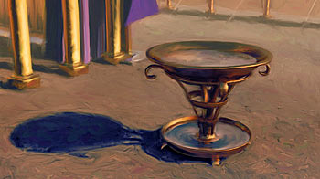
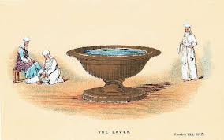
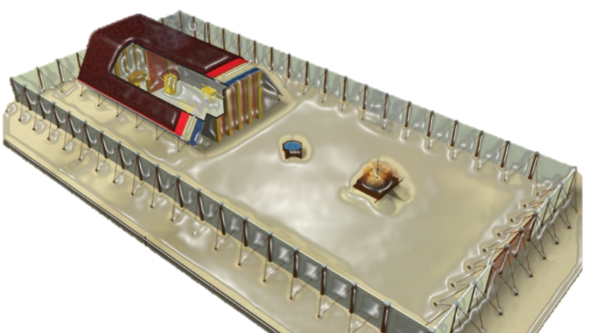

P3 Under the OC, 1) only Priests could enter God's Sanctuary;
2) only the tribe of Levi were priests; 3) they could only enter when on active duty, and 4) only after being cleansed for duty at the Laver (Basin)
You shall put [the Laver] between the tent of meeting and the altar… Aaron and his sons [the Levites, the tribe of priests] shall wash their hands and their feet when they go into the tent of meeting, or when they come near the altar to minister
(Ex 30: 18-20)
Notes:
Now we’re not going to cover the scriptures in detail but it is there in your notes for you to study. What you will learn is 4 principles related to entering the Holy Places.
Under the OC,
only Priests could enter God's Sanctuary;
only the tribe of Levi were priests;
they could only enter when on active duty, and
only after being cleansed for duty at the Laver (Basin)
That means that of the 13 tribes of Israel, only 1 could ever enter the Holy Places to enjoy God’s Presence. And even then, only when on active duty. See, God’s dwelling place, the place of His Presence is a Holy Place and it is reserved for priests, those set apart or called to serve Him.
→ Who can tell me how things are different under the NC?

Slide 13
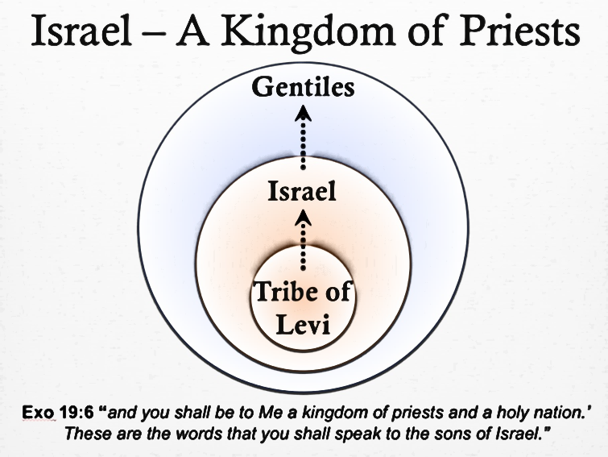

But you [Christ’s followers] are … a royal priesthood (1 Pet 2:9; Rev 1:6)
For we are his workmanship, created in Christ Jesus for good works, which God prepared beforehand (Eph 2:8–10)
[Christ] gave himself for us to … purify for himself a people for his own possession who are zealous for good works. (Tt 2:14)
God… gave us the ministry of reconciliation; (2 Co 5:18)
    P4. Under the NC, all in Christ are adopted into God’s Priestly Family, & called as priests to serve God
Notes:
The key difference is that we are priests. You are a priest. Did you know that you are a priest? It says so right there in 1 Peter, and Revelation Ch 1: you are a royal priesthood. He has made us a kingdom full of priests.
That’s why He gives us the ministry of reconciling men to God. Under the OC, the priests offered sacrifices to God to deal with peoples’ sin and make peace between them and God. Now that’s our job. We bring Christ, the perfect sacrifice, into their life to deal with their sin and make peace between them and God.
We were adopted into a family of priests, all with the privileged calling of ministering to God
[EXCLUDE
What does it mean to be a priest? It means we are ordained, by divine calling, to serve God, by representing God to others, and others to God. We are called to be God’s voice to others.
Under the Old Covenant the 3 most important aspects of the duties of priests were
To offer sacrifices to God on behalf of the people, to make peace between them and God
To take care of God’s house, the temple, making sure everything in God’s house of worship runs smoothly
To minister before God – offering up incense for His pleasure
What do you think that means in the NC?
Bring Christ into their lives to make peace between them and God
To take care of God’s house, the Church, making sure everything is in order
To offer up incense, which is praise and thanksgiving and all kinds of prayer
We are all priests and that is our calling]

Slide 14

P5. Because we are all priests set apart to serve God, we can enter His sanctuary & enjoy His Presence
Since we have confidence to enter the holy places by the blood of Jesus ... let us draw near with a true heart in full assurance of faith, with our hearts sprinkled clean from an evil conscience and our bodies washed with pure water (Heb 10:19–22)
[Jesus] gave himself for us,so that he
might redeem us from all iniquity,
and set apart for himself a special
people zealous for good works
(Titus 2:14)
Notes:
And because we are all priests set apart to serve God, we can enter His sanctuary & enjoy His Presence
Remember only priests can enter. But now, you’re a priest. You have the privilege of entering the very holy places, because you are a priest of God
Hebrews Ch 10 says:….
Now I want you to notice the tabernacle language here
“Hearts sprinkled clean from an evil conscience” – where does sin get dealt with? Right, at the alter
“Bodies washes with pure water” – where do we wash with pure water? Right, at the laver.
And because we have dealt with sin at the alter and been cleansed for priestly duty, we can enter the holy places
Now I want you to notice, this has nothing to do with our works. We don’t get to enter because we do enough works. We get to enter because we are priests who have been called to God’s service. It’s by grace that we have been given this identity of priests. We simply walk in that identity by faith, and because we are walking in that identity by faith, we enter the holy places by faith
Lets look also at Titus 2:14, the NT’s great definition of grace: do you notice again the tabernacle language?
- “Redeem us from all iniquity” – where was the price for our iniquity paid? At the alter
“and set apart a people zealous for good works” – where do we get set apart for God’s service? At the laver
Are you seeing the tabernacle references? Are you seeing how Jesus dealing with our sin, and adopting us into a priestly family, gets us access into the holy places?

Slide 15

But here we find a third obstacle:
James, a servant of… the Lord Jesus Christ, To the twelve tribes …
[who] hold the faith in our Lord
Jesus …
Do you not know that
friendship with the world is enmity
with God? Therefore whoever
wishes to be a friend of the world
makes himself an enemy of God….
Draw near to God, & He will draw
near to you. Cleanse your hands,
you sinners, and purify your hearts,
you double-minded (Jas 4:1–10)
    P6. … an impure heart, which symbolises loving “the world”
Notes:
But here we find a third obstacle:
Remember our friend James? Well he writes, to born again Christians, saying:
Draw near to God, & He will draw near to you. Cleanse your hands, you sinners, and purify your hearts, you double-minded (Jas 4:1–10)
To paraphrase: if you want to be near to God, it’s easy. Just draw near and he’ll draw near to you. But you can’t draw near with dirty hands and an impure heart. You have to first cleanse your hands and purify your heart.
Did you notice the tabernacle imagery again? Where do you deal with sin? At the alter. And where do you purify yourself to prepare to enter God’s presence? At the Laver.
Now, remember he’s speaking to Christians, but to Christians not walking by faith.
The obstacle at the altar was dirty hands, from clinging to sin. Believing we are sinners, and acting like sinners. We dealt with those unclean hands by standing in agreement with what the Word says about us, which is that I am not a sinner, I have been made a new creature, I love what God loves and I hate what God hates. I am dead to sin therefore I don’t respond to sin, I respond to God because I have been made a slave to righteousness in Christ Jesus. So at the altar we took the faith step of committing to walk by faith in the truth of our new righteous nature
The obstacle at the laver is an impure heart, which means clinging to desires and pursuits that are not pure and set apart to God. That’s because the truth is we are priests of Go, set apart to serve God. That’s the truth. And to Christians not walking in faith, James says: guys you have to make a choice. Either you love the world, or you love God. If you love the world, you make yourself an enemy of God because the world is at war with God. You cannot draw near to God, you cannot enter the holy places where God dwells, unless you deal that impure heart. And by purifying the heart, he means stop being a lover of this world. Set your mind to serve God, rather than to live according to the world’s value system of pleasure and comfort.

Slide 16
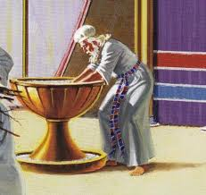

P7. At the Laver, we respond in faith to our new identity in Christ by devoting our lives to serve God
Who I am not
Who I am
Not of this world (Jn 15:19, Jn 17:14-16)
Do not love this world or the things of this world (1. Jn 2:15)
Child of God (fam. business)
Priest of God (Rev 1:6)
Bride of Christ (intimacy + p’nship) (Eph 5:22-23)
Servant of God (Rev 22:6)
God’s army (2 Cor 10; Eph 6)
God’s instrument, created
for good works (Eph 2:10)
Jesus’s hands and feet
Branch, to bare fruit (Jn 15)
Be steadfast, immovable, always abounding in the work of the Lord
(1 Co 15:58)
    Faith says “that’s me – I don’t love this world, I’m partnering with God, always abounding in His works, making disciples of all nations”
Notes:
At this station of prayer, we respond in faith to our new identity in Christ by devoting our lives to serve God
Remember, we don’t have to promote ourselves to being God’s priests, we don’t have to conjure the desire, we don’t have to do anything. We just respond in faith to what Christ has already done.
Remember the only requirement to entering God’s Presence and living in fellowship with Him is faith, and the only obstacle is unbelief. And faith is living by what the Word of God says. And what the Word says about you is that
- You are not of this world
And you do not love this world or the things of this world
That’s not who you are anymore.
You are a new creature and this is who you are:
You are a child of God, born into the family business
You are a priest of God, born into a priestly calling
You are the Bride of Christ, called to walk in intimacy and in partnership with the King of kings
You are a bond servant of God, called to serve Him in love
You are His army, sent to destroy the works of the devil
You are His specially crafted instrument, created for good works He set before you
You are the hands and feet of Jesus, doing the works the heads commands
You are the branch, connected to the true vine of Christ, baring fruit unto God
That is who you are
And faith says “that’s me. I don’t love this world. I’m a priest of God. I’m partnering with God, always abounding in His works, making disciples of all nations, reconciling men to God in Christ Jesus. That;s me and I’m walking in it by the empowering grace of the Almighty.

Slide 17
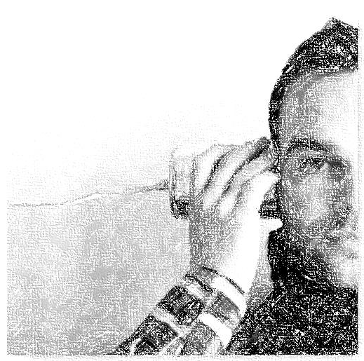
P8. We then actively seek God’s leadership to walk in His plans
I know the plans I have for you, declares the Lord
(Je 29:11)
I appeal to you therefore, brothers … to present your bodies as a living sacrifice, holy and acceptable to God, which is your spiritual worship.
Do not be conformed to this world, but be transformed by renewing your mind, that by testing you may discern what is the will of God, what is good and acceptable and perfect. (Ro 12:1–2)
1
2
3
    When we
    1) by faith, yield life to serve God; and
    2) align life to the Word, not world;
    We then (because we are now “tuned in” to God)
    3) Receive revelation of God’s will
Notes:
Now when we accept that identity in Christ, the very next thing we do is seek to know the will of God because, well, He’s prepared good works that I should walk in them. I better know what they are so I can walk in them!
And because by faith we have committed our lives to serving God, and we are aligning our lives to the Word of God, we are able to discern the will of God. We begin to hear His voice and know His desires and purposes.

Slide 18
Consecration is being a disciple of Jesus: walking in faith that I am a priest of God, & devoting myself to His works
3
Station | 3 - Consecration
Biblical truth | I have been set apart as a priest of God. I am called to devote my life to serving Him I am not of this world (Jn 18:36; Rom 12:2; 1 Jn 2:15) I am adopted into God’s priestly family, sharing Jesus’ ministry of reconciling the world to God (Rev 1:6; 1 Pet 2:9; 2 Cor 5:18; Rom 12:1-2)
Obstacles (untruth/ ignorance / unbelief) | Impure heart / double-minded / half in the Kingdom, half in the world (Jas 4:1–10; 1 Jn 2:15-16)
Faith step (spirit agreeing with God) | LIFE: Be a disciple of Jesus: live out priestly identity in Christ by being devoted to good works for God Deny self; 2. Take up cross; 3. “Follow Jesus” – share His mission; (1 Cor 15:58; Tit 2:11-14; Mt 6:25-33, Mt 10:38-39, Mark 8:34) PRAYER: 1. Commitment, 2. Devotion, 3. Listening
Fruit | Hear His voice, know His will, &… (next session)

Slide 19


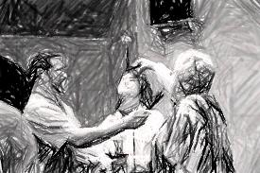
HOW Part 1: 3 practical applications
1
After beginning the day with Adoration, spend time devoting your life, day & efforts to the Lord. Pray for leadership to fulfil His plans
2
At every opportunity in the day, take a few seconds to devote yourself to serve Him as an expression of love for Him, and ask for His leadership to do His will
3
Before any time of ministry, remind Him (and you) that you are His servant, for Him to fulfil His plans through you, & you depend on His leadership to do His will

Slide 20
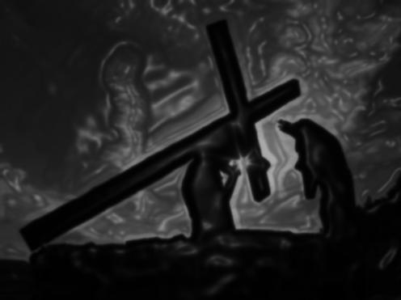
HOW Part 2: Process
Consecration Prayer Guide (1/2)
Prayers of commitment and devotion to the Lord
Pray prayers of commitment, from a sincere heart
  Commit to the Lord, without reservation, to live in His service, to learn and do His will, and fulfil the assignments He has given you (Eph 2:8-10)
  Commit to devote yourself to support the broader Body of Christ
  in fulfilling the Great Commission (Mt 28:18-20)
Pray prayers of devotion, from a sincere heart
  Acknowledge that all you possess really belongs to Him and is
  under your stewardship on His behalf so that through you Father
  will further His mission on the earth
  Commit the time, resources, assets, etc that the Lord has placed under your stewardship to be used as He pleases. Be specific
  where you feel led to be

Slide 21
HOW Part 2: Process
Consecration Prayer Guide (2/2)
Prayers for leadership
Seek His leadership in pursuing His will for your life
  First, THANK Him that He delights in leading you by His Spirit so that you will fulfil His plans (Eph 2:10; Prov 16:3; Jn 14:15-26)
  Ask the Lord to release passions, desires and burdens in your heart that will reveal your role in fulfilling the great commission and supporting the Body of Christ
  Ask the Lord to reveal people, ministries or organisations He wants you to support or serve
  Ask the Lord to bring across your path those needs which He has called you to meet
  Ask the Lord to reveal the gifts, resources etc which you can use more fruitfully for His purposes
  In all this, listen attentively for the Spirit’s leading as He moves your heart in the direction He wants you to go
  After prayer, be faithful to do what the Lord requests of you. Record His guidance and translate into action

Slide 22
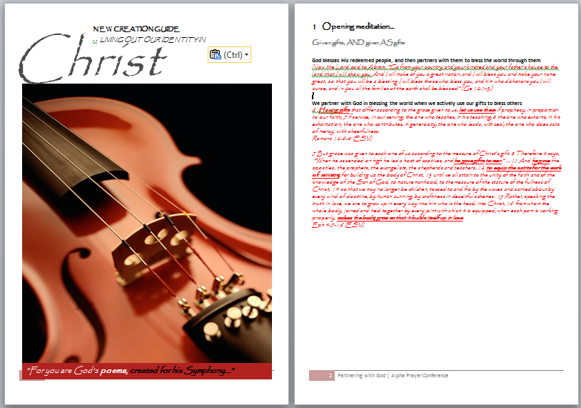
HOW Part 3: Tools
T1. New Creation meditation & prayer guide
If you desire to enter deeper into your true identity in Christ, consider using this guide to deepen your understanding of, and experience of, your identity in Christ
Booklet is part of handout notes

Slide 23
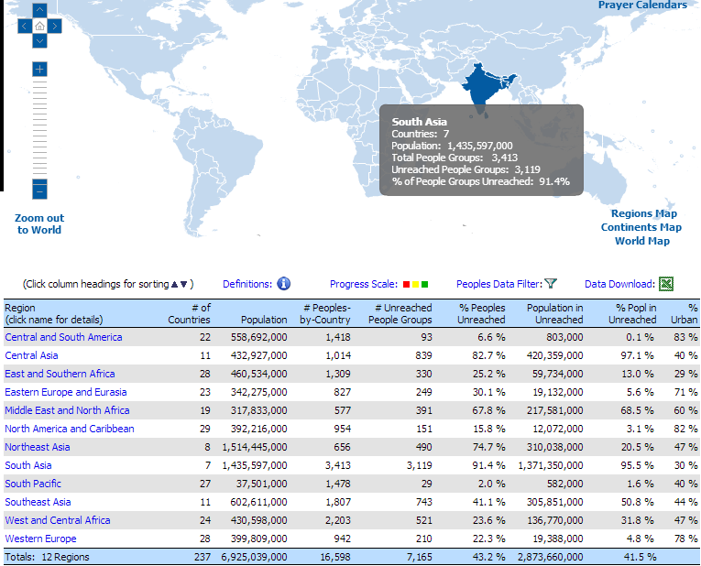
HOW Part 3: Tools
T2. The Great Commission: Status Update
Go to www.joshuaproject.net
Meditate on the statistics. Consider how many people have never had the chance to hear the gospel of Jesus Christ, or be reconciled to God, and are stuck in sin and darkness. Ask Father where and how He wants to use you.
Source: The Joshua Project | http://www.joshuaproject.net/global-regions.php

Slide 24
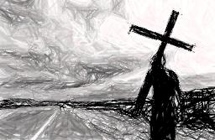
Exercise
If you want to offer yourself fully as a living sacrifice to God, to do whatever He calls you to – whether just what you do today or something totally new - without any reservation, to use all your energy, resources, and time to serve God in His mission of reconciling the world to Himself through Jesus, walking in the works He has set apart for you (Eph 2:10)…
  ...Wash your hands at the Basin/ Laver in the Tabernacle as a prophetic act – “I am set apart to God”
  Pray prayers of commitment, devotion, and pray for guidance
  Repeat these prayers for the next 40 days (with fasting if you feel so led)

Slide 25
Edification
“Our Father”… A Prayer Journey
Week 6 of 8
Session 10 of 13
Jan – Mar 2014
2 Chron. 7:14
If My people who are called by My name...

Slide 26
When [Jesus] had entered Capernaum, a centurion came forward to him, appealing to him, “Lord, my servant is lying paralyzed at home, suffering terribly.” And he said to him, “I will come and heal him.” But the centurion replied, “Lord, I am not worthy to have you come under my roof, but only say the word, and my servant will be healed. For I too am a man under authority, with soldiers under me. And I say to one, ‘Go,’ and he goes, and to another, ‘Come,’ and he comes, and to my servant, ‘Do this,’ and he does it.” When Jesus heard this, he marveled and said to those who followed him, “Truly, I tell you, with no one in Israel have I found such faith… “Go; let it be done for you as you have believed.” And the servant was healed at that very moment. (Mt 8:5–13)
    P1. When we serve Authority, we receive authority

Slide 27
Our 4th Station on the journey to God's Presence is the Candlestick, representing the Spirit of Christ
“I am the light of the world.”
(John 8:12)

Slide 28
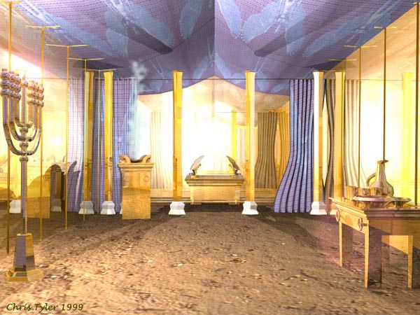
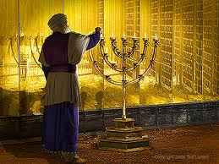
For those who wash their hands at the Laver, we now enter “The Holy Places” – the inner chambers of God…

Slide 29


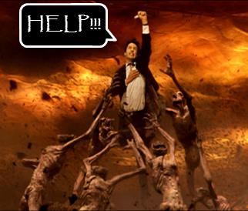
What are some of the possible ways to respond to the call on our lives as God’s priests?
…
Works legalism
  Take on heavy yoke of living up to an impossible standard of holiness
  Result: guilt, shame, defeat
Avoidance legalism
  Avoid facing our radical call (e.g. Rom 12:1-2): not possible God could expect it because I am too weak (i.e. call of God depends on my ability)
  Result: live in conflict with Word, powerless faith
Faith!

Slide 30
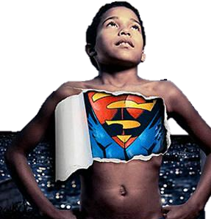
Greater is
than he who is in the world.
(1 Jn 4:4)
To [the saints] God chose to make known how great among the Gentiles are the riches of the glory of this mystery, which is Christ in you, the hope of glory. (Col 1:27)
Greater is He in you than he who is in the world. (1 Jn 4:4)
It is no longer I who live, but
Christ who lives in me. And the life I now live in the flesh I live by faith in the Son of God (Ga 2:19–21)
He in you
    P2. The epicenter of our faith is the mystery of Christ dwelling in us: His Life as our power for godly living

Slide 31
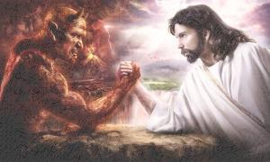
    P2. The problem is…
Put off your old self, which belongs to your former manner of life and is corrupt through deceitful desires, … put on the new self, created after the likeness of God (Eph 4:22–24)
    … there are 2 natures within us – old self and new self (inward man, & carnal nature; or spirit & flesh)

Slide 32

    P3. The flesh nature (old man) opposes the spirit (new man) and fellowship with God
For the mind that is set on the flesh is hostile to God, for it does not submit to God’s law; indeed, it cannot. Those who are in the flesh cannot please God. (Ro 8:7–8)
walk by the Spirit, and you will not gratify the desires of the flesh. For the desires of the flesh are against the Spirit, and the desires of the Spirit are against the flesh, for these are opposed to each other, to keep you from doing the things you want to do. (Gal 5:16–17)

Slide 33
    P4. The obstacle of unbelief is…
Put off your old self, which belongs to your former manner of life and is corrupt through deceitful desires, … put on the new self, created after the likeness of God (Eph 4:22–24)
    … not putting on the “new self”, continuing to live as the “old self” who loves self, sin and the world

Slide 34
    P5. At the candlestick, we walk by faith in Christ within:
Greater is
than he who is in the world.
(1 Jn 4:4)
He in you
Put off your old self, which belongs to your former manner of life and is corrupt through deceitful desires, … put on the new self, created after the likeness of God (Eph 4:22–24)
But put on the Lord Jesus Christ, and make no provision for the flesh, to gratify its desires (Ro 13:14)
… it is God who works in you, both to will and to work for his good pleasure. (Php 2:12–13)
    We commit to overcoming the world and the flesh by “putting on” the might of Christ

Slide 35
P6. The first way we do this is to ask for the Baptism of the Holy Spirit, which is Power from on High to fulfill our calling
1
2
3
4
a
Jesus told us not to pursue our calling without receiving Power from on High – the Baptism of the Spirit
And while staying with them he ordered them not to depart from Jerusalem, but to wait for the promise of the Father, which, he said, “… you will be baptized with the Holy Spirit not many days from now… you will receive power when the Holy Spirit has come upon you, and then you will be my witnesses in Jerusalem and in all Judea and Samaria, and to the end of the earth.” (Ac 1:8 – cf. Lk 24:46–49)

Slide 36
P6. The first way we do this is to ask for the Baptism of the Holy Spirit, which is Power from on High to fulfill our calling
b
This Baptism in the Spirit comes as a separate experience, after salvation, for those who ask
But to all who did receive him, who believed in his name, he gave the right to become children of God, who were born, not of blood nor of the will of the flesh nor of the will of man, but of God. (Jn 1:12–13)
What father among you, if his son asks for a fish, will instead of a fish give him a serpent; or if he asks for an egg, will give him a scorpion? If you then, who are evil, know how to give good gifts to your children, how much more will the heavenly Father give the Holy Spirit to those who ask him!” (Lk 11:1–13)

Slide 37
P6. The first way we do this is to ask for the Baptism of the Holy Spirit, which is Power from on High to fulfill our calling
b
This Baptism in the Spirit comes as a separate experience, after salvation, for those who ask
Paul passed through the inland country and came to Ephesus. There he found some disciples. And he said to them, “Did you receive the Holy Spirit when you believed?” And they said, “No”… And he said, “Into what then were you baptized?” They said, “Into John’s baptism.” And Paul said, “John baptized with the baptism of repentance, telling the people to believe in the one who was to come after him, that is, Jesus.” On hearing this, they were baptized in the name of the Lord Jesus. And when Paul had laid his hands on them, the Holy Spirit came on them, and they began speaking in tongues and prophesying. (Ac 19:1–6)

Slide 38
P6. The first way we do this is to ask for the Baptism of the Holy Spirit, which is Power from on High to fulfill our calling
c
This Baptism is for ALL
And Peter said to them, “Repent and be baptized every one of you in the name of Jesus Christ for the forgiveness of your sins, and you will receive the gift of the Holy Spirit. For the promise is for you and for your children and for all who are far off, everyone whom the Lord our God calls to himself” (Ac 2:38–39)

Slide 39
P6. The first way we do this is to ask for the Baptism of the Holy Spirit, which is Power from on High to fulfill our calling
d
We receive this Baptism when we yield our lives to serve God and ask for His Power to serve Him
Repent (turn from sins – literally change mind about sin, i.e. a self-centred life) [Acts 2:28-29, Isaiah 53:6]
Be baptized in the name of Jesus – come under His Lordship, literally, make His will your will, and live to obey Him [Acts 2:28-29]
Thirst for righteousness - desire above all to live a life that is fully pleasing to the Lord in every way (not to earn salvation or His love, but by faith to express your love for the Lord) [Jn 7:37]
Come to Jesus – to receive His provision, the promised living waters [Jn 7:37]
Ask for the Outpoured Holy Spirit [Luke 11: 1-13]

Slide 40
P7. The second way…
Greater is
than he who is in the world.
(1 Jn 4:4)
1
2
3
He in you
4
For this reason I [pray], …that … He may grant you to be strengthened with power through his Spirit in your inward man,
so that Christ may dwell in your hearts through faith — so that you, being rooted and grounded in love, may have strength to comprehend with all the saints what is the breadth and length and height and depth, and to know the love of Christ that surpasses knowledge, that you may be filled with all the fullness of God. (Eph 3:14–19)
    … is we strengthen our capacity to draw on the might of Christ by strengthening our “inward man”, through prayer

Slide 41
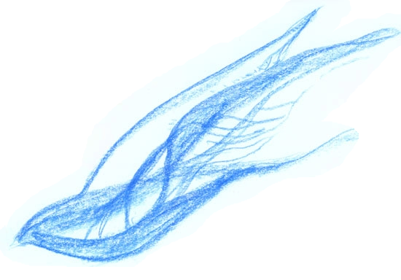
P8. The third way we do this is by strengthening the inward man by praying in tongues
1
2
3
4
The one who speaks in tongues edifies himself [builds himself up] (1 Co 14:4)

Slide 42
P9. The fourth way we strengthen the inward man is by fasting, to train ourselves to deny carnal urges (amongst other goals)
1
2
3
4
Set your minds on things that are above, not on things that are on earth. For you have died, and your life is hidden with Christ in God…Put to death therefore what is earthly in you, [all kinds of sin] … On account of these the wrath of God is coming. In these you too once walked, when you were living in them. But now you must put them all away… seeing that you have put off the old self with its practices and have put on the new self, which is being renewed in knowledge after the image of its creator… Put on then… compassionate hearts, kindness, humility, meekness, and patience… and above all these put on love… and let the peace of Christ rule in your hearts
(Col 3:1–15)

Slide 43
Edification is strengthening our spirit man, hence trusting in the might of Christ within, hence overcoming ‘the world’
4
Station | 4 - Edification
Biblical truth | I am an overcomer of this world – by Christ in me, the power of a victorious life (Col 1: 27; Jn 14-15; 1 Jn 4:4,16; Phil 2:12-13; Tit 2:11-14; Rev 21:7-8)
Obstacles (untruth/ ignorance / unbelief) | Walking in the flesh nature / old man / having a mind conformed to the ways of this world : selfish, self-seeking, deceiving, uncaring, etc (Gal 5:16-24; Rom 8:1-11; Gal 6:8, Col 3:5-9)
Faith step (spirit agreeing with God) | PRAYER: 1) for baptism of the Spirit 2) to strengthen the spirit man & be more filled with Christ (Eph 3:14-19;); 3) pray in tongues 1 Cor 14:4); 4) Fast LIFE: “Put on new self”, set mind on God’s priorities, abandon sinful habits, live in the Spirit & hence by Christ within. Hence overcome world & fleshly desires (Rom 8:1-11; Gal5:16-25, Col 3:1-15)
Fruit | Power from on High. Strong in the spirit, by Christ within. Overcome worldly temptations. Fruit of Spirit

Slide 44
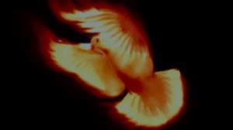
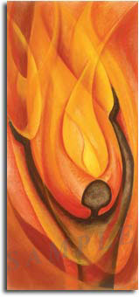
Edification – Summary of principles
    The epicenter of our faith is the mystery of Christ dwelling in us: His Life as our power for godly living
    Problem: 2 natures (spirit & flesh)
    The flesh opposes the spirit & fellowship with God
    The obstacle of unbelief is not putting on the “new self”, continuing to live as the “old self” who loves self, sin & the world
    Walking in faith is overcoming the world and the flesh by “putting on” the might of Christ
    At the candlestick, we strengthen our capacity to draw on the might of Christ by strengthening our “inward man”, through prayer for this strengthening and by praying in tongues

Slide 45

HOW Part 1:
3 practical applications
1
As part of your morning prayers, after consecrating your life to God, pray Eph 3:14-19 for yourself, church leadership worldwide, & loved ones in Christ
2
Whenever you sense yourself not flowing in the fruits of the spirit: 1) stop; 2) breath; 3) repent; 4) pray Eph 3:14-19
3
Before any time of ministry, after consecrating yourself to God, pray Eph 3:14-19

Slide 46
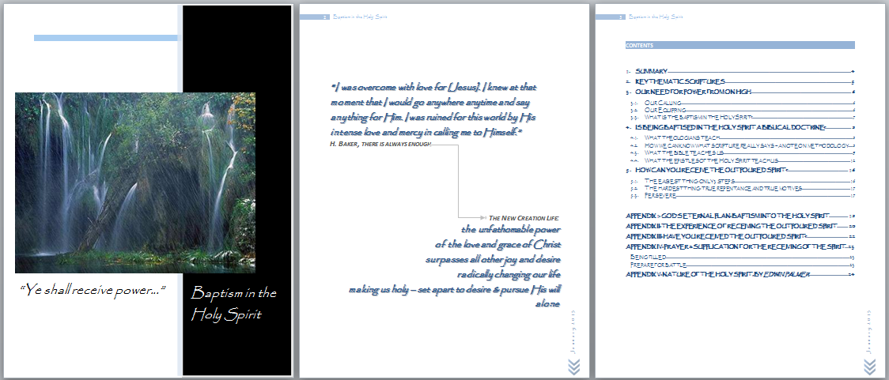
HOW Part 2: Tools
T1. Teaching on the Baptism in the Holy Spirit
If you are not convicted of the promise of the Baptism in the Holy Spirit for all believers today, consider reading this booklet which provides a detailed biblical argument for the doctrine
Booklet available for download
https://dl.dropboxusercontent.com/u/19075674/CONSECRATION%20T1.pdf

Slide 47
HOW Part 2: Tools
T2: F-E-L-L-O-W-S-H-I-P Prayer
F - Fear of God - Ps 86:11
E - Endurance - Col 1:9-11
L - Love - Eph 3:14-21
L - Light of glory - Ex 33:18
O - One thing - Ps 27:1-4
W - Worthy - Ps 51:10; Eph 4:1-3
S - Speech - Ps 19:14
H - Humility - Mt 11:28-30
I - Insight unto intimacy - Eph 1:14-21
P - Peace - Jn 14:23; Ph 4:6-7
Source: Mike Bickle, IHOP-KC

