Slide 1
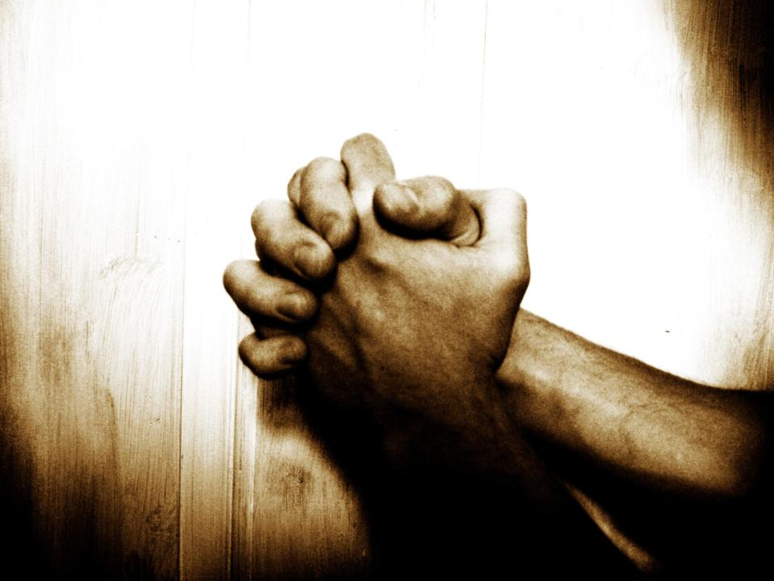
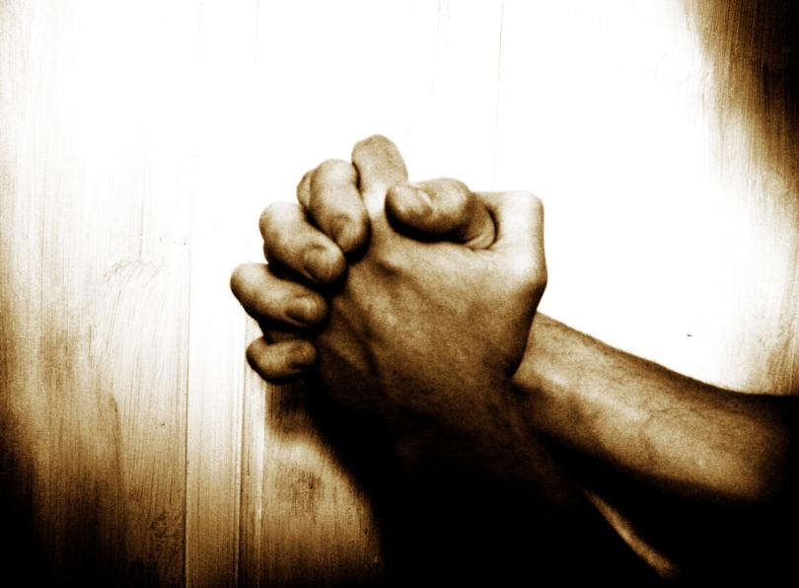

Confession
“Our Father”… A Prayer Journey
Session 4
How to pray, Part 2
Nov 2013
2 Chron. 7:14
If My people who are called by My name...
Notes:
We have now laid the foundation by revealing Father’s deep desire for intimacy and for partnership with His children. The next few sessions will unpack some of the principles of experiencing spiritual intimacy with the Living God in a practical and experiential way.

Slide 2
P1. Our 2nd Station on the way into God's Presence is the Bronze Altar of sacrifice…
“Behold, the Lamb of God, who takes away the sin of the world!
(Jn 1:29).

Slide 3
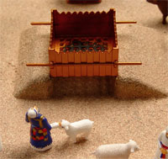
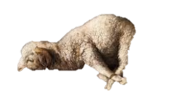
P1. … Under the OC, the altar was where sacrifices were made to atone for our sins
(their life was taken, as a substitute for ours)
For the wages of sin is death (Ro 6:23)
“For the life of a creature is in the blood, and I have given it to you to make atonement for yourselves on the altar; it is the blood that makes atonement for one's life.” (Lev 17:11)
"The law requires that nearly everything
be cleansed with blood, and without the
shedding of blood there is no
forgiveness.” (Hebrews 9:22)
“He is to lay his hand on the head of the
burnt offering, and it will be accepted on
his behalf to make atonement for him.” (Leviticus 1:4)

Slide 4
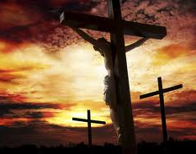
P2. The OC Altar symbolised the true Altar - the Cross of Jesus. Jesus is our once-for-all sacrifice, Who’s death atoned for all our sins
“Behold, the Lamb of God, who takes away the sin of the world! (Jn1:29)
“you were redeemed … with the precious blood of Christ, a lamb without blemish” (1 Peter 1:18-19)
“We have been cleansed through the sacrifice of the body of Jesus Christ once for all. (Hebrews 10:10, 14, 18)
Notes:
…
Do you think when Jesus died for your sins, He died only for the sins you commit UNTIL you are a born again believer?
Do you think He died only for your sins until you are spiritually mature enough that you should know better and not sin any more?
what percentage of your sins did Jesus die for?
Ok, past, present, or future?
Hallelujah!

Slide 5
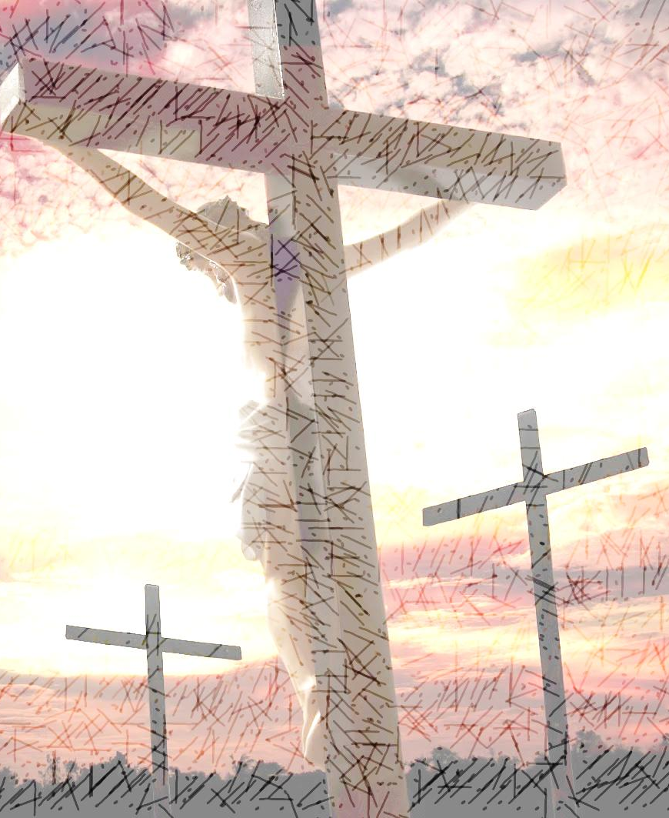
P3. We are called to enter Father’s Presence boldly, since through Jesus’s sacrifice there is now no condemnation. We are guiltless in Him
He made Him who knew no sin to be sin for us; that we might be made the righteousness of God in him. (2 Co 5:21)
There is therefore [because of Christ’s atoning death on our behalf, and our being considered sinless and fully obedient through faith in Him] now no condemnation for those who are in Christ Jesus (Rom 8:1)
Who shall bring any charge against God’s elect? It is God who justifies. Who is to condemn? Christ Jesus is the one who died… who indeed is interceding for us. Who shall separate us from the love of Christ? (Ro 8:33–35)
Having… boldness to enter the holiest by the blood of Jesus … Let us draw near… in full assurance of faith (He 10:19–22)
“There is therefore” – what does that mean?
Expand with 3 aspects of what He has done i.r.t. sin, from Rom Ch 5 - 8
Forgiven
Killed – dead to sin
Regenerated - nature of sons
Highlight the faith response
“wish you would read bible so we can have sensible conversation”

Slide 6
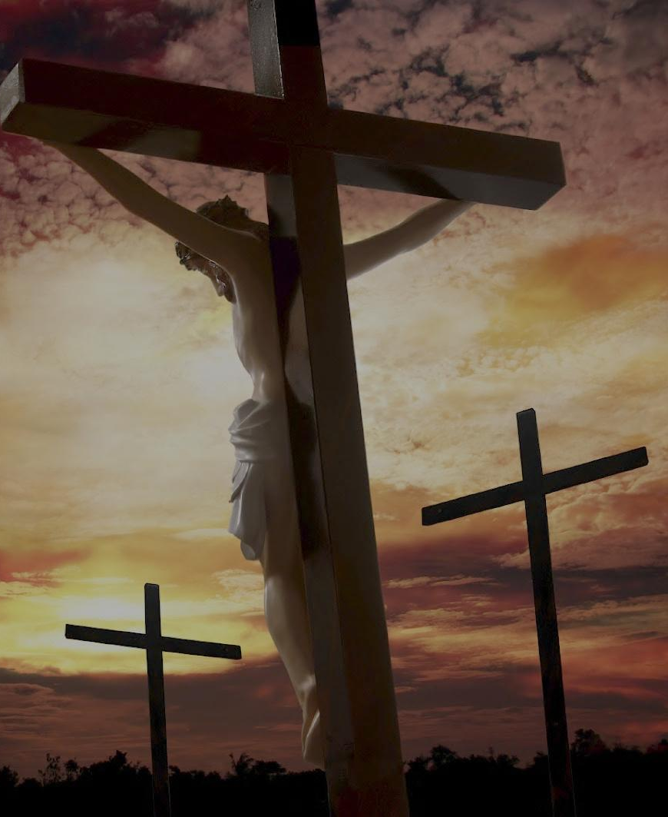
P4. However, unbelief presents a second obstacle: A guilty conscience, which will always stop us from coming before God boldly
Who shall ascend the hill of the Lord? And who shall stand in his holy place?
He who has clean hands and a pure heart… (Ps 24:3–6)
James, a servant of… the Lord Jesus Christ, To the twelve tribes … [who] hold the faith in our Lord Jesus (Jm1:1; 2:1) Draw near to God, and he will draw near to you…
Cleanse your hands, you sinners, and purify your hearts, you double-minded. (Jas 4:8)
Beloved, if [our heart does not condemn us], → [we have confidence before God; and whatever we ask we receive from him], ← because [we keep his commandments and do what pleases him] (1 Jn 3:21-22)
Notes:
There are 2 wrong attitudes towards sin:
Sin is a problem
Sin is not a problem
Sin is a problem, because sin is at war with God and His holy nature. Sin offends God. And sin does separate us from God’s presence
BUT – ALL your sin has been dealt with already on the cross.
We cannot take away EITHER of these truths. If we take away EITHER ONE, BOTH of which are CLEAR in the NEW TESTAMENT, then we lost the plot. The bible tells us BOTH that we are ALREADY CLEANSED by Jesus, AND that we must GET CLEANSED if we are not clean

Slide 7
P5. At the Cross, Jesus waits to cleanse us….
God is light, and in him is no darkness at all. If we say we have fellowship with him while we walk in darkness, we lie and do not practice the truth. But if [we walk in the light, as he is in the light] → [we have fellowship with one another, and the blood of Jesus his Son cleanses us from all sin]
If [we confess our sins], → [he is faithful & just to forgive us our sins and to cleanse us from all unrighteousness]
(1 Jn 1:5-9)
For if [you forgive others their trespasses], → [your heavenly Father will also forgive you], but if you do not forgive others their trespasses, neither will your Father forgive your trespasses. (Mt 6:14–15)
    …when we: 1) repent of sin (return to walking in the light); and 2) forgive others (which is also repenting of sin)
7

Slide 8
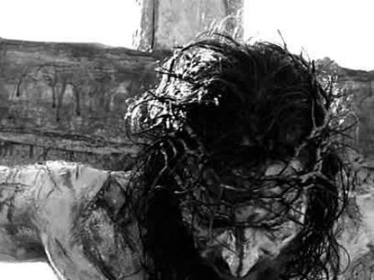
P6. He is faithful to fully forgive every sin; therefore, we seal this cleansing experience through further thanksgiving
But thou art a God ready to pardon (Neh 9:17)
If we confess our sins,
he is faithful and just to forgive us our sins and to cleanse us from all unrighteousness. (1 Jn 1:9)

Slide 9
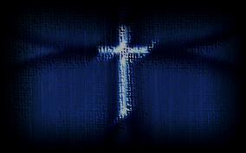
Confession – Summary of principles
P1. Our 2nd Station on the way into God's Presence is the Altar. Under the OC, the altar was where sacrifices were made to atone for sins, and seek fellowship with God
P2. The OC Altar symbolised the true Altar - the Cross of Jesus. Jesus is our once-for-all sacrifice, who’s death atoned for all our sins, and reconciled us to God
P3. We are called to enter Father’s Presence boldly, since through Jesus’s sacrifice there is now no condemnation. We are righteous in Him
P4. However, the flesh presents a second obstacle: A guilty conscience for unconfessed, unrepented sins
P5. At the Cross Jesus waits to cleanse us when we: 1) forgive others, and 2) confess & repent of sin
P6. He is faithful to fully forgive every sin; therefore, we seal this cleansing experience through further thanksgiving

Slide 10

T1. The Altar Prayer Guide (1/2)
1. Preparation
Begin in a spirit of sonship and faith. Delight in dealing with sin. Remember:
  The Lord only chastises those He loves.
  The Lord loves you too much to leave you in bondage to darkness – He is committed to His sons walking in His marvelous freedom and light
  Your sins have already been dealt with on the cross
2. Prayers of Forgiveness
Ask the Holy Spirit to search your heart & reveal any unforgiveness
When feeling convicted of any unforgiveness:
  Confess not forgiving as a sin before Father
  If having trouble wanting to forgive, read Mt Ch 6:9-15,
  & Mt 18:21-35 & thank the Lord for forgiving your sins
  Declare (to Father before all the heavenly witnesses)
  that you choose to fully forgive your offender
  Bless your offender. Pray for their blessing
  Commit to Father to respond in love to your offender
  Command your soul to align with the Word of God, &
  release all feelings of bitterness & resentment, in Jesus’ name

Slide 11
T1. The Altar Prayer Guide (2/2)
3. Prayers of Confession & Repentance
Ask the Holy Spirit to search your heart and reveal any sins
Spend time “listening” for conviction – the Holy Spirit will reveal any areas where the Lord is not pleased.
When feeling convicted of any particular sin
  Confess
  Renounce sin
  Commit to stop
  Thank the Lord for His forgiveness
  Ask Him to show you how He wants you to
  respond to similar temptations as a son of God
  Thank the Lord for His New Covenant promises.
  Remember Phil 2:12-13
  Commit to respond as He has shown you, by the power of His
  Spirit
  If still convicted, ask the Lord to reveal any lack in repentance & repeat above
  Praise God, proclaim “I am forgiven in Jesus name”, quoting 1 John 1:9

Slide 12
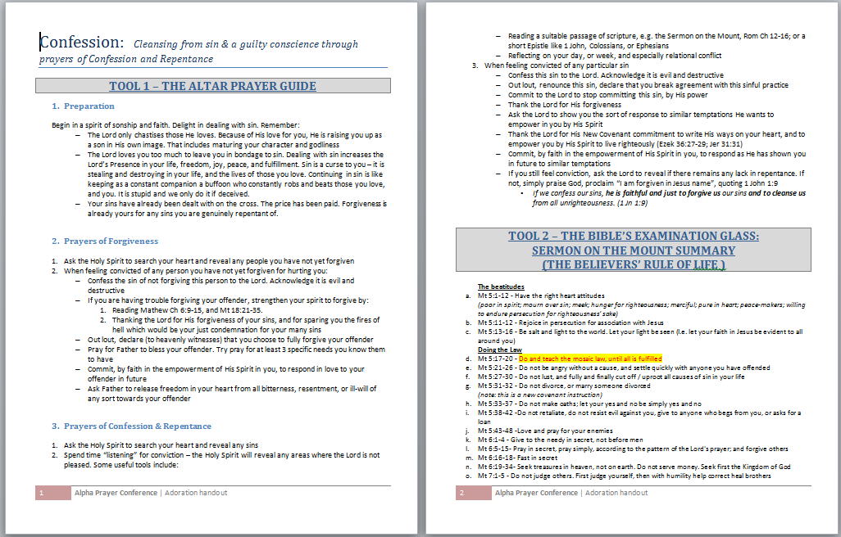
T2. The Bible’s Examination glass: Sermon on the Mount Summary – the believers’ rule of life
Booklet included in digital resources

Slide 13
Confession – Summary of Tools
T1. The Altar Prayer Guide - a guide for prayer at the Altar prayer station
T2. The Bible’s Examination glass: Sermon on the Mount in summary – the believers’ rule of life

Slide 14
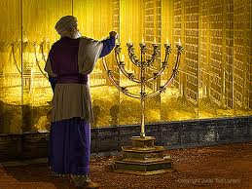
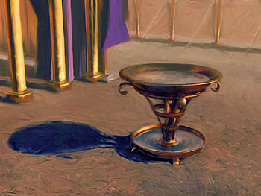
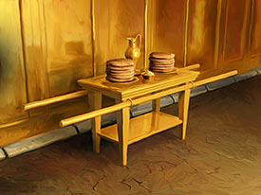
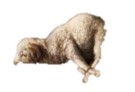
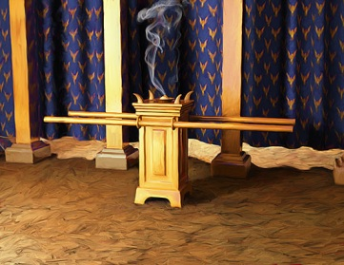
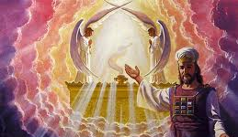
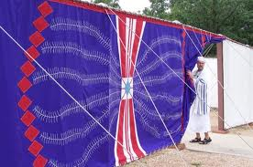
T1. The Tabernacle prayer model (1/3)
Candlestick
Edification
4
3
Laver / Basin
Consecration
5
2
Shewbread
Meditation
Altar
Confession
Altar of Incense
Petition
7
6
1
Gate
Adoration
Ark / Throne
Soaking In His Presence

Slide 15
T1. The Tabernacle prayer model (2/3)
Stn | Biblical truths | Obstacles (untruth/ ignorance / unbelief) | Faith steps (spirit agreeing with God) | Tabernacle “Prayer Station”
1 | I am called to come (draw & stay near to God, in worship) | Don’t “come” / draw & stay near to God, in worship | “Come” – Devoted time, Intimacy Paradigm, Praise & thanks | Adoration (praise, thanksgiving, worship)
2 | I can draw near as a son | Cling to sin → ashamed to come (1Jn 3:19-24) Don’t forgive → not forgiven | Forgive, turn from sin, be cleansed & come boldly | Confession (forgiveness, confession, repentance)
3 | I must come as a priest | Impure heart / double-minded / self-centered life | Accept & live out priestly identity in Christ | Consecration (commitment, devotion)
4 | I must come as an overcomer of this world – by Christ in me | Flesh nature / worldly outlook | Live in the spirit | Edification (strengthen, build up)
5 | I am “born of the Word”- it describes my new nature. As I walk in it, God’s grace is manifest | Ignorance of, despising, or not believing the Word | Be transformed by renewing mind | Meditation (seek revelation of Word, to align life)
6 | As I do, I learn His heart. When I pray His heart, I receive answers | Don’t seek His will Don’t ask in faith Don’t receive by faith | Ask & receive | Petition (make requests, for self & others)
7 | His love is better than life; joy & pleasure are found in His Presence | Don’t seek His face | Seek His manifest Presence | Soaking (bask in His Presence, enjoy His glory & love)

Slide 16
T1. The Tabernacle prayer model (3/3)
Stn | Biblical truths | Obstacle (untruth/ ignorance / unbelief) | Faith steps (spirit agreeing with God) | Tabernacle “Prayer Station”
1 | I am called to draw & stay near to God, in worship God is. He alone is worthy of my worship. He calls me to draw near & worship Him (Jm 4:8; Jn Ch 4,14-15) | Don’t “come” to draw near to and worship God | “Come” 1. Draw near; 2. with Intimacy Paradigm; 3. through Praise & thanks | Adoration (praise, thanksgiving, worship)
2 | I can draw near as a son I am dead to sin & forgiven and adopted in Christ (Rom Ch 5-8) | Cling to sin → heart condemns → ashamed to come (1Jn 3:19-24) Don’t forgive → not forgiven | Forgive, be cleansed & come boldly 1. Confess; 2. Repent - sin is death God’s ways are life; I am dead to sin; 3. Forgive; 4. Accept forgiveness; 5. Draw near | Confession (forgiveness, confession, repentance)
3 | I have been set apart as a priest I am adopted into God’s priestly family, sharing Jesus’ ministry of reconciling the world to God (Rev 1:6; 1 Pet 2:9; 2 Cor 5:18) | Impure heart / double-minded / self-centered life | Live out priestly identity in Christ 1. Deny self; 2. Take up cross; 3. Follow Jesus; 4. Pray for Baptism of Spirit | Consecration (commitment, devotion)
4 | I am an overcomer of this world – by Christ in me, the power of a victorious life (Col 1: 27; Jn 14-15; 1 Jn 4:4,16; Phil 2:12-13; Tit 2:11-14; Rev 21:7-8) | Flesh nature / worldly outlook | Life in the spirit Strengthen your spirit man, and be ever more filled with His Spirit | Edification (strengthen, build up)
5 | I am “born of the Word”- it describes my new nature. As I walk in it, God’s grace is manifest (2 Pet 1:3-8; Jn 1:1; 1 Jn 5:3; Jn 14-15) | Ignorance of, despising, or not believing the Word (all of it) | Be transformed by renewing mind 1. Agree with Word; 2. Receive revelation; 3. Keep Word (align life); 4. Discover His heart; 5. Hence, “come” in truth - belief, confession & action aligned with His heart | Meditation (seek revelation & understanding, align life / be transformed)
6 | As I do walk in truths 1-5, I learn His heart, pray His heart, and receive answers | Don’t seek to know His will Don’t ask in faith Don’t receive by faith | Ask & receive 1. Seek to know His will; 2. Ask in faith, according to His will; 3. Receive by faith | Petition (request, for self & others)
7 | His love is better than life; joy & pleasure are found in His Presence (Ps 63:3, Ps 16:11) | Don’t seek His face | Seek His manifest Presence 1. Devote time for “the one thing”; 2. Pursue His Presence as a treasure | Soaking (bask in His Presence, enjoy His glory & love)

