Slide 1
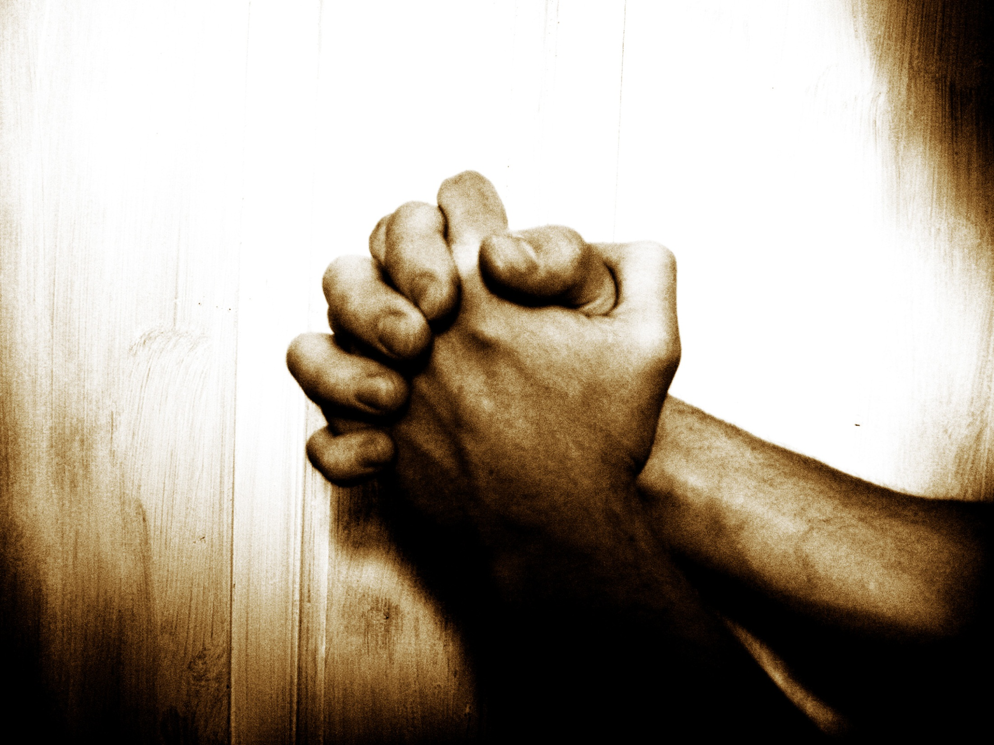
“Our Father”…
… A Prayer Journey
Jan 2014
2 Chron. 7:14
If My people who are called by My name...

Slide 2


Tabernacle Prayer model
“Our Father”… A Prayer Journey
Week 4 of 8
Session 6 of 13
Jan 2014
2 Chron. 7:14
If My people who are called by My name...
Notes:
We have now laid the foundation by revealing Father’s deep desire for intimacy and for partnership with His children. The next few sessions will unpack some of the principles of experiencing spiritual intimacy with the Living God in a practical and experiential way.

Slide 3

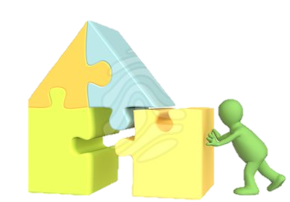
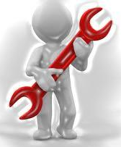

I. Why pray?
II. Foundations for effective prayer
III. Practicing prayer:
7 types: Principles & tools
Part 1 – Intro
Part 2 – Intimacy
Part 3 –
Part 4 –
1 – Call to prayer
2 – Intimacy
3 – Partnership
4 – Role of Prayer
"The main lesson about prayer is just this: Do it! Do it!
Do it! You want to be taught to pray? My answer is
pray and never faint…" John Laidlaw

Slide 4
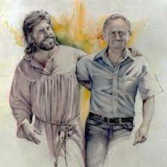
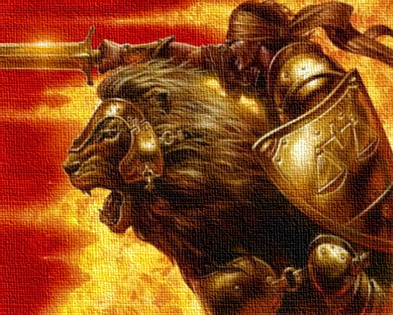
Recap: Week 1
Intimacy + Partnership
Koinonia = Fellowship = Sharing life =
Principle 1: Called to unceasing prayer
  5x Call to “pray without ceasing”
  “The Great Prayer Disconnect”
  Problem: Paradigm & Enemy
  Objective: Fix paradigm, win war
Principle 2: Reason = Sharing life with God
  Fellowship
  Picture: Marriage = Share life = Intimacy + Partnership
Principle 3: God wants us to know Him
  Golden thread of intimacy
FAITH RESPONSE: Intimacy paradigm

Slide 5
I. Why pray?
II. Foundations for effective prayer
III. Practicing prayer:
7 types: Principles & tools
Part 1 – Intro
Part 2 – Intimacy
Part 3 –
Part 4 –
1 – Call to prayer
2 – Intimacy
3 – Partnership
4 – Role of Prayer
"The main lesson about prayer is just this: Do it! Do it!
Do it! You want to be taught to pray? My answer is
pray and never faint…" John Laidlaw

Slide 6
Recap: Week 2, S1- Partnership
Intimacy + Partnership
Koinonia = Fellowship = Sharing life =
Principle 4: Called to partner in God’s mission, & develop a missional lifestyle
  Where is God?
  Golden thread of Partnership
  Fellowship Package
  Identity
  Paul’s call to a missional lifestyle (x4)
  Not contrary to grace: defines grace
  Why? Fellowship → Family business
  Intimacy First
FAITH RESPONSE: Partnership paradigm

Slide 7
I. Why pray?
II. Foundations for effective prayer
III. Practicing prayer:
7 types: Principles & tools
Part 1 – Intro
Part 2 – Intimacy
Part 3 –
Part 4 –
1 – Call to prayer
2 – Intimacy
3 – Partnership
4 – Role of Prayer
"The main lesson about prayer is just this: Do it! Do it!
Do it! You want to be taught to pray? My answer is
pray and never faint…" John Laidlaw

Slide 8
Recap: Week 2, S2 – Role of prayer
Intimacy + Partnership
Koinonia = Fellowship = Sharing life =
Principle 5 = Mystery 1: He waits
  Prayer is central in the Fellowship Package
  Order: “He will be very gracious, at the sound of your cry”
  Five things that come through prayer:
  1. Intimacy; 2. Provision; 3. Protection;
  4. Power; 5. Fulfillment of God’s plans
Principle 6 = Mystery 2 : Called to pray His will
  Even when He wants to & has promised to do it already
Faith response: Power of prayer paradigm

Slide 9

I. Why pray?
II. Foundations for effective prayer
III. Practicing prayer:
7 types: Principles & tools
1 – Seeking His Presence by Faith
2 – Tabernacle prayer model
"The main lesson about prayer is just this: Do it! Do it!
Do it! You want to be taught to pray? My answer is
pray and never faint…" John Laidlaw

Slide 10
Recap: Week 3 (1/2)
Intimacy + Partnership
Koinonia = Fellowship = Sharing life =
Principle 7: Presence first, answers second
  God really wants to answer our prayers. But! Not the normal experience. What are the keys to effective prayer?
  Key #1: Presence first, answers second
  Tangible, manifest Presence of God is an important part of our Christian walk
Principle 8: Seek His Presence, and grace, by faith
  But, many obstacles taught in scripture
  How is that possible if Jesus has opened the way for us?
  Key # 2: Faith is the issue. Need full gospel and real faith

Slide 11
Recap: Week 3 (2/2)
Intimacy + Partnership
Koinonia = Fellowship = Sharing life =
Principle 9: Faith = trust & live by His Word
  What faith is not: Example of Israel
  What faith is: invisible bridge illustration
  10 principles of faith
    Faith is trusting God’s word, regardless of circumstances
    Therefore, thinking, speaking, and doing His Word
    Grace becomes manifest when we act on His Word

Slide 12
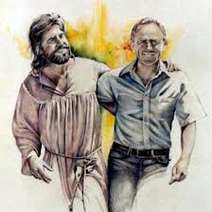
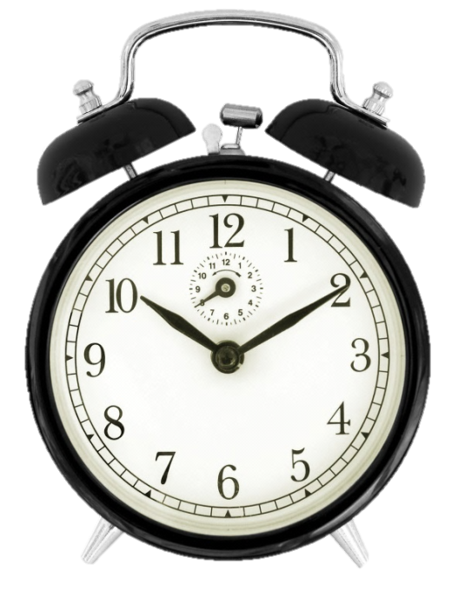
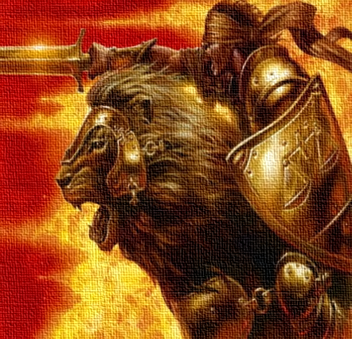
Faith response: 3 paradigms of prayer + time
The Intimacy Paradigm:
The Partnership paradigm:
The Power of Prayer Paradigm

Slide 13
I. Why pray?
II. Foundations for effective prayer
III. Practicing prayer:
7 types: Principles & tools
1 – Seeking His Presence by Faith
2 – Tabernacle prayer model
"The main lesson about prayer is just this: Do it! Do it!
Do it! You want to be taught to pray? My answer is
pray and never faint…" John Laidlaw

Slide 14
Introductory remarks
Guide for seeking deep intimacy with God & power in prayer - not for short discrete prayers
Helpful guide, not the only way
Helpful principles, not law
The Spirit of Grace is the Enabler, He is enabling us already

Slide 15
Seek the Lord… seek his presence continually! (Ps 105:4)
Let us then with confidence draw near to the throne of grace, that we may receive mercy and find grace to help in time of need. (Heb 4:16)
    P1. We are called to seek God’s Presence, in His throne room
    How do we find His throne?

Slide 16
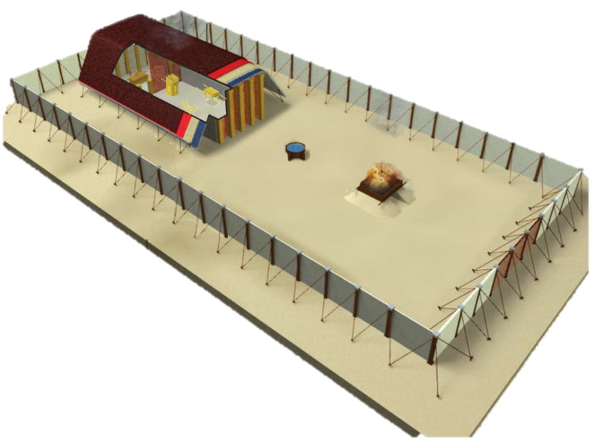
The Tabernacle as a guide
Moses’ Tabernacle
  For whatever was written in former days was written for our instruction (Ro 15:4)
  [The earthly tabernacle] serves as a copy and shadow of the heavenly things (Heb 8:5)
    P2. Moses’ Tabernacle is a copy of the heavenly tabernacle, providing a visual illustration of the way to God’s Presence
Notes:
you see, Moses’ tabernacle serves as a visual illustration…
Scripture actually tells us that, in just so many words.
It tells us firstly, that there is a “tent of witness” in heaven. Did you know that?
And then it says, that Moses tabernacle was a copy of the one in heaven…

Slide 17
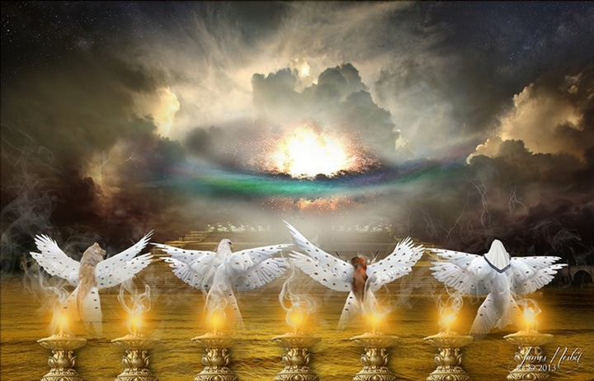
Moses’ Tabernacle
(in fact, all the articles of Moses’ Tabernacle are copies of those found in God’s Tabernacle in heaven)
2. ALTAR OF SACRIFICE: Re 6:9
3. LAVER = Sea of glass Rev 4:6
4. CANDLESTICK =7 Spirits of God: Re 4:5–
5. SHEWBREAD = The Word, Jesus: Rev 19:13
6. ALTAR OF INCENSE: Re 8:1–5
7. ARK OF THE COVENANT: Re 11:19
8. HOLY PLACE = God’s Sanctuary: Re 11:19; Re 15:5
8
Notes:
→ So Moses’ tabernacle gives us some very important insights about finding God’s Presence, His throne, under the Old Covenant arrangement

Slide 18
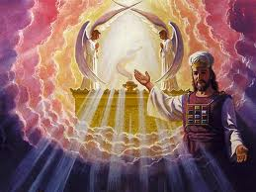
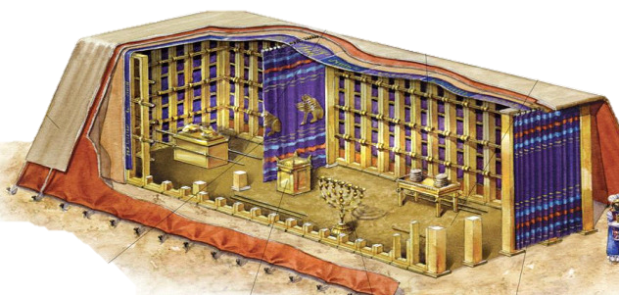
Moses’ Tabernacle
  “O Lord Almighty, God of
  Israel, enthroned between
  the cherubim” (Isa 37:16)
  And there I will meet with thee, and I will commune with thee from above the mercy seat… upon the ark of the covenant
  (Exo 25:8-9, 22)
    P3. Under the OC, they would seek God’s Presence in “the Most Holy Place”
Notes:
→ So Moses’ tabernacle gives us some very important insights about finding God’s Presence, His throne, under the Old Covenant arrangement

Slide 19
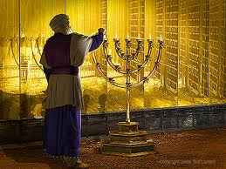
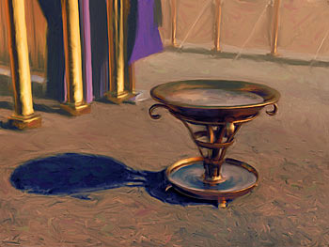
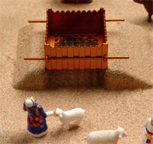
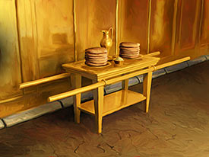
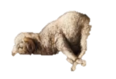
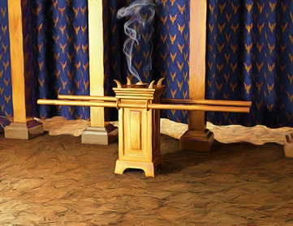
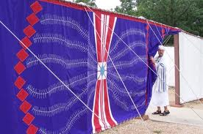
Our map: The 7 stations of the Tabernacle of Moses
Candlestick
4
3
Laver / Basin
5
2
Shewbread
Altar
Altar of Incense
7
6
1
Gate
Ark / Throne

Slide 20
3 Important differences for us
Difference 1: Who.
Context
Behind the second curtain was a second section called
the Most Holy Place… the priests go regularly into the first section… but into the second, only the high priest goes, and he but once a year… By this the Holy Spirit indicates that the way into the holy places is not yet opened as long as the first section is still standing
(Heb 9:1–9)
Notes:
→ So Moses’ tabernacle gives us some very important insights about finding God’s Presence, His throne, under the Old Covenant arrangement

Slide 21

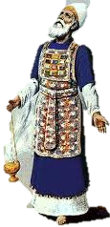
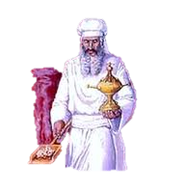
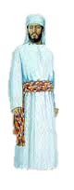

Under the Old Covenant, the common man could not enter …The pathway past the veil, into “the Holy Places” was reserved for Priests
High priest only
Priests only
Israelites only
“Gentiles”
Notes:
So I want you to imagine with me these dotted lines that existed that declared who could go where… and you can see that only the priests could enter the holy places – normal everyday Israelites couldn’t enter the places where God’s Presence was. And even the priests were separated from God’s Presence by a thick curtain – only 1 guy, the high priest could to in into the most Holy place where God’s presence was, and then only once a year…

Slide 22
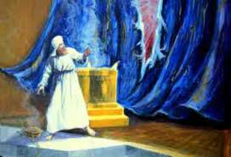
    P4. 1st DIFFERENCE: We are ALL able to enter. Jesus’ Death & resurrection opened the way for us through that veil
…Jesus cried out again with
a loud voice and yielded up his
spirit. And behold, the veil
of the temple was torn in two,
from top to bottom (Mt 27: 50–52)
Therefore, …since we have confidence to enter the holy places by the blood of Jesus, by the new and living way that he opened for us through the veil…
let us draw near (Heb 10:19–23)
Notes:
But remember what we learned in Hebrews Chapter 10?
Jesus made the way in… by sacrificing His life to pay the price for our sins, he made the way into God’s Holy Presence.
<click>
And in fact, we see that when Jesus died, at that very moment, the curtain that closed off God’s Presence from the people was inexplicably torn, from top to bottom. Now, I want to create context here. This curtain in the temple in Jerusalem was 10cm thick, could not be torn by 2 elephants pulling at either side, and it was torn at the moment Jesus died. And it was torn from top to bottom. Do you know what that means? It was torn by God. Jesus’ death caused God to tear the curtain that separated us from His Presence…
That’s why Hebrews tells is that we can enter boldly by the new way that Jesus opened for us, through the veil…
The way is open, and now the ordinary man can enter God’s Presence… Hallelujah!

Slide 23
    Difference 2: Where
Jesus said …“the hour is coming when neither on this mountain nor in Jerusalem will you worship the Father.... the true worshipers will worship the Father in spirit and truth
(John 4:20–24)
    P5. 2nd DIFFERENCE: We no longer seek Him in a physical place (the tabernacle, in Jerusalem); but in a spiritual place (spirit and truth)
 | Old Covenant | New Covenant
Type of place | Physical location | Spiritual “place”
Where? | Temple mount, Jerusalem | “Spirit & truth”

Slide 24
DIFFERENCE 3: How
Old Covenant:
Physical steps
New Covenant:
Faith steps
    P6. We don’t take physical steps, but spiritual ones - “Faith steps”. The Tabernacle reveals 7 “faith steps” into “The Most Holy Place” of God’s Presence

Slide 25


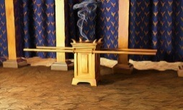
Each station of the tabernacle corresponds to a truth, which requires a response of faith (faith step)
Tabernacle “Station” |  |  | Biblical truths | Obstacles (untruth/ ignorance / unbelief) | Faith steps (spirit agreeing with God)
1 | Gate |  | I am called to come (draw & stay near to God, in worship) | Don’t “come” / draw & stay near to God, in worship | “Come” – Devoted time, Intimacy Paradigm, Worship
2 | Altar |  | I can draw near as a son, cleansed by Jesus’ blood | Cling to sin → ashamed to come Don’t forgive → not forgiven | Forgive, be cleansed & come boldly
3 | Laver / basin |  | I am a priest of God, in Christ | Impure heart / double-minded / self-centered life | Accept & live out priestly identity in Christ
4 | Lamp |  | I am an overcomer of this world – by Christ in me | Flesh nature / worldly outlook | Strengthen spirit, Live in the spirit
5 | Bread |  | I am “born of the Word” – my nature is described in the Word. As I walk in it, God’s grace is manifest | Ignorance of, despising, or not believing the Word | Be transformed by renewing mind in the Word
6 | Altar of Incense |  | As I do, I learn His heart. When I pray His heart, I receive answers | Don’t seek His will Don’t ask in faith Don’t receive by faith | Ask & receive
7 | Ark |  | His love is better than life; my highest joy & pleasure are found in His Presence | Don’t seek His face | Seek His manifest Presence

Slide 26
Each truth corresponds to a “prayer station”, in which we take the respective “faith step”
Stn | Biblical truths | Obstacles (untruth/ ignorance / unbelief) | Faith steps (spirit agreeing with God) | “Prayer Station”
1 | I am called to come (draw & stay near to God, in worship) | Don’t “come” / draw & stay near to God, in worship | “Come” – Devoted time, Intimacy Paradigm, Worship | Adoration (praise, thanks, worship)
2 | I can draw near as a son, cleansed by Jesus’ blood | Cling to sin → ashamed to come Don’t forgive → not forgiven | Forgive, be cleansed & come boldly | Confession (forgiveness, confession, repentance)
3 | I am a priest of God, in Christ | Impure heart / double-minded / self-centered life | Accept & live out priestly identity in Christ | Consecration (commitment, guidance)
4 | I am an overcomer of this world – by Christ in me | Flesh nature (self centered) | Strengthen spirit, Live in the spirit | Edification (strengthen, build up)
5 | I am “born of the Word”- it describes my new nature. As I walk in it, God’s grace is manifest | Ignorance of, despising, or not believing the Word | Be transformed by renewing mind in the Word | Meditation (seek revelation, align life)
6 | As I do, I learn His heart. When I pray His heart, I receive answers | Don’t seek His will Don’t ask in faith Don’t receive by faith | Ask & receive | Petition (make requests)
7 | His love is better than life; highest joy & pleasure in His Presence | Don’t seek His face | Seek His manifest Presence | Soaking (bask in His Presence, enjoy His glory & love)

Slide 27
T1. The Tabernacle prayer model (1/3)
Candlestick
Edification
4
3
Laver / Basin
Consecration
5
2
Shewbread
Meditation
Altar
Confession
Altar of Incense
Petition
7
6
1
Gate
Adoration
Ark / Throne
Soaking In His Presence

Slide 28
T1. The Tabernacle prayer model (2/3)
Stn | Biblical truths | Obstacles (untruth/ ignorance / unbelief) | Faith steps (spirit agreeing with God) | Tabernacle “Prayer Station”
1 | I am called to come (draw & stay near to God, in worship) | Don’t “come” / draw & stay near to God, in worship | “Come” – Devoted time, Intimacy Paradigm, Praise & thanks | Adoration (praise, thanksgiving, worship)
2 | I can draw near as a son | Cling to sin → ashamed to come (1Jn 3:19-24) Don’t forgive → not forgiven | Forgive, be cleansed & come boldly | Confession (forgiveness, confession, repentance)
3 | I must come as a priest | Impure heart / double-minded / self-centered life | Accept & live out priestly identity in Christ | Consecration (commitment, devotion, listening)
4 | I must come as an overcomer of this world – by Christ in me | Flesh nature / worldly outlook | Strengthen spirit, Live in the spirit | Edification (strengthen, build up)
5 | I am “born of the Word”- it describes my new nature. As I walk in it, God’s grace is manifest | Ignorance of, despising, or not believing the Word | Be transformed by renewing mind | Meditation (seek revelation of Word, to align life)
6 | As I do, I learn His heart. When I pray His heart, I receive answers | Don’t seek His will Don’t ask in faith Don’t receive by faith | Ask & receive | Petition (make requests, for self & others)
7 | His love is better than life; joy & pleasure are found in His Presence | Don’t seek His face | Seek His manifest Presence | Soaking (bask in His Presence, enjoy His glory & love)

Slide 29
T1. The Tabernacle prayer model (3/3)
Stn | Biblical truths | Obstacle (untruth/ ignorance / unbelief) | Faith steps (spirit agreeing with God) | Tabernacle “Prayer Station”
1 | I am called to draw & stay near to God, in worship God is. He alone is worthy of my worship. He calls me to draw near & worship Him (Jm 4:8; Jn Ch 4,14-15) | Don’t “come” to draw near to and worship God | “Come” 1. Draw near; 2. with Intimacy Paradigm; 3. through Praise & thanks | Adoration (praise, thanksgiving, worship)
2 | I can draw near as a son I am dead to sin & forgiven and adopted in Christ (Rom Ch 5-8) | Cling to sin → heart condemns → ashamed to come (1Jn 3:19-24) Don’t forgive → not forgiven | Forgive, be cleansed & come boldly 1. Confess; 2. Repent - sin is death God’s ways are life; I am dead to sin; 3. Forgive; 4. Accept forgiveness; 5. Draw near | Confession (forgiveness, confession, repentance)
3 | I have been set apart as a priest I am adopted into God’s priestly family, sharing Jesus’ ministry of reconciling the world to God (Rev 1:6; 1 Pet 2:9; 2 Cor 5:18) | Impure heart / double-minded / self-centered life | Be a disciple of Jesus: live out priestly identity, being devoted to God’s works 1. Deny self; 2. Take up cross; 3. Follow Jesus; 4. Seek God’s guidance | Consecration (commitment, devotion, listening)
4 | I am an overcomer of this world – by Christ in me, the power of a victorious life (Col 1: 27; Jn 14-15; 1 Jn 4:4,16; Phil 2:12-13; Tit 2:11-14; Rev 21:7-8) | Flesh nature / worldly outlook | Strengthen spirit, Live in the spirit 1. Put on Christ; 2. Strengthen spirit man, and be ever more filled with His Spirit; 3. overcome world & flesh | Edification (strengthen/ build up spirit & Presence of Christ within)
5 | I am “born of the Word”- it describes my new nature. As I walk in it, God’s grace is manifest (2 Pet 1:3-8; Jn 1:1; 1 Jn 5:3; Jn 14-15) | Ignorance of, despising, or not believing the Word (all of it) | Be transformed by renewing mind 1. Agree with Word; 2. Receive revelation; 3. Keep Word (align life); 4. Discover His heart; 5. Hence, “come” in truth - belief, confession & action aligned with His heart | Meditation (seek revelation & understanding, align life / be transformed)
6 | As I do walk in truths 1-5, I learn His heart, pray His heart, and receive answers | Don’t seek to know His will Don’t ask in faith Don’t receive by faith | Ask & receive 1. Seek to know His will; 2. Ask in faith, according to His will; 3. Receive by faith | Petition (request, for self & others)
7 | His love is better than life; joy & pleasure are found in His Presence (Ps 63:3, Ps 16:11) | Don’t seek His face | Seek His manifest Presence 1. Devote time for “the one thing”; 2. Pursue His Presence as a treasure | Soaking (bask in His Presence, enjoy His glory & love)

Slide 30
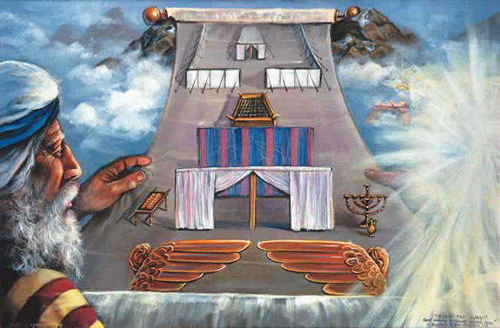
Summary
PRINCIPLE 10: The Tabernacle is a guide to seeking God’s Presence. It presents us with 7 faith steps to be taken in prayer and lived out
  Called to seek God’s Presence, on His throne. How do we find His throne?
  The Tabernacle provides a “map”
  Under the OC, God’s throne was in the Most Holy Place. They went from outside the courts, into the Most Holy Place
  3 differences for us. DIFFERENCE 1: WHO - Can all enter, not just the High Priest
  DIFFERENCE 2: WHERE - Don’t seek God in a physical place, but a “spiritual place” – in spirit and truth.
  DIFFERENCE 3: Steps are not physical, but faith steps. Each station represents a truthwe must walk in. Hence, “7 stations of prayer”
8

Slide 31
Remember…
Guide for seeking deep intimacy with God & power in prayer - not for short discrete prayers
Helpful guide, not the only way
Helpful principles, not law
The Spirit of Grace is the Enabler, He is enabling us already

Slide 32
Pause for reflection
Where am I “at” regarding the intimacy paradigm? How should I pray accordingly?
Where am I “at” regarding the partnership paradigm? How should I pray accordingly?
Where am I “at” regarding the power paradigm? How should I pray accordingly?

Slide 33
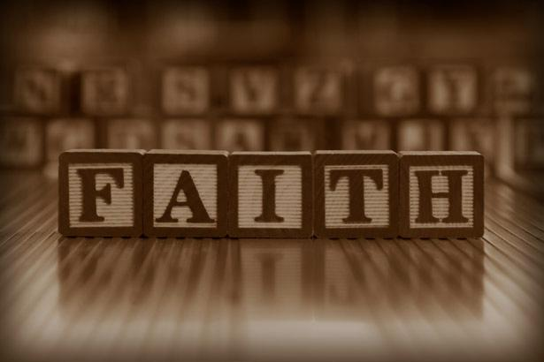
PERSONAL JOURNEY:
If you desire to experience God’s Presence, love and power in a deeper way…
…walk through the Tabernacle…
  Meditate on what Jesus did to make the way open for us, and on Father’s call to “draw near”
  Tell God about your desire to know Him more intimately
  Ask Him to lead your heart by His Spirit during this course, to take the faith steps necessary to enter into a deeper walk with Him

