Slide 1
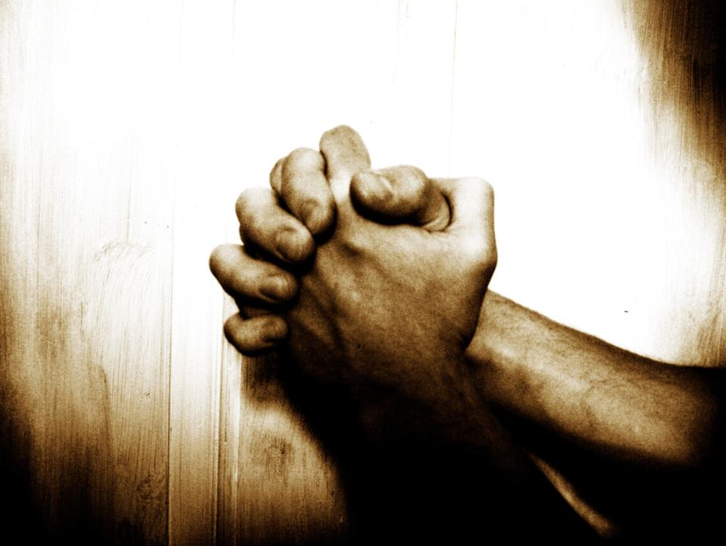
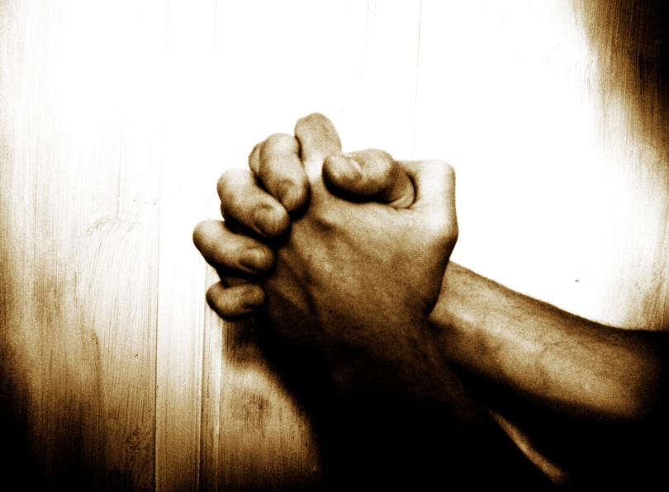
Seeking His Presence
“Our Father”… A Prayer Journey
Week 3 of 8
Session 4 of 13
Jan 2014
2 Chron. 7:14
If My people who are called by My name...

Slide 2

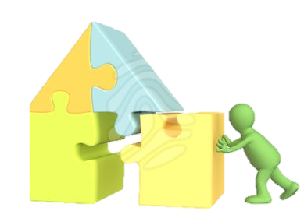
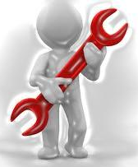

I. Why pray?
II. Foundations for effective prayer
III. Practicing prayer:
7 types: Principles & tools
1 – Seeking His Presence by Faith
2 – Tabernacle prayer model
"The main lesson about prayer is just this: Do it! Do it!
Do it! You want to be taught to pray? My answer is
pray and never faint…" John Laidlaw

Slide 3
P1. God has a clear desire to answer our prayers
(Mt 7:7–11) “Ask, and it will be given to you; seek, and you will find; knock, and it will be opened to you. For everyone who asks receives, and the one who seeks finds, and to the one who knocks it will be opened. … If you … know how to give good gifts to your children, how much more will your Father who is in heaven give good things to those who ask him!
(Jn 14:12–14) “Whatever you ask in my name, this I will do, that the Father may be glorified in the Son. If you ask me anything in my name, I will do it.
(1 Jn 5:14–15) “If we ask anything according to his will he hears us. And if we know that he hears us … we know that we have the requests that we have asked of him.

Slide 4
…(cont.)
(Jn 15:7–9) “If you abide in me, and my words abide in you, ask whatever you wish, and it will be done for you”
(Mk 11:22–24) “…whatever you ask in prayer, believe that you have received it, and it will be yours”.
(Jas 5:13–17) Is anyone among you suffering? Let him pray. … The prayer of a righteous person has great power
    Is this what we experience?
    Why not? What’s the catch? Was Jesus joking?
    What’s the truth about God answering prayer?

Slide 5
Let us then with confidence draw near to the throne of grace,
that
we may receive mercy and find grace to help in time of need. (Heb 4:16)
Seek the Lord… seek his presence continually!
(Ps 105:4)
G2443. ἵνα, hina, hin´-ah; in order that (denoting the purpose…) Strong, J. (2009).
    P2. But the foundational principle for “how to pray” is:
    Presence first, Answers second.
    Prayer begins with intimacy.
Notes:
So let’s begin with a question… what is prayer? Keep it simple whats the FIRST THING that comes to mind when someone mentions the word prayer?
Most people I speak to mean asking God for stuff – asking Him to help us , to protect us, to guide us…
<click>
I would say prayer is seeking God’s presence, and then seeking His aid
But the key thing I want you to notice is that prayer BEGINS with Seeking God’s Presence
Christianity is not a religion, it’s a relationship
Its not a superstition, it’s a fellowship
Yes, we seek answered prayers, but we seek them from our Father, and the starting point for seeking answered prayer is seeking Him – Our Father - His Presence
Is your prayer life dead? Maybe that’s because you’re not starting by seeking His Presence?
SO…
Now that’s quite an intimidating thing, wouldn’t you say? Seeking God’s Presence! When you think of meeting a president, it’s a novel idea at first 5 minutes before you walk into his office, your stomach’s doing the ramba… I mean, its intimidating.
Well God is the president of the UNIVERSE!!! I mean, that’s intimidating…

Slide 6
Therefore, …since we have confidence to enter the holy places by the blood of Jesus, by the new and living way that [Jesus] opened for us …let us draw near (Heb 10:19–23)
    P3. We can boldly enter His Presence because Jesus’ death & resurrection opened the way for us
Notes:
But the bible says for all those in Christ Jesus, its not at all intimidating, we can come with CONFIDENCE
We’re going to learn a lot this morning from Hebrews Ch 4 and Ch 10. And here in Ch 10, Father tells us we HAVE CONFIDENCE to approach His presence, by the blood of Jesus – Jesus’ death and resurrection actually opened a way into God’s Presence for us. Did you know that? Just think about it. That means a few things
There is a way into God’s Presence
It was closed
It was opened when Jesus died and was resurrected – His blood made the way into the Holy Places (and we’re going to learn today why that is)
So now, the way is open, and we can simply come to Him, BOLDLY
DID YOU KNOW that one of the cornerstone features of the christian faith is experiencing God’s Presence? I mean are you living in this Christian faith with excitement that God actually calls us to seek His Presence – the Presence of the living God? That this is not just for the priests or guru’s but for everyone saved by Jesus?
There it is, right there… let US draw near… to what? His Presence in the holy places…
Are you drawing near to God? Are you seeking His Presence? Because that is the starting point for prayer…

Slide 7
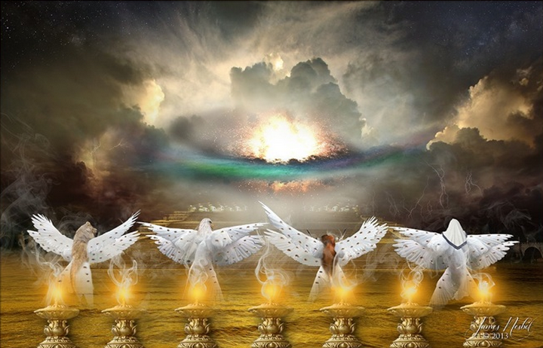
Testimony
In your presence there is fullness of joy; at your right hand are pleasures forevermore. (Ps 16:11)
Notes:
<CLIP>
So you see, experiencing God’s manifest, mighty, glorious Presence is a normal part of everyday life, for normal Christians. I meant that excites me… The Kingdom of God is not words, it is power. It is reality, it is experiencing what the bible says. It is a supernatural lifestyle of enjoying companionship with the Almighty Creator of the universe, hallelujah!
Are you enjoying your inheritance? Do you have a religion, or a relationship?

Slide 8
P4. Experiencing God’s tangible presence is a normal part of the Christian walk
OLD TESTAMENT PROMISE: I will give you a new heart, and a new spirit I will put within you…. And I will put my Spirit within you (Eze 36:25–27)
NEW TESTAMENT REALITY: “If you love me, you will keep my commandments. And I will ask the Father, and he will give you another Helper, to be with you forever, even the Spirit of truth... You know him, for he dwells with you and will be in you. I will not leave you as orphans; I will come to you… In that day you will know that I am in my Father, and you in me, and I in you. Whoever has my commandments and keeps them, he it is who loves me. And he who loves me will be loved by my Father, and I will love him and manifest myself to him.” (Jn 14:15–21)
Notes:
And I want to highlight again this is NORMAL for the Christian life.
In the Old Testament, God tells us hundreds of years in advance what the new testament (the time after Jesus comes to die for our sins) will be like, and one of the cornerstone features He mentions is that He will put HIS SPIRIT inside us. I mean talk about being in His Presence, talk about experiencing nearness to God – His Spirit inside of us…
And then the night before Jesus dies, He describes how this new covenant is going to work – and what He describes is basically, God will come and BE WITH US and that we will experience His manifest presence… read with me
<read 2nd>
I mean, that couldn’t be more clear. God intends for us to experience His tangible Presence as a normal part of our day to day Christian life…
I want to share with you a testimony from a friend. I’m going to share a few of these today. And I want to say, every testimony shared today is from a personal close friend or family member. We have not scoured the earth for wild and exceptional testimonies – we have spoken to ordinary people that are part of my day to day life. Watch with me…
→

Slide 9
P5. But, paradoxically, there still SEEM TO BE obstacles to entering Father’s Presence…
Who shall ascend the hill of the Lord? And who shall stand in his holy place?
He who has clean hands and a pure heart… (Ps 24:3–6)
James, a servant of God and of the Lord Jesus Christ, To the twelve tribes in the Dispersion … [who] hold the faith in our Lord Jesus Christ…(Jm1:1; 2:1)
Draw near to God, and he will draw near to you.
Cleanse your hands, you sinners, and purify your hearts, you double-minded. (Jas 4:8)

Slide 10
… and to answered prayer
“Husbands, live with your wives in an understanding way…so that your prayers be not hindered”
(1 Pe 3:7);
“if husbands do not treat their wives in a godly way, the Lord will pay no heed to their prayers”.
(ESV Study Bible notes.

Slide 11
P5. The NT in fact teaches about many obstacles. They are not matters of law, but of the heart
Obstacles to His Presence
… and to answered prayer
NOT BELIEVING: “whoever would draw near to God must believe” (Heb 11:6)
SIN & WORLDLINESS: “Draw near to God, and he will draw near to you. Cleanse your hands, you sinners, and purify your hearts, you double-minded” (Jas 4:8)
UNFORGIVENESS: “But if ye do not forgive, neither will your Father… forgive… your sins” (Mk 11:25–26)
NOT ASKING: “you do not have because you do not ask” (Jas 4:2)
NOT BELIEVING: “the one who doubts will not receive anything” (Jas 1:6–8)
SIN: Husbands, live with your wives in an understanding way…so that your prayers be not hindered (1 Pe 3:7);
“If I had cherished iniquity… the Lord would not have listened” (Ps 66:18)
MOTIVES: You do not receive, because you ask wrongly (Jas 4:3)
IGNORANCE: “if we ask… according to his will he hears us (1 Jn 5:14–15)
How can there be any obstacles, if Jesus’ finished work eliminated all obstacles by grace, once for all time?

Slide 12
And without faith it is impossible to please him, for whoever would draw near to God must believe that he exists and that he rewards those who seek him (Heb 11:6)
    P6. The solution is more FAITH! The basic requirement to draw near to God and to answered prayer is faith – ONLY faith. Therefore, if we experience obstacles, we simply need to grow to a fuller faith in the full gospel
    What then is faith?
Notes:
Do you remember how in Hebrews chapter 10 we are told to draw near to God’s Presence?
Well just after that here in Ch 11 he carries on and says…<read>
Can you see the key in there? The key is faith…
The only requirement is faith. God has done His part. The only thing we have to do is believe He has done what He says He has done. We have to believe. And not believing is the obstacle to entering His Presence…
→

Slide 13
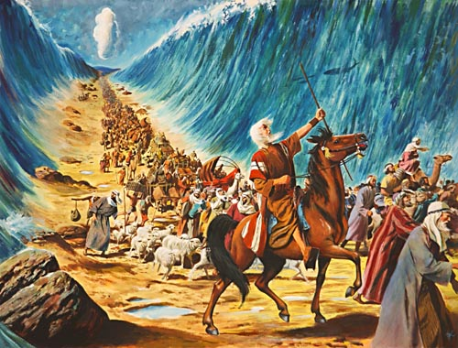
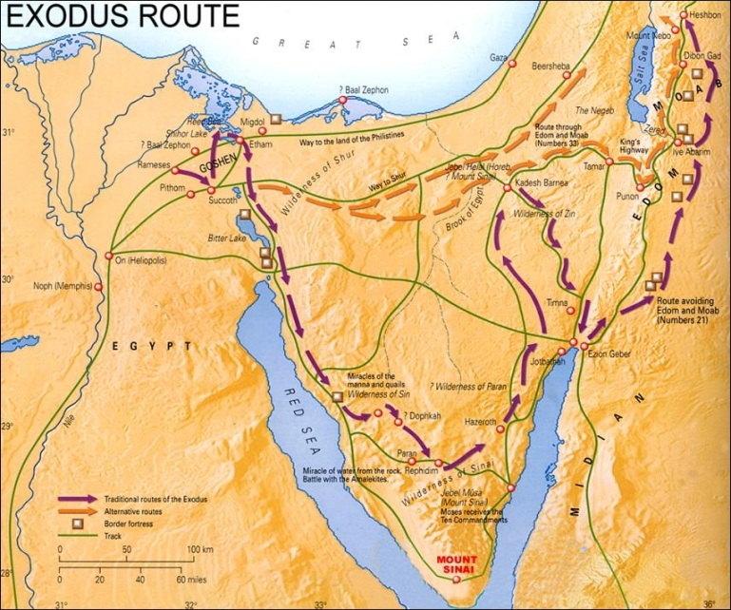
The example of Israel (1/5): What faith is not…
What the Israelites did :
Believed God exists
Believed in the One God of Abraham, Isaac & Jacob
Desired and pursued what
God offered – deliverance from Pharaoh to the Promised Land
Left their old life behind to pursue God’s promise
Followed Moses most of the time
Followed God’s worship traditions
But still…
  They were unable to enter because of unbelief (Heb 3:18–19)
    What then is faith?

Slide 14
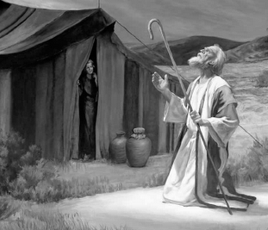
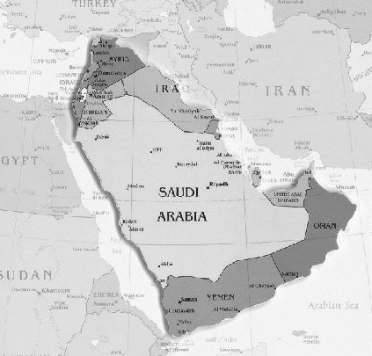
The example of Israel (2/5): God’s Promise to Israel
The Lord said to Abram, “Go from your country… to the land that I will show you. … I will bless you… so that you will be a blessing… and in you all the families of the earth shall be blessed.” So Abram went… Then the Lord … said “To your offspring I will give this land.” (Ge 12:1–7)
“I will send the hornet before you, which shall drive out the [enemies]…
I will give [them] into your hand, and you shall drive them out … for I will give the inhabitants of the land into your hand” (Ex 23:27–31)

Slide 15
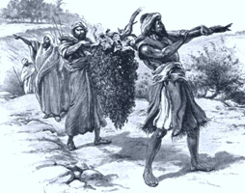
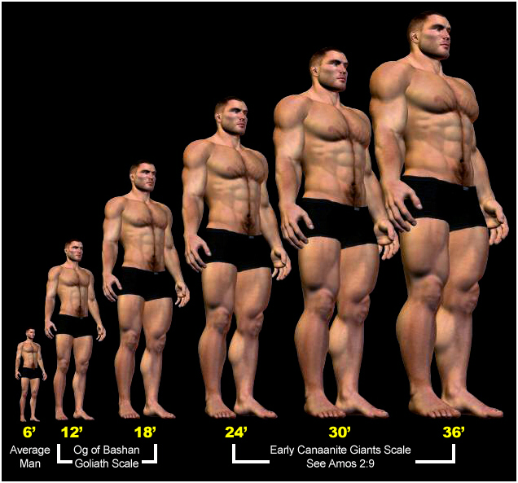
The example of Israel (3/5): Israel’s response
Moses sent [12 spies] to spy out the land of Canaan and said to them, “Go up … & see what the land is …
They brought back word…“the land… flows with milk and honey… but the people… are strong, and the cities are fortified”
  But Caleb… said “Let us go up…we are well able to overcome”
  The [others] said, “We are not able to go up against the people, for they are stronger than we are….
  [The people] said…“Why is the Lord bringing us into this land, to fall by the sword? Let’s… go back to Egypt.” (Nu 13:17–14:30)

Slide 16
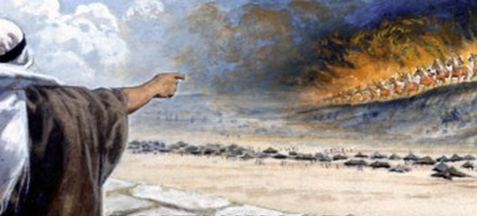
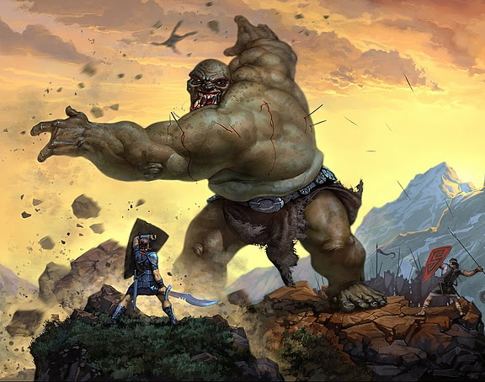
The example of Israel (4/5): Unbelief vs. faith
The 10 spies & the Nation
vs. Joshua & Caleb
God said “I will send hornets before you, which shall drive out the [enemies]… I will give [them] into your hand, and you shall drive them”
“the people… are strong, and the cities are fortified… We are not able to go up against the people, for they are stronger than we are’
But…
But…
“the people… are strong, and the cities are fortified… We are not able to go up against the people, for they are stronger than we are’
God said “I will send hornets before you, which shall drive out the [enemies]… I will give [them] into your hand, and you shall drive them”
    Faith is getting your but in the right place at the right time

Slide 17
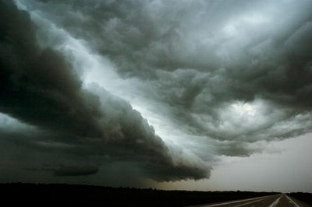
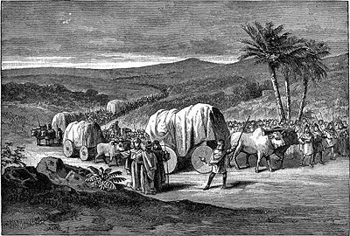
The example of Israel (5/5): The fruit of faith & unbelief
As I live, declares the Lord, what you have said in my hearing I will do to you: your dead bodies shall fall in this wilderness, and… all …who have grumbled against me. Not one shall come into the land where I swore that I would make you dwell, except Caleb … and Joshua
(Nu 14:28 - 30)

Slide 18
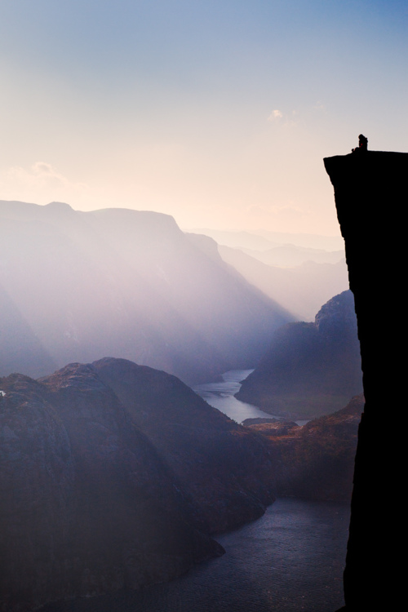

Illustration:
God says there’s a bridge to His promise, 1m from the edge. It’s not visible. It only supports human feet – no stones etc. Do you jump?
P
P
    Whether you jump depends on what you ‘see’, and what you see depends on whether you believe God’s promise.
    What do you ‘see’?

Slide 19

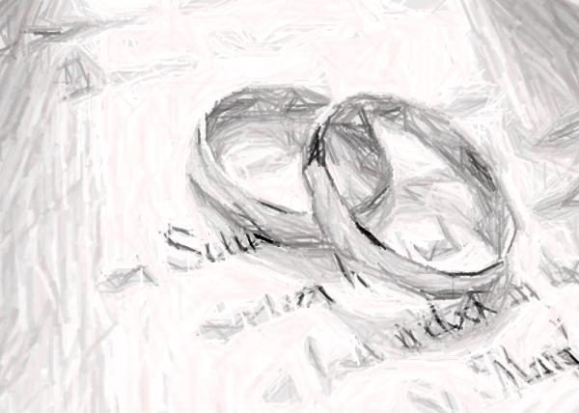
The 10 Principles of faith (1)
The LORD is… the faithful God who keeps covenant¹ (Deut 7:8)
My faithfulness and my steadfast love shall be with him… forever, and my covenant¹ will stand firm for him (Ps 89:24-34)
¹ - covenant
kəv-nənt,
noun –
formal, solemn,
and binding agreement; a compact; a written agreement or promise usually under seal between two or more parties especially for the performance of some action
Merriam-Webster, I. (2003).
    P1. God is a God of love covenants: He deals with us in covenant; i.e. a binding commitment¹ to promises which represent His will for us. But His covenant¹ is rooted in His steadfast love & faithfulness towards us

Slide 20
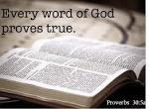
The 10 Principles of faith (2)
My word … that goes out from my mouth… shall not return to me empty, but it shall accomplish my purpose (Is 55:10–11)
    P2. He fulfills His promises by His Word. He sends His Word to accomplish His purposes

Slide 21
The 10 Principles of faith (3)
“Abraham believed God, and it was counted to him as righteousness… to the one who… believes in Him who justifies the ungodly, his faith is counted as righteousness (Ro 4:3-5)
My faithfulness and my steadfast love shall be with him… forever, and my covenant will stand firm for him… I will not remove from him my steadfast love or be false to my faithfulness. I will not violate my covenant or alter the word that went forth from my lips (Ps 89: 24-34)
    P3. Faith is trusting God’s Word because we trust Him. His Word is as true as His character; therefore, faith is always trusting God’s Word is always fully true, because we trust His character
Notes:
…
Now I want to give you a picture over here to make this more practical:
Picture yourself are standing on the cliff edge overlooking the Grand Canyon in the USA, the fall to the bottom is hundreds of meters down. It’s certainly a fatal fall. Now you need to get to the other side. But I mean it’s a sheer drop and there’s just no way. God says: I have built you a bridge of glass. You can’t see it. It’s 50 cm away from the edge of the cliff. You have to jump onto it. but I promise you will land on a bridge of glass that takes you all the way to the other side. I promise you. It’s there. Trust me.
Do you or do you not jump off the edge?
That question can be put another way – is there, or is there not a bridge?
Or it can be put this way: is God, or is he not being honest? Is he trustworthy? Does He love me, or hate me?
Do I or do I not jump? It’s all the same question.
Faith, is looking to the unseen bridge, seeing it as though there, because God says it is there. So faith jumps.

Slide 22
The 10 Principles of faith (4)
…As we look not to the things that are seen but to the things that are unseen [God’s promises]. For the things that are seen are transient, but the things that are unseen are eternal. (2 Co 4:18)
…For we walk by faith, not by sight. (2 Co 5:7)
In hope [Abraham] believed against hope… He did not weaken in faith when he considered his own body, which was as good as dead… or… the barrenness of Sarah’s womb. No unbelief made him waver concerning the promise of God… [He was] fully convinced that God was able to do what he had promised. (Ro 4:18–21)
    P4. Faith trusts God’s Word over observable reality. Faith sees God’s Word as the final word, the ultimate reality. Faith sees observable ‘reality’ through the lens of God’s Word
Notes:
…
Now I want to give you a picture over here to make this more practical:
Picture yourself are standing on the cliff edge overlooking the Grand Canyon in the USA, the fall to the bottom is hundreds of meters down. It’s certainly a fatal fall. Now you need to get to the other side. But I mean it’s a sheer drop and there’s just no way. God says: I have built you a bridge of glass. You can’t see it. It’s 50 cm away from the edge of the cliff. You have to jump onto it. but I promise you will land on a bridge of glass that takes you all the way to the other side. I promise you. It’s there. Trust me.
Do you or do you not jump off the edge?
That question can be put another way – is there, or is there not a bridge?
Or it can be put this way: is God, or is he not being honest? Is he trustworthy? Does He love me, or hate me?
Do I or do I not jump? It’s all the same question.
Faith, is looking to the unseen bridge, seeing it as though there, because God says it is there. So faith jumps.

Slide 23
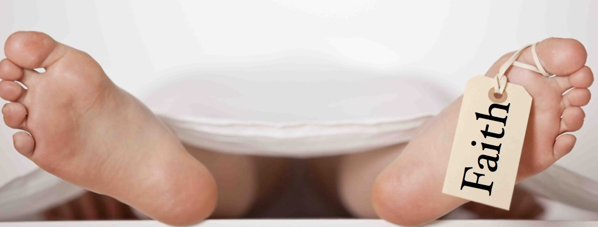
The 10 Principles of faith (5)
What good is it, my brothers, if someone says he has faith but does not have works? Can that faith save him? … faith by itself, if it does not have works, is dead…. You believe that God is one; you do well. Even the demons believe—and shudder!… For as the body apart from the spirit is dead, so also faith apart from works is dead.
(Jas 2:14–26)
For by grace you have been saved through faith (Eph 2:8)
    P5. We access grace when we act on God’s Word. ‘Faith’ without corresponding actions is dead. Faith ‘comes alive’ when we act on the Word. Since all His promises are ours “by grace through [living] faith”, grace becomes manifest when we act on God’s Word

Slide 24
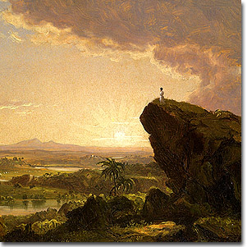
The 10 Principles of faith (6)
They were unable to enter because of
unbelief. (Heb 3:18-19)
‘What you have said in my hearing I will
do to you: your dead bodies shall fall in this wilderness, and… all …who have grumbled against me. not one shall come into the land where I swore that I would make you dwell, except Caleb … and Joshua (Nu 14:28 - 30)
    P6. Therefore, our experience of God is dictated by whether we act on His Word. If we believe His Word and act on it, we experience His grace. If we don’t, we don’t. But grace is still not ‘earned’ by obedience, because faith-based obedience originates in grace

Slide 25
The 10 Principles of faith (7)
Time would fail me to tell of Gideon, Barak, Samson, Jephthah, of David and Samuel and the prophets— who through faith conquered kingdoms, enforced justice, obtained promises, [etcetera]…
Some were tortured, refusing to accept release, so that they might rise again to a better life. Others suffered mocking and flogging, and even chains and imprisonment. They were stoned, they were sawn in two, they were killed with the sword [etcetera]… And all these, though commended through their faith, did not receive what was promised
(Heb 11:32–40)
    P7. Tense matters! We must know what is for today. Promises are either for 1) now (rebirth), 2) this life (sanctification), or 3) eternity (perfection). We must believe now to receive now, so we must know what is for today.

Slide 26
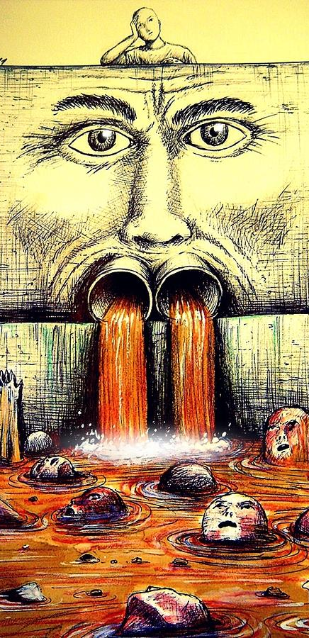
The 10 Principles of faith (8)
From the fullness of the heart the mouth speaks. (Mt 12:34)
…with the heart one believes and is justified, & with the mouth one confesses and is [sozo’d] (Rom 10:9)
‘As I live, declares the Lord, what you have said in my hearing I will do to you: your dead bodies shall fall in this wilderness, and of all your number… who have grumbled against me (Nu 14:28–30)
    P8. We say what we believe, so we get what we say. Speaking from the heart is the first act of faith. When we speak in agreement with God’s Word, we reveal faith. When we speak contrary to God’s Word, we reveal unbelief

Slide 27
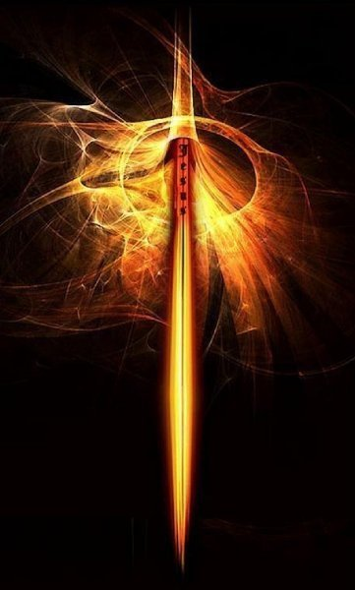
The 10 Principles of faith (9)
For the weapons of our warfare are not of the flesh but have divine power to destroy strongholds. We destroy arguments and every lofty opinion raised against the knowledge of God, and take every thought captive to obey Christ (2 Co 10:4–6)
“…they have conquered him by the blood of the Lamb and by the word of their testimony” (Rom 12:10–12)
    P9. Our main weapon to overcome satan is confessing God’s Word. Because we receive God’s promises by faith, the devil’s strategy against us is always deception, and we always overcome by holding onto God’s Word

Slide 28
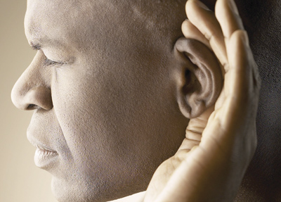
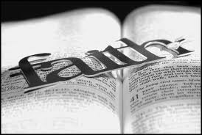
The 10 Principles of faith (10)
So faith comes from hearing, and hearing through the word of God. (Ro 10:17)
Blessed is the man who walks not in the counsel of the wicked… but his delight is in the law of the Lord, and on his law he meditates day and night. (Ps 1:1–2)
    P10. We can and must grow in faith. ‘Faith comes’ – that is, if we don’t have enough of it we can get more. We grow in faith by meditating on the Word of God
28

Slide 29
In summary: Recognizing biblical, saving faith
True, saving faith is a supernatural thing, the result of grace. It is what you have when you so truly believe with all your being that what God says is true, that:
  You think according to His Word;
  … you confess (speak in agreement with) His Word;
  … and you make decisions and act based on His Word
  …even when the stakes are very high (e.g life and death)
This is the Jm 2:14-28 sort of faith which:
  Causes you to walk in obedience to God
  Causes you to love in deed and in truth (actually practice risky, sacrificial love)
  Causes you to abide in Christ
  Causes you to experience intimacy with God
  Gets answered prayer
  Saves

Slide 30
Example 1: Psalm 91
He who dwells in the shelter of the Most High will abide in the shadow of the Almighty. I will say to the Lord, “My refuge and my fortress, my God, in whom I trust.” For he will deliver you from the snare of the fowler and from the deadly pestilence. He will cover you with his pinions, and under his wings you will find refuge; his faithfulness is a shield and buckler. You will not fear the terror of the night, nor the arrow that flies by day, nor the pestilence that stalks in darkness, nor the destruction that wastes at noonday. A thousand may fall at your side, ten thousand at your right hand, but it will not come near you. You will only look with your eyes and see the recompense of the wicked. Because you have made the Lord your dwelling place— the Most High, who is my refuge— no
evil shall be allowed to befall you, no plague come near your tent. For he will command his angels concerning you to guard you in all your ways. On their hands they will bear you up, lest you strike your foot against a stone. You will tread on
the lion and the adder; the young lion and the serpent you will trample underfoot. “Because he holds fast to me in love, I will deliver him; I will protect him,
because he knows my name. When he calls to me, I will answer him; I will be with him in trouble; I will rescue him and honor him. With long life I will satisfy him
and show him my salvation.” (Ps 91)

Slide 31
Example 1: Psalm 91
He who dwells in the shelter of the Most High will abide in the shadow of the Almighty. I will say to the Lord, “My refuge and my fortress, my God, in whom I trust.” For he will deliver you from the snare of the fowler and from the deadly pestilence. He will cover you with his pinions, and under his wings you will find refuge; his faithfulness is a shield and buckler. You will not fear the terror of the night, nor the arrow that flies by day, nor the pestilence that stalks in
darkness, nor the destruction that wastes at noonday. A thousand may fall at your side, ten thousand at your right hand, but it will not come near you. You will only look with your eyes and see the recompense of the wicked. Because you have made the Lord your dwelling place— the Most High, who is my refuge— no evil shall be allowed to befall you, no plague come near your tent. For he will command his angels concerning you to guard you in all your ways. On their hands they will bear you up, lest you strike your foot against a stone. You will tread on the lion and the adder; the young lion and the serpent you will trample underfoot. “Because he holds fast to me in love, I will deliver him; I will protect him, because he knows my name. When he calls to me, I will answer him; I will be with him in trouble; I will rescue him and honor him. With long life I will satisfy him and show him my salvation.” (Ps 91)
    In crisis, are you responding to the blue, or the orange?

Slide 32
Grp discussion: Unbelief response, vs. faith response
Put off your old self, which belongs to your former manner of life and is corrupt through deceitful desires, and to be renewed in the spirit of your minds, and to put on the new self, created after the likeness of God in true righteousness and holiness. (Eph 4:22– 24)
Work out your own salvation with fear and trembling, for it is God who works in you, both to will and to work for his good pleasure. (Php 2:13)
Whoever makes a practice of sinning is of the devil… The reason the Son of God appeared was to destroy the works of the devil. No one born of God makes a practice of sinning, for God’s seed abides in him, and he cannot keep on sinning because he has been born of God. (1 Jn 3:8–9)

Slide 33
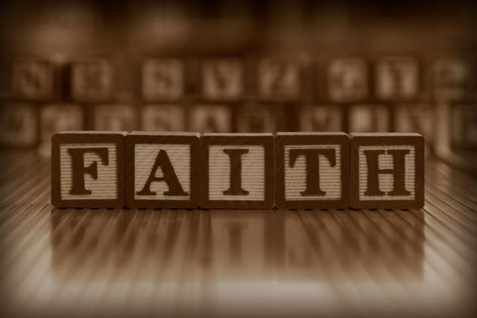
The 10 Basic principles of faith - Summary
    P1. God is a God of love covenants: He deals with us in covenant; i.e. a binding commitment to promises which represent His will for us. But His covenant¹ is rooted in His steadfast love & faithfulness towards us
    P2. He fulfills His promises by His Word. He sends His Word to accomplish His purposes
    P3. Faith is trusting God’s Word because we trust Him. His Word is as true as His character; therefore, faith is trusting God’s Word is always fully true, because we trust Him
    P4. Faith trusts God’s Word over observable reality. Faith sees God’s Word as the final word, the ultimate reality. Faith sees observable ‘reality’ through the lens of God’s Word
    P5. We access grace when we act on God’s Word. ‘Faith’ without corresponding actions is dead. Faith ‘comes alive’ when we act on the Word. Since all His promises are ours “by grace through [living] faith”, grace becomes manifest when we act on God’s Word
    P6. Therefore, our experience of God is dictated by whether we act on His Word. If we believe His Word and act on it, we experience His grace. If we don’t, we don’t. But grace is still not ‘earned’ by obedience, because faith-based obedience originates in grace
    P7. Tense matters! We must know what is for today. Promises are either for 1) now (e.g. rebirth), 2) this life (e.g. sanctification), or 3) eternity (e.g. perfection). We must believe now to receive now, so we must know what is for today.
    P8. We say what we believe, so we get what we say. Speaking from the heart is the first act of faith. When we speak in agreement with God’s Word, we reveal faith. When we speak contrary to God’s Word, we reveal unbelief
    P9. Our main weapon to overcome satan is confessing God’s Word. Because we receive God’s promises by faith, the devil’s strategy against us is always deception, and we always overcome by holding onto God’s Word
    P10. We can and must grow in faith. ‘Faith comes’ – that is, if we don’t have enough of it we can get more. We grow in faith by meditating on the Word of God

