Slide 1
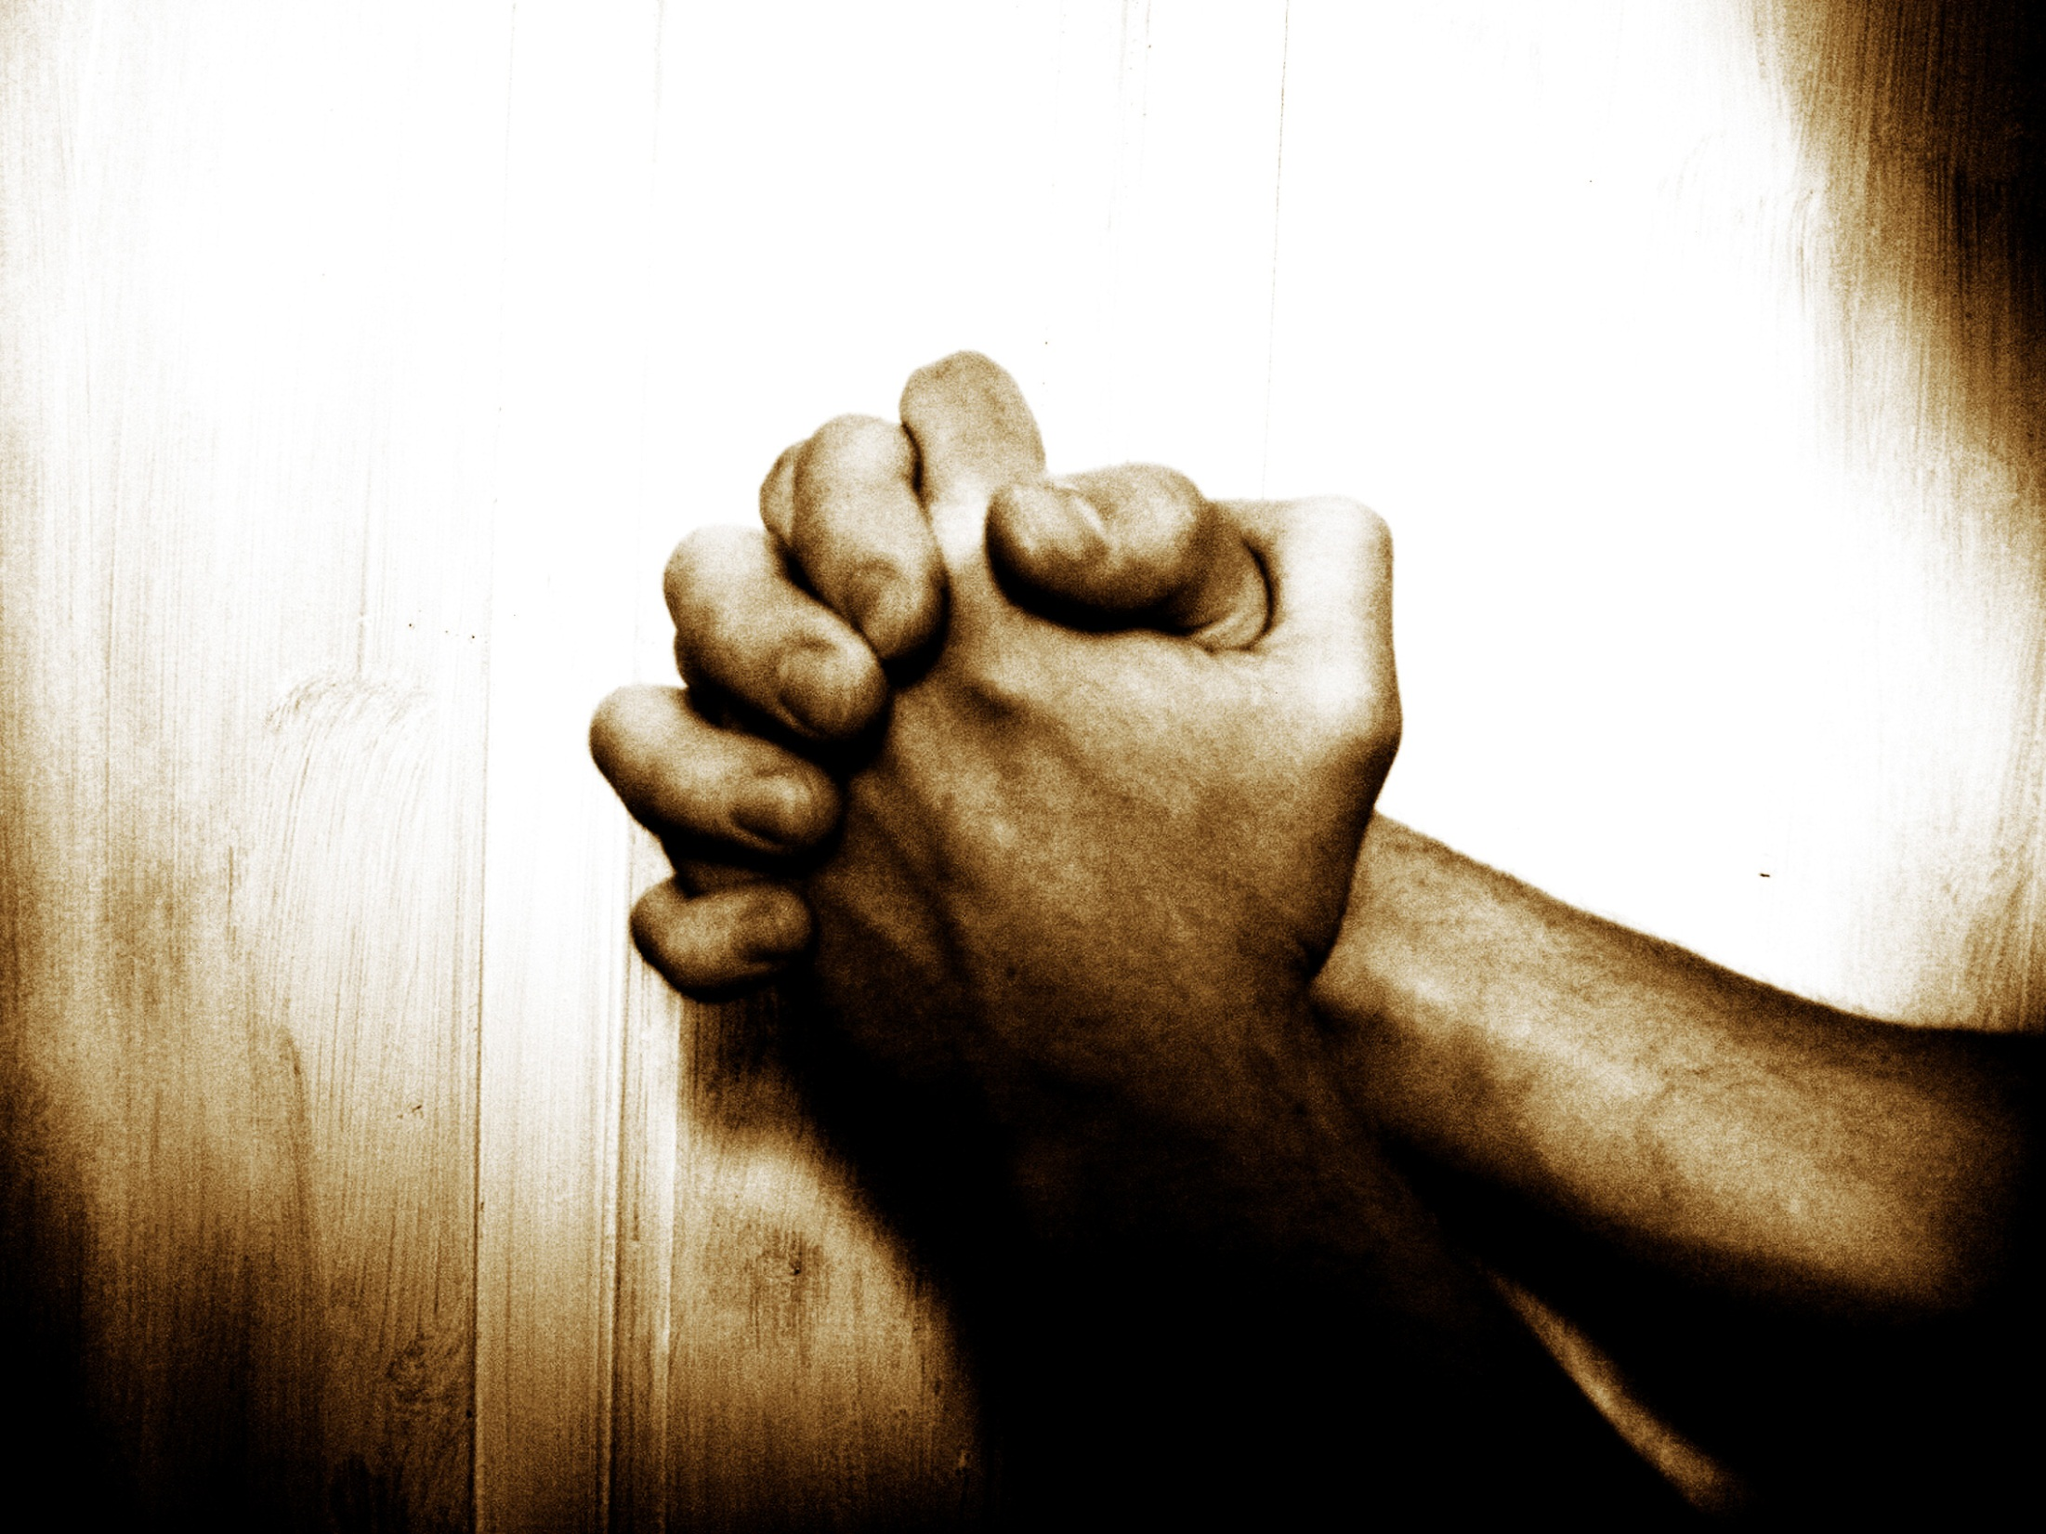

“Our Father”…
… A Prayer Journey
Jan 2014
2 Chron. 7:14
If My people who are called by My name...

Slide 2
RECAP (1 / 6): The call to prayer
“And [Jesus] spake a parable unto them to this end, that men ought always to pray, and not to faint; ” (Luke 18:1)
Rejoice in hope, be patient in tribulation, be constant in prayer (Ro 12:12)
“Continue [always be] in prayer, and watch in the same with thanksgiving” (Colossians 4:2)
…praying at all times in the Spirit, with all prayer and supplication (Eph 6:18-20)
Rejoice always, pray without ceasing, give thanks in all circumstances; for this is the will of God in Christ Jesus for you (1 Thess 5:16-24)

Slide 3

RECAP (2 / 6): The Great Prayer Disconnect
"We are too busy to pray, and so we are too busy to have power. We have a great deal of activity, but we accomplish little; many services, few conversions; much machinery but few results."
R. A. Torrey
The Great Prayer Disconnect:
There is a total disconnect between how important prayer is to us, & how important it is to the Lord. He calls us to pray without ceasing. We hardly pray at all…

Slide 4
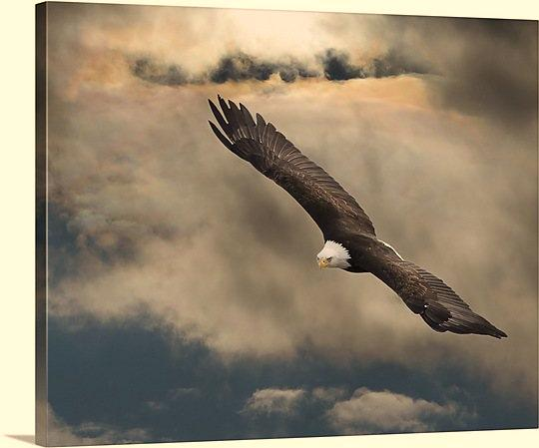
RECAP (3 / 6): The problem …
Do not believe in the
importance & power of prayer
Do not enjoy prayer
AND: The devil wars against our time in the secret place
Isaiah 40…
    P3. The 2 great enemies of prayer are
    1) our paradigm of prayer
    (importance, pleasure, power)
    2) And the devil

Slide 5
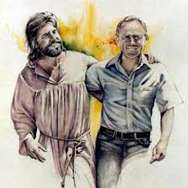
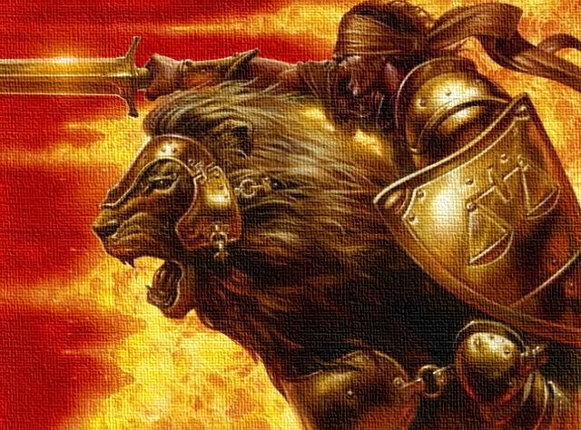
RECAP (4/6): Why does God want us to pray?
Why does God want us?
“We preach the gospel to you so that you can have the same <koinonia> we have, which is <koinonia> with God” (1 Jn 1:3)
Koinonia = Fellowship = Sharing life = …
Intimacy
partnership
+
  Gen 2:18a
  Gen 2:18b
    P1. God wants us to pray because
    He wants to share life with us

Slide 6

RECAP (5 / 6): The golden thread of Intimacy
Genesis 1
Genesis 2
Genesis 3
Jer 31:31-34
Jer 31:31-34
Isaiah 7
Isaiah 62
John 17:3, 25
John 17:24
John 14
Revelation 19
“…It was very good”
“On the 7th day…”
“Adam…”
“Though I was their…”
“They shall all know [yada] me”
“His name shall be called…”
“As the bridegroom rejoices”
“This is eternal life…”
“I desire that they would…”
“He shall be…”
“Hallelujah…”

Slide 7
RECAP (6 / 6): The Intimacy
Paradigm
The Almighty is my Dad
He loves me AND He really LIKES me
He wants to build the deep
fellowship of a Father and
a son, who is a best friend, with me
He is always with me, but He delights in devoted times alone with me
When I approach Him in prayer, He eagerly awaits manifesting Himself to me in a glory reserved for these devoted times
“There is not in the world a kind of life more sweet and delightful than that of a continual conversation with God."
Brother Lawrence

Slide 8

Why Pray? Part 2
“Our Father”… A Prayer Journey
Week 2 of 8
Session 2 of 13
Feb 2013
2 Chron. 7:14
If My people who are called by My name...

Slide 9
Reminder: How to get maximum
HEAR: Him who has ears, let him hear what the Spirit has to say
TRUST: Father to work miracles in your heart
ENGAGE: hungry heart, repentant (committed to Word-aligned action)
PRAY: 80% about prayer at home

Slide 10


More than 1.5 billion people around the world live on less than
R10 a day.
What must life be like
?

Slide 11
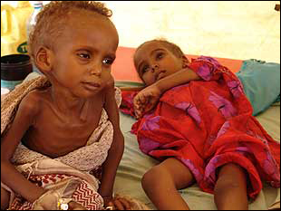
More than 50% of Africans suffer from water-related diseases such as cholera & infant diarrhea.

Slide 12
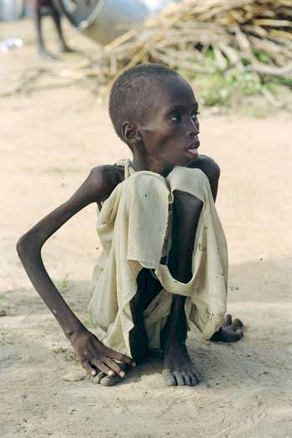

Slide 13
The Lord watches over the sojourners;
he upholds the widow and the fatherless
Ps 146:9
? ? ?

Slide 14
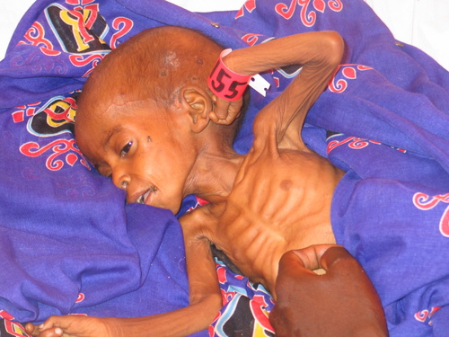
More than
800 million
people go to bed hungry
every day
300 million are children

Slide 15
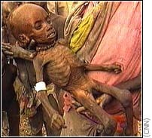
Every year six million children die from malnutrition before their fifth birthday.

Slide 16
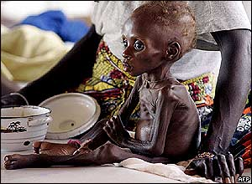
That’s one child dead every 5 to 6 seconds…
… from hunger

Slide 17
“I know the LORD will get justice for the poor and will defend the needy in court”
Ps. 140:12
[He] gives food to the hungry.
Ps 146:7
???

Slide 18
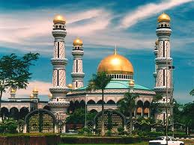
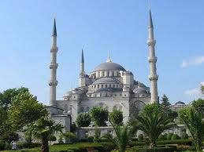
865 million Muslims have never heard about Jesus
?
What will death be like

Slide 19
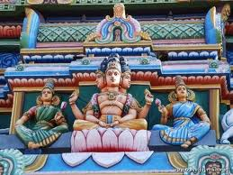
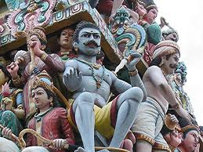
550 million Hindus have never heard of Jesus

Slide 20
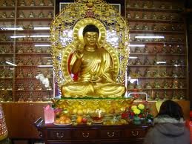
275 million unreached Buddhists

Slide 21
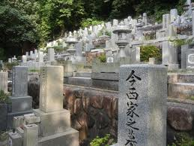
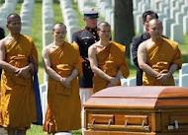
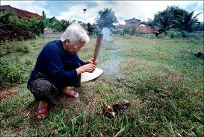
66,000 people die every day in communities that have never heard of Jesus

Slide 22
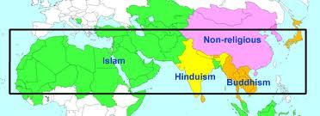
4 billion people in “the 10/40 window” may die never having heard of Jesus

Slide 23
God our Savior… desires
to be saved and to come to the knowledge of the truth (1 Ti 2:3–5)
all people
???

Slide 24
Where is God?

Slide 25
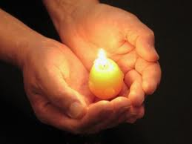
Go therefore
All authority in heaven and on
earth has been given to me.
and make disciples of all nations, baptizing them in the name of the Father and of the Son and of the Holy Spirit, teaching them to observe all that I have commanded you. And behold, I am with you always, to the end of the age
Mt 28:16–20
Go therefore

Slide 26
“…all who call on the
Lord will be saved…
How then will they call on him in whom they have not believed?
And how are they to believe in him of whom they have never heard?
And how are they to hear without someone preaching?
And how are they to preach unless they are sent?
… “How beautiful are the feet of those who preach the good news!” (Ro 10:8–15)

Slide 27
“
And God gave the apostles, the prophets, the evangelists, the pastors and teachers,
to equip the saints ,
to build up the body of Christ,
until we are all fully united in faith
and the knowledge of Jesus,
and are fully mature in Christ
(Eph 4:11-13)
to do His works
”

Slide 28
“
All this is from God, who through Christ reconciled us to himself and gave us the ministry of reconciliation; that is, in Christ God was reconciling the world to himself… and entrusting to us the message of reconciliation. Therefore, we are ambassadors for Christ,
God making his appeal through us.
(2 Co 5:18–20)
”

Slide 29
“
Since we are surrounded by so great a cloud of witnesses, let us lay aside every hindrance, and sin which clings so closely, and let us with endurance the race that is set before us, looking to Jesus, the author and perfecter of our faith
(Heb 12:1–2)
run
”

Slide 30
SO WHERE IS GOD?
P1. God's remedy for the world is Christ, in US

Slide 31




I. Why pray?
II. Foundations for effective prayer
III. Practicing prayer:
7 types: Principles & tools
Part 1 – Intro
Part 2 – Intimacy
Part 3 –
Part 4 –
1 – Intro
2 – Intimacy
3 – Partnership
4 – Prayer
This week

Slide 32
P2. The golden thread of PARTNERSHIP is woven from beginning to end of scripture
Gen 1: ADAM’s dominion”
Gen 6: Noah’s ark
Gen 12: Abram
Gen 37: Joseph - “for good”
Ex 3: Moses “bring this people”
Josh 1: Joshua - “…you shall cause this people to inherit”
Mark 3: Jesus & 12 disciples
Mt 28: “Go therefore”
2 Cor 5: The Church - “gave us the ministry”
Eph 4: The 5-fold ministry
(Mark 3:13–15)
“And he went up on the mountain and called to him those whom he desired, & they came to him. And he appointed twelve (whom he also named apostles) so that…
  …they might be with him [intimacy]
  … & he might send them out to preach & have authority to cast out demons. ” [partnership]
[fellowship]
Notes:
INTRO
Last week we looked at the golden thread of intimacy. How Father reveals His burning zeal to enjoy intimacy with us right throughout scripture.
This week, we're looking at the golden thread of Partnership. You see, you can see God's jealous passion to do His works in partnership with His people from beginning to end of scripture..... It fills the scripture and colors the entire history of mankind
So lets begin at the beginning… Genesis Ch 1

Slide 33
P3. Partnership & intimacy are part of the same fellowship package described in Jn 14&15
Love for Jesus
The fellowship with God package
1 | If you love me, you will keep my commands (Jn 14:15 ; Jn 14:23-24 ; Jn 14:21)
2 | Keep My commandment and … the Father… shall give you another Comforter, that He may abide with you forever (14:15) He that has My commandments & keeps them, he it is that loves Me: and he that loves Me shall be loved of my Father, and I will love him, and will manifest Myself to him (14:21). If a man love Me, he will keep My words: and My Father will love him, and We will come unto him, and make Our abode with him (14:23). If you keep My commandments, you will abide in My love (15:10)
3 | Jn 15:5 ; Jn 15:16 | 6 | Jn 15:16
4 | Jn 15:7 | 7 | Jn 15:16-17
5 | Jn 15:16-17 | 8 | Jn 15:11
Obedience/ partnership
(i.e. real faith)
Fellowship
1
Intimacy (abiding in Jesus, and He in us)
2
Much Fruit
3&4
Answered
prayer
Glory to God
6
5
7
Fullness of joy
8
Notes:
How does this correspond with Grace?
Easy… grace makes you love Jesus
→ It’s one package guys. Obedience to God – desiring to know and to give our lives to doing His will and being used by Him for Him to fulfill His plans through lives – that’s partnership with God, and that’s part of the same package of knowing Jesus as intimacy. It’s one package. You either have the package, or you don’t. So if you don’t have obedience, then you don’t have the package, and then you don’t have any of these things in the package… that’s how it is…
Do you have the package? Or do you need to get the package?

Slide 34

P4. Father has made His mission the family business, and working in the family business is our identity in Christ
Family / household / child of God
Temple of God
Bride of Christ – “helper”
Servants of God - to steward His talents and create increase
God’s army, to wage His warfare
God’s Governing Assembly
God’s workmanship –
to do His good works
Jesus’ Body – His hands and feet to do His works in the earth
The vine & branches, to bare fruit
For by grace you were saved through faith; and that not of yourselves: it is the gift of God: Not of works, lest any man should boast…For we are his workmanship, created in Christ Jesus FOR GOOD WORKS, which God prepared before hand that we should walk in them
(Eph 2:8-10)

Slide 35
P5. In the context of being God’s family, we are all called to a missional lifestyle
"devoting yourselves to good works" (Tit 3:8)
Be "ready for every good work" (Tit 3:1)
“don’t weary of doing good" (2 Thes 3:13)
“Therefore, my beloved brothers, be steadfast, immovable, always abounding in the work of the Lord, knowing that in the Lord your labor is not in vain”. (1 Co 15:58)
Did Paul forget about grace? Did he revert to Law?

Slide 36
P6. The “grace package” includes God’s Spirit working in our hearts to make us passionate about His mission and works
Titus 2:11–14
“For the grace of God has appeared:
bringing salvation for all people,
training us to
  renounce ungodliness and worldly passions
  and to live self-controlled, upright, and godly lives in the present age,
  waiting for our blessed hope, the appearing of the glory of our great God and Savior Jesus Christ
…who gave himself for us to…
  redeem us from all lawlessness
  and to purify for himself a people for his own possession who are zealous for good works.”

Slide 37
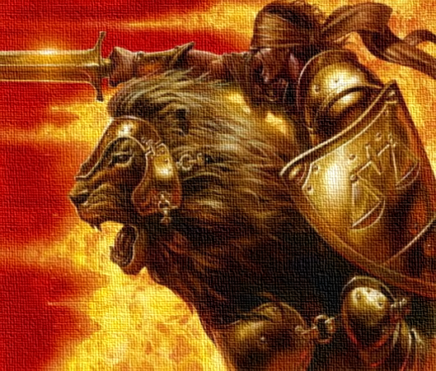
WHY?...
Fellowship!
  Father delights in sharing life together with you
  Partnership is an integral part of sharing life – He wants us to share His mission
That’s why Kingdom building – the ministry of reconciliation - is the family business!!!
That’s why serving God is the natural response of saving faith
P7. Said another way, because Father wants to share life with us, sharing His mission is built into salvation
Notes:
Are you sharing life with God?
What could change in your life if you were sharing life with God?
What would be possible if you were walking In companionship with the God of the impossible?

Slide 38
P8. BUT: Intimacy must come first
Jesus entered a village. And a woman named Martha welcomed him into her house. And she had a sister called Mary, who sat at the Lord’s feet and listened to his teaching. But Martha was distracted with much serving. And she went up to him and said, “Lord, do you not care that my sister has left me to serve alone? Tell her then to help me.” But the Lord answered her, “Martha, Martha, you are anxious and troubled about many things, but one thing is necessary. Mary has chosen the good portion, which will not be taken away from her.”
(Luke 10:38-42)
God wants you, before he wants you to…

Slide 39

Summary
Father desires fellowship (to share life) with us
Fellowship includes partnership – sharing His mission
Therefore, He gave us His mission “of reconciliation” to us
Intimacy and partnership are part of the same fellowship package – when we seek Jesus, we seek fellowship with God, & we seek intimacy & partnership. No partnership, no fellowship
Koinonia = Fellowship = Sharing life =

Slide 40
Discussion – groups of 4
Do you see God’s call to share His mission?
How does this compare to your present understanding of living by grace?
How does it make you feel?
  Excited? Scared? Uncertain? Guilty? Challenged? Unworthy? Bold? Expectant?
What do you think “being zealous for good works” “looks like” for us?

Slide 41
I. Why pray?
II. Foundations for effective prayer
III. Practicing prayer:
7 types: Principles & tools
Part 1 – Intro
Part 2 – Intimacy
Part 3 –
Part 4 –
1 – Intro
2 – Intimacy
3 – Partnership
4 – Prayer

Slide 42
Notice the role of prayer in the
“Love Jesus package”…
"The men who have done the most for God in this world have been early on their knees”
E.M. Bounds
Love for Jesus
The fellowship with God package
Obedience/ partnership
Fellowship
1
Intimacy
P1. Prayer is the departure point for God using us
2
Much Fruit
Answered
prayer
3&4
Answered
prayer
Glory to God
6
5
7
Fullness of joy
8

Slide 43
And notice the order…
The Lord will wait, that He may be gracious to you... He will be very gracious to you at the sound of your cry; when He hears it, He will answer you.
(Isa. 30:18-19)
The Lord is near to all who call on him, to all who call on him in truth. He fulfills the desire of those who fear him; he also hears their cry and saves them.
(Ps 145:18–19)
"God does nothing except in response to believing prayer."
John Wesley
P2. Father waits on our prayers before releasing His grace, in answer to our prayer
Notes:
What comes first? God answering, or our prayer?
What comes first, God saving, or our crying out for Him to save us?
Are you noticing the trend here? HE WANTS on our prayers…
So what happens then if we don’t cry out for help?
… now I always hear these nice rosey sayings about how God doesn’t need us to pray before He can help us – He’s bigger than that… now that’s true, He is bigger than that , but the bible doesn’t tell us that He acts without our prayers. You can see it there for yourself – it says He WAITS on our prayers before acting… I mean, is it just me, or is it dead clear there?
Well in case you think – that’s only 2 old testament passages, that doesn’t limit God – lets take a look at how this same statement is repeated over and over again in the new testament.…

Slide 44
5 things that come through prayer
Fruits of prayer
1
2
3
4
5

Slide 45
1. Intimacy comes through prayer
1
Draw near to God and He will draw near to you (Jas 4:8)
Let us draw near (Heb 4:16)
"Prayer is the acid test of devotion."
Samuel Chadwick
Notes:
When we look through the new testament, we find 4 things the bible tells us that come in answer to our prayers… these will surprise you, I mean you would think, God already knows what I need, and He loves me, and is always looking out for me, I mean, He doesn’t need to wait on my prayer…
And using human reasoning, thats obvious. But the bible doesn’t always bow to our sentimental human reasoning…
The first thing the bible tells us father gives us only in answer to prayer, is provision – I mean, our loving Father does provide for all our needs, but He does so, in answer to our prayers…
- Here we have both the positive AND the negative…

Slide 46
2. Provision comes through prayer
2
You do not have because you do not ask (Jas 4:2)
“Ask, and it will be given to you; seek, and you will find; knock, and it will be opened to you. (Mt 7:7–11)
"Prayer is not overcoming God's reluctance, but laying hold of His willingness."
Martin Luther.
Notes:
When we look through the new testament, we find 4 things the bible tells us that come in answer to our prayers… these will surprise you, I mean you would think, God already knows what I need, and He loves me, and is always looking out for me, I mean, He doesn’t need to wait on my prayer…
And using human reasoning, thats obvious. But the bible doesn’t always bow to our sentimental human reasoning…
The first thing the bible tells us father gives us only in answer to prayer, is provision – I mean, our loving Father does provide for all our needs, but He does so, in answer to our prayers…
- Here we have both the positive AND the negative…

Slide 47
3. Protection & deliverance come through prayer
3
We do not wrestle against flesh and blood, but against principalities, against powers, against the rulers of the darkness...in the heavenly places. In all circumstances take up [your armor] … praying at all times in the Spirit, with all prayer and supplication. (Eph 6:16-18)
This will turn out for my deliverance through your prayer... (Phil. 1:19)
Notes:
Lets remember this is our heavenly loving Father, who delights in us, who alone is all knowing, all powerful, and all loving … surely He protects me whether I am praying or not? He doesn’t need me to be praying, to be protecting me… He is bigger than that?
Well yes he is. But again scripture often does not agree with our sentimental human reasoning. Scripture just tells us how it is, and scripture tells us that Father protects us when we pray…
SCRIPTURES
Are you getting the pattern yet?
What comes first – our prayers, or God’’s grace?

Slide 48
4. Power in ministry comes through prayer
4
"If I fail to spend two hours in prayer each morning, the devil gets the victory through the day. I have so much business I cannot get on without spending three hours daily in prayer.”
Martin Luther
… praying at all times in the Spirit, with all prayer and supplication. To that end keep alert with all perseverance, making supplication for all the saints, and also for me, that words may be given to me in opening my mouth boldly to proclaim the mystery of the gospel, for which I am an ambassador in chains, that I may declare it boldly, as I ought to speak (Eph 6)
Notes:
Lets just put this in perspective here… this is Paul the Apostle, responsible for taking the gospel to all gentile nations, and for writing most of the new testament.
- who’s idea was it to call paul as an apostle?
… and to anoint paul with power from on High?
And to send him to preach the gospel?
So surely its automatic that God would give him grace to preach the gospel boldly and clearly , right?
Well look at what he says – pray for me, that God would give me words to preach the gospel boldly!!!
This is Paul. That’s basically his job! Yet he tells us he needs prayer for God to give him the grace to do, what God has already commissioned and empowered Paul to do!
Are you getting the pattern yet?
What comes first – our prayers, or God’’s grace?

Slide 49
5. Fulfillment of His purposes comes through prayer (1/2)
“I would rather teach one man to pray than ten men to preach.”
Charles Spurgeon
“The man who mobilizes the Christian church to pray will make the greatest contribution to world evangelization in history.”
Andrew Murray
5
… Pray ye therefore the Lord of the harvest, that he will send forth labourers into his harvest. Matt 9:35-38
Pray then like this: “Our Father in heaven, hallowed be your name. Your kingdom come, your will be done, on earth as it is in heaven. Matt 6:9-13
Notes:
Just to put the nail in the coffin, scripture also tells us that even Father’s own purposes are accomplished through our prayers…
Who’s idea was the gospel ?
Who’s idea was it to make preaching the gospel the plan of salvation for the world?
And is He incompetent – do you think there’s some kind of risk God might, you know, have this plan to send this gospel to the world, but not really you know do anything about it, like send people?
And do you think He’s forgetful, like He might forget to send people?
Yet JESUS tells us to pray for God to send men into the harvest…
I mean can you fathom it?
But Are you getting the pattern now?
What comes first – our prayers, or God acting?

Slide 50
5. Fulfillment of His purposes comes through prayer (2/2)
5
Prayer for revelation of Jesus- so we will walk in our calling & destiny by God’s power
  That the Father of glory, may give to you the spirit of wisdom and revelation in the knowledge of Him, the eyes of your understanding being enlightened; that you may KNOW (experience) what is the hope of His calling (assurance/clarity of God’s call for our life) what are the riches of the glory of His inheritance in the saints (our destiny as Jesus’ inheritance), and what is the exceeding greatness of His power toward us who believe, according to the working of His mighty power... (Eph. 1:17-19)
Prayer to receive the Spirit’s power, Jesus indwelling Presence, and to experience God’s love
  THAT He would grant you, according to the riches of His glory, to be strengthened with might through His Spirit in the inner man, THAT Christ may dwell (manifest His presence) in your hearts through faith; THAT you, being rooted and grounded in love, may be able to comprehend (experience) with all the saints what is the width and length and depth and height-- to know the love of Christ which passes knowledge; THAT you may be filled with all the fullness of God. (Eph. 3:16-19)
Prayer for God’s love to abound in us by the knowledge of God resulting in righteous living
  That your love may abound still more and more in knowledge (of God) and all discernment, that you may approve (rejoice in) the things that are excellent, that you may be sincere (no compromise) and without offense till the day of Christ, being filled with the fruits of righteousness... (Phil. 1:9-11)

Slide 51

2 mysteries of prayer

Slide 52
The first mystery of prayer…
Why does He wait, if He knows what I need?
The Lord will wait, that He may be gracious to you...
He will be very gracious to you at the sound of your cry; when He hears it, He will answer you (Isa. 30:18-19)
Why?
--- To “starve us out” of prayerlessness.
Why?
--- Jealously protecting His fellowship with us by not answering us until we connect with Him by asking
Why?
--- If we just received blessing and provision without asking, we would probably never seek fellowship with God
P3. In general, God waits for our prayers before releasing grace, because He desires fellowship with us
Notes:
So the million dollar question we’re all dying to ask – WHY does He wait?
I mean, He knows what is needed, He wants to do it, He plans to do it, He is able to do it… uhhhhh… WHY doesn’t He just do it? Why does He wait?
Well I can tell you why I think He does…
Is God waiting for you? What are you waiting for God to do, that He is waiting for you to pray for Him to do?

Slide 53
The second mystery of prayer…
Why must we pray for what He wants to do, if’s He wants to & is fully committed to doing it?
We are called…
  … to know His heart and mind and voice in intimacy
  … so we will know what He wants to do
  … so we can ask Him to do what He wants to do
  … so He can do what He wants to do
  … in answer to our prayers
Why?
P4. We come into agreement with God’s heart and pray His will so He will accomplish it in partnership with us, as we seek to know, align with & satisfy His heart

Slide 54
Why Pray - Summary
Koinonia = Fellowship = Sharing life =
We need a fundamental change in paradigm towards prayer
Father wants us to pray because He wants FELLOWSHIP with us
  He DELIGHTS in us, & desires intimacy with us with a bridegroom-like passion
  He wants to build His Kingdom in partnership with His sons & daughters
  Hence, His eternal plans will come to pass through our prayers & service
He has made prayer the place of deepest pleasure (enjoying Him) & greatest power
"Prayer does not fit us for the greater work; prayer is the greater work." Oswald Chambers.

Slide 55
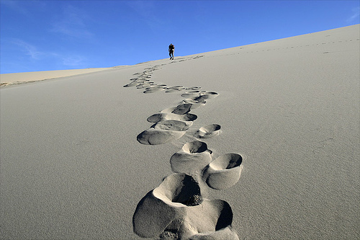


P5. The 3 paradigms of prayer: the intimacy paradigm,
the partnership paradigm, and the power paradigm
The Intimacy Paradigm:
The Partnership paradigm:
The Almighty is
my Dad. He loves me, AND He really LIKES me. He wants to build the deep fellowship of a Father and
a son, who is a best friend, with me. He delights in spending time with me. When I approach Him in prayer, He is eagerly waiting for me
God is committed to reconcile the world to Himself, in partnership with His people, & me. I am instrumental to Father’s mercy reaching others. My works of faith will really count for all eternity! I was born again into His mission!
The Power of Prayer Paradigm
Father fulfils His plans primarily by leading and answering the prayers of His people. Therefore my prayers are immensely powerful and important . I trust Father to move mountains through my prayer.

Slide 56
Discussion
General impressions on “Why Pray?”
Reflections on the 3 paradigms of prayer
Reflections on how prayer will change for you going forward

Slide 57
T1. The Intimacy Paradigm
The Almighty is my Dad
He loves me AND He really LIKES me
He wants to build the deep
fellowship of a Father and
a son, who is a best friend, with me
He is always with me, but He delights in devoted times alone with me
When I approach Him in prayer, He eagerly awaits manifesting Himself to me in a glory reserved for these devoted times
“There is not in the world a kind of life more sweet and delightful than that of a continual conversation with God."
Brother Lawrence

Slide 58
T2. The Partnership Paradigm
God is always good – He is never short of perfect in love, wisdom, goodness, and power
God is always God – He is totally in charge. He always reigns fully over the affairs of all men
Nothing is impossible with God – He can accomplish whatever He wants to, no mountain cannot be moved, and nothing can thwart His will
Father’s primary purpose for me is fellowship with Him – both intimacy and partnership in doing His works; in that order, but both
We are in a war – the prince of this world is still prince, and wages war against us
The battle is already won in Christ – The devil was rendered powerless by the Cross, God’s eternal purposes are secure
…but the victory of Christ is still being worked out, day by day, in my life – e.g. the Old man has been crucified with Christ, but that becomes manifest in time and space when I walk by faith in what He has done (walk in the new man in Christ, led by the Spirit)
I am instrumental to Father’s purposes being fulfilled in human history - He intends to fulfil many of His purposes through me as I imitate Jesus
I will be judged for my faithfulness to the works He has given me – I will look Jesus in the eyes and give an account for my life; my eternal reward is based on the fruit I bare for Him
I am totally dependent on Him to bare fruit – “Not by might, nor by power, by by My Spirit” - it is only by abiding in Him that I will bare fruit. It is Christ in me, the hope of glory.
He is totally faithful – He WILL bare fruit through me as I abide in Him and in prayer

Slide 59
T3. The Power of Prayer Paradigm
Father is committed to accomplishing His purposes in and through me
He does so primarily by leading and answering my prayers
Therefore my prayers are both very powerful and very important
Therefore, there is no work more important than the work of prayer
I trust Father to move mountains through my prayer
"If you want that splendid power in prayer, you must remain in loving, living, lasting, conscious, practical, abiding union with the Lord Jesus Christ."
Charles Spurgeon

Slide 60
T4. The Apostolic Prayers (1/2)
Prayer for revelation of Jesus’ beauty that we might walk in our calling and destiny by God’s power
  17 That the Father of glory, may give to you the spirit of wisdom and revelation in the knowledge of Him, 18 the eyes of your understanding being enlightened; that you may KNOW (experience) what is the hope of His calling (assurance/clarity of God’s call for our life) what are the riches of the glory of His inheritance in the saints (our destiny as Jesus’ inheritance), 19 and what is the exceeding greatness of His power toward us who believe, according to the working of His mighty power... (Eph. 1:17-19)
Pray to receive the Spirit’s power that Jesus’ Presence be manifest in us so we experience God’s love
  16 THAT He would grant you, according to the riches of His glory, to be strengthened with might through His Spirit in the inner man, 17 THAT Christ may dwell (manifest His presence) in your hearts through faith; THAT you, being rooted and grounded in love, 18 may be able to comprehend (experience) with all the saints what is the width and length and depth and height-- 19 to know the love of Christ which passes knowledge; THAT you may be filled with all the fullness of God. (Eph. 3:16-19)
Prayer for God’s love to abound in us by the knowledge of God resulting in righteousness in our life
  9 That your love may abound still more and more in knowledge (of God) and all discernment, 10 that you may approve (rejoice in) the things that are excellent, that you may be sincere (no compromise) and without offense till the day of Christ, 11 being filled with the fruits of righteousness... (Phil. 1:9-11)
Prayer to know God’s will, to be fruitful in ministry and strengthened by intimacy with God
  9 That you may be filled with the knowledge of His will in all wisdom and spiritual understanding; 10 that you may have a walk worthy of the Lord, fully pleasing Him, being fruitful in every good work and increasing in the knowledge of God; 11 strengthened with all might, according to His glorious power, for all patience and longsuffering with joy... (Col. 1:9-11)

Slide 61
T4. The Apostolic Prayers (2/2)
Prayer for unity in the church and to be filled with supernatural joy, peace and hope (confidence)
  5 May the God of patience and comfort grant you to be like-minded toward one another...6 that you may with one mind and one mouth glorify the...Father...13 May the God of hope fill you with all joy and peace in believing, that you may abound in hope by the power of the Holy Spirit. (Rom. 15:5-6, 13)
To be enriched by all the gifts of the Spirit including powerful preaching and prophetic revelation
  5 That you were enriched in everything by Him in all utterance (anointed preaching/singing) and all knowledge (prophetic revelation), 6 even as the testimony of Christ was confirmed in you (by miracles), 7 so that you come short in no gift, eagerly waiting for the revelation of...Jesus Christ, 8 who will also confirm you to the end, that you may be blameless in the day of our Lord Jesus Christ. (1 Cor. 1:5-8)
For the release of grace to bring the Church to maturity especially to abound in love and holiness
  10 Praying exceedingly that... (God will release His Spirit and grace to) perfect what is lacking in your faith...12 And may the Lord make you increase and abound in love to one another and to all... 13 that He may establish your hearts blameless in holiness before our God and Father.
  (1 Thes. 3:10-13)
Pray to be worthy (prepared or made spiritually mature) to walk in the fullness of our destiny in God
  We pray always for you that God would count you worthy of (prepare us for) this calling, and fulfill all [His plans for us through faith, with power] that the name of...Jesus may be glorified in you, and you in Him, according to the grace of our God. (2 Thes. 1:11-12)

