Slide 1
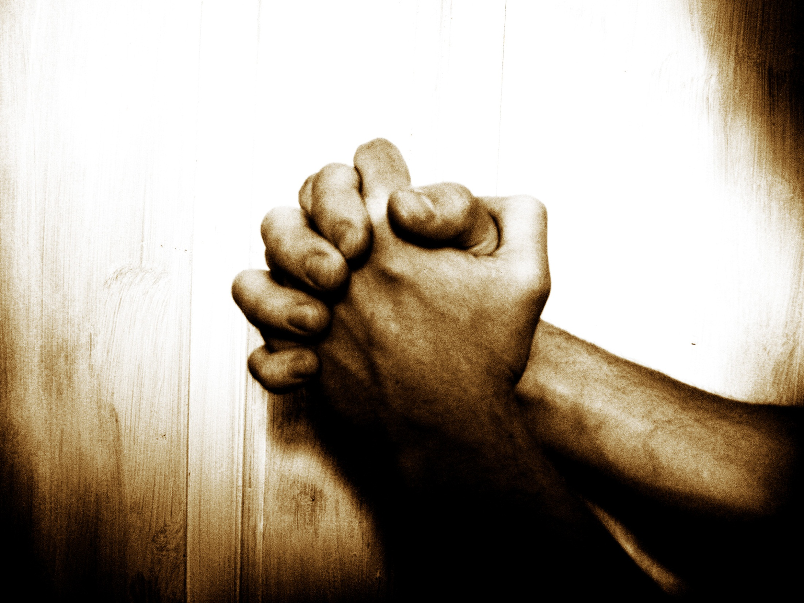

“Our Father”…
… A Prayer Journey
Jan 2014
2 Chron. 7:14
If My people who are called by My name...

Slide 2
For the Spirit searches everything, even the depths of God. For who knows a person’s thoughts except the spirit of that person, which is in him? So also no one comprehends the thoughts of God except the Spirit of God. Now we have received not the spirit of the world, but the Spirit who is from God, that we might understand the things freely given us by God.
(1 Cor 2:10-12)

Slide 3

About “Our Father”
An Alpha S.A resource
A response to cry for help from churches
A work in progress: 3 years, v3.0
An aid: to facilitate a journey of the heart

Slide 4
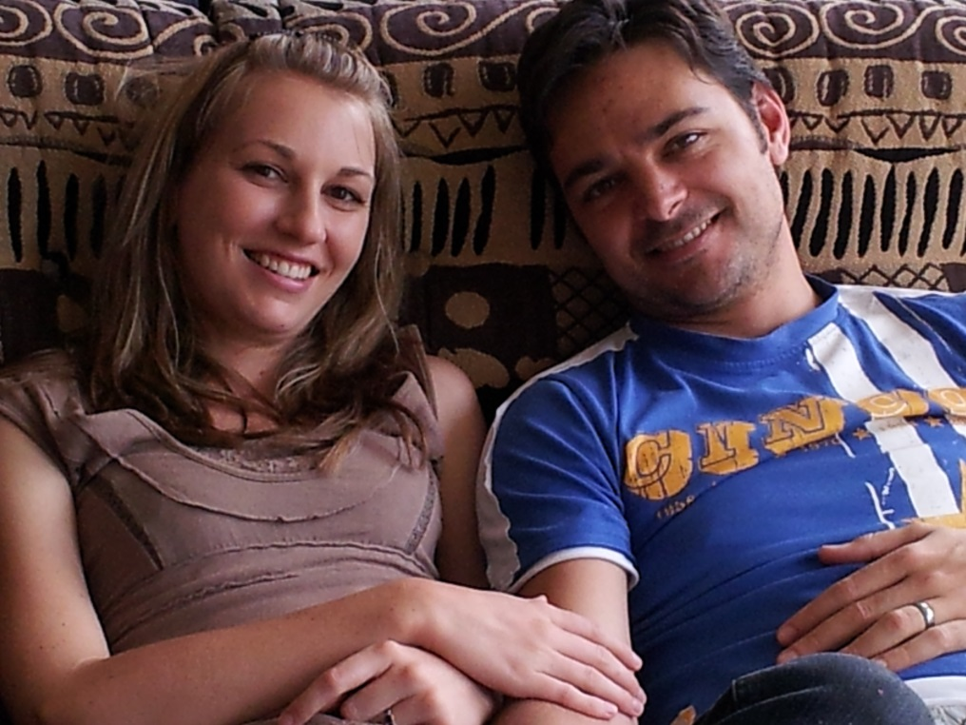
About me

Slide 5
Housekeeping
7pm – 920pm
50% teaching, 25% discussion, 25% prayer
Notes at end of evening (from week 2)
Downloadable prayer aid materials
(weeks 4 – 8)
Optional Saturday (half day) faith workshop
Optional Saturday prayer retreat
Cameras
Phones

Slide 6
How to get maximum
HEAR: Him who has ears, let him hear what the Spirit has to say
TRUST: Father to work miracles in your heart
ENGAGE: hungry heart, repentant (committed to Word-aligned action)
PRAY: 80% about prayer at home

Slide 7



I. Why pray?
II. Foundations for effective prayer
III. Practicing prayer:
7 types, with principles & tools
Weeks 1 & 2
Weeks 3 & 4
Weeks 5 - 8

Slide 8
I. Why pray?
II. Foundations for effective prayer
III. Practicing prayer:
7 types: Principles & tools

Slide 9
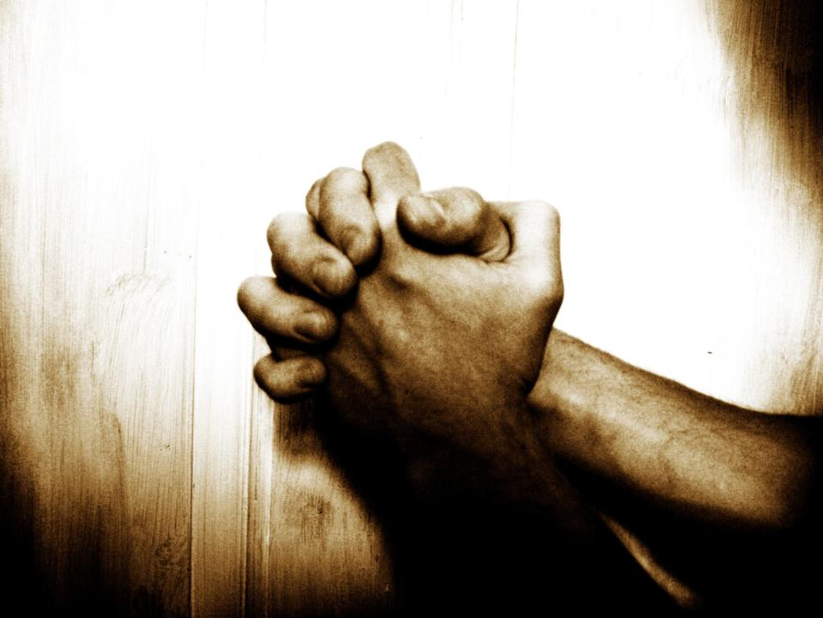

Why Pray?
“Our Father”… A Prayer Journey
Week 1 of 8
Session 1 of 13
Jan 2014
2 Chron. 7:14
If My people who are called by My name...

Slide 10

Some questions…

Slide 11
The call to prayer
“And [Jesus] spake a parable unto them to this end, that men ought always to pray, and not to faint; ” (Luke 18:1)
Rejoice in hope, be patient in tribulation, be constant in prayer (Ro 12:12)
“Continue [always be] in prayer, and watch in the same with thanksgiving” (Colossians 4:2)
…praying at all times in the Spirit, with all prayer and supplication (Eph 6:18-20)
Rejoice always, pray without ceasing, give thanks in all circumstances; for this is the will of God in Christ Jesus for you (1 Thess 5:16-24)

Slide 12
What do you think He means by
“pray without ceasing”
What does He not mean?
What does He mean?
    P1. We have an amazing God. Our God pleads with us to pray, instead of us pleading with Him to listen.

Slide 13

How do our prayer lives compare to “pray without ceasing”?
"We are too busy to pray, and so we are too busy to have power. We have a great deal of activity, but we accomplish little; many services, few conversions; much machinery but few results."
R. A. Torrey
P2. The Great Prayer Disconnect:
There is a total disconnect between how
important prayer is to us, & how important it is to the Lord. He calls us to pray without ceasing. We hardly pray at all…

Slide 14
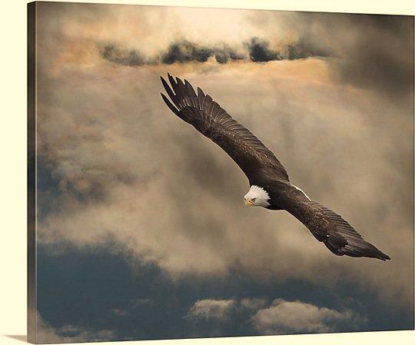
The problem …
Do not believe in the
importance & power of prayer
Do not enjoy prayer
AND: The devil wars against our time in the secret place
Isaiah 40…
    P3. The 2 great enemies of prayer are
    1) our paradigm of prayer
    (importance, enjoyment, power)
    2) And the devil

Slide 15
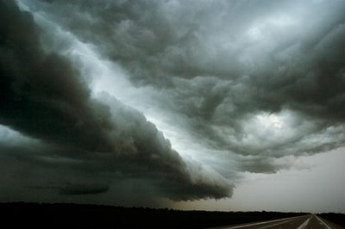
P4. First step to building a prayer life is changing our paradigm – prayer is:
“The one concern of the devil is to keep Christians from praying. He fears nothing from prayerless studies, prayerless work and prayerless religion. … but he trembles when we pray.”
Samuel Chadwick
THE source of deepest pleasure
KEY source of provision, protection, and power
The fountain of a Christian life
    With the right paradigm of prayer, we will win the war for time in prayer

Slide 16
Why pray?
Why does God want us to pray?
Why does God want us?
“That which we have seen and heard we proclaim also to you,
so that
you too may have fellowship <koinonia> with us; and indeed our fellowship <koinonia> is with the Father and with his Son Jesus Christ.” (1 Jn 1:3)
We preach the gospel to you
so that
you can have the same <koinonia> we have, which is <koinonia> with God
Fellowship = Koinonia = ?

Slide 17
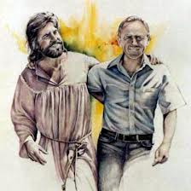
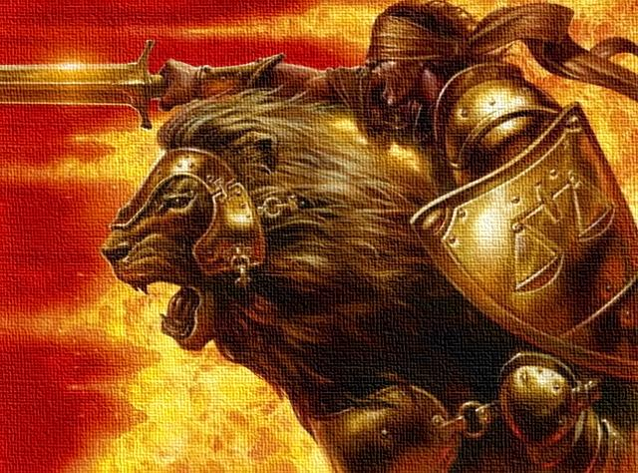
So what is <koinonia>?
Koinonia = Fellowship = Sharing life = …
Intimacy
partnership
+
  Gen 2:18a
  Gen 2:18b
    P1. God wants us to pray because
    He wants to share life with us

Slide 18
I. Why pray?
II. Foundations for effective prayer
III. Practicing prayer:
7 types: Principles & tools
Part 1 – Intro
Part 2 – Intimacy
Part 3 –
Part 4 –
1 – Intro
2 – Intimacy
3 – Partnership
4 – Prayer
This week
Next week

Slide 19

P2. The golden thread of Intimacy is woven from beginning to end of scripture
Genesis 1
Genesis 2
Genesis 3
Jer 31:31-34
Jer 31:31-34
Isaiah 7
Isaiah 62
John 17:3, 25
John 17:24
John 14
Revelation 19
“…It was very good”
“On the 7th day…”
“Adam…”
“Though I was their…”
“they shall all know [yada] me”
“His name shall be called…”
“As the bridegroom rejoices”
“This is eternal life…”
“I desire that they would…”
“He shall be…”
“Hallelujah…”

Slide 20
P3. Bridal intimacy is a call to us as individuals
“I will not leave you as orphans; I will come to you. …In that day you will know that I am in My Father, and you in Me,and I in you. Whoever has My commandments and keeps them, he it is who loves Me. And he who loves Me will be loved by My Father, and I will love him and manifest Myself to him… If anyone loves Me, he will keep my word, and My Father will love him, and We will come to him and make Our home with him.”

Slide 21
P4. The Intimacy Paradigm
The Almighty is my Dad
He loves me AND He really LIKES me
He wants to build the deep
fellowship of a Father and
a son, who is a best friend, with me
He is always with me, but He delights in devoted times alone with me
When I approach Him in prayer, He eagerly awaits manifesting Himself to me in a glory reserved for these devoted times
“There is not in the world a kind of life more sweet and delightful than that of a continual conversation with God."
Brother Lawrence

Slide 22
Example: David
The Lord is my light and my salvation; whom shall I fear? The Lord is the stronghold of my life; of whom shall I be afraid?
When evildoers assail me to eat up my flesh, my adversaries and foes, it is they who stumble and fall.
Though an army encamp against me, my heart shall not fear; though war arise against me, yet I will be confident.
One thing have I asked of the Lord, that will I seek after:
that I may dwell in the house of the Lord all the days of my life, to gaze upon the beauty of the Lord and to inquire in his temple. Psalm 27:1–4 (ESV)

Slide 23
20 min break out discussion -
Discussion points
Do you “see” the golden thread of intimacy in scripture?
  Have you seen it before?
  Do you see it now?
  Does it quicken your heart with faith & excitement?
  If not, what to do about it?
Are you walking in it? - Do you know God experientially, intimately?
How should this revelation of God’s desire for intimacy with me effect my prayer life?
How should it affect my life?
“We should dedicate ourselves to becoming in this life the most perfect worshipers of God we can possibly be”
Brother Lawrence
23

Slide 24
Prayer time –
Pray for:
Revelation & faith for intimacy
Deep desire for intimacy
Wisdom, faith & discipline to invest in nurturing intimacy
Experiential intimacy
“The Bible is not an end in itself, but a means to bring men to an intimate and satisfying knowledge of God, that they may enter into Him, that they may delight in His Presence, may taste and know the inner sweetness of the very God Himself in the core and center of their hearts.”
A.W. Tozer

Slide 25
I. Why pray?
II. Foundations for effective prayer
III. Practicing prayer:
7 types: Principles & tools
Part 1 – Intro
Part 2 – Intimacy
Part 3 –
Part 4 –
1 – Intro
2 – Intimacy
3 – Partnership
4 – Prayer
Next week

Slide 26
Invitation to a prayer journey
8 weeks, 8 prayer topics
1 hour a day
30min meditation
  Meditate prayerfully on the scriptures discussed
  Talk to God about them. Be honest. If it’s not real to you ask for revelation – its our need & His pleasure (pretence = powerless religion; honesty & asking & trusting = relationship)
30min prayer
  Always begin with intimacy
  By faith, thank & praise God for His grace
"A man who is intimate with God will never be intimidated by men."
Leonard Ravenhill

Slide 27
Week 1 of prayer journey:
Seeking Intimacy
Devote your heart to knowing God
  Be honest with God – if your desire is weak, pray for revelation & healing
Approach prayer & meditation with the intimacy paradigm
Meditate on & pray the call to prayer scriptures – focus on His heart toward you
Meditate on & pray the intimacy scriptures – focus on His heart toward you
Flow in Spirit-led cry for deep intimacy
"All fruitfulness flows from intimacy."
Heidi Baker
"The men who have done the most for God in this world have been early on their knees.“
E.M. Bounds

